Slide 1
Planning after High School & Grade 10 Registration
Welcome to High School!

Slide 2
Alberta High School Diploma Requirements
Each high school course is worth 5 credits
You must pass one level to move to the next level
At the end of grade 12 you must earn a minimum of 100 credits At Ardrossan you must carry a full timetable (40 credits) in grade 10
English 30-1 or 30-2
Social 30-1 or 30-2
10 more 30 level credits
10 credits in options
Math (10 credits)
Science (10 credits)
CALM
Phys Ed 10

Slide 3
French Immersion Certificate
At least 2 French courses (one of which must be FLA) to the 30 level
At least 30 credits in French Immersion
French Language Arts Etudes Sociales
Science Biologie
Mathematiques Chimie
Students may choose to write the Diplome d’etudes en langue francaise (DELF) (Certificate in French Language Studies)
Official diploma awarded by the National Ministry of Education of France and recognized around the world
Evaluation of French proficiency based on 4 competence levels
A Basic User B Independent User
A1 Beginner B1 Pre-intermediate
A2 Elementary B2 Intermediate

Slide 4
Recommended Paths
Math 9
80+ - Math 10C Honours
50+ - Math 10C
<50 – Math 10-3
Science 9
80+ - Science 10 Honours
50+ - Science 10
<50 – Science 14

Slide 5
Recommended Paths
Language Arts
80+ - English 10-1 Honours
60+ - English 10-1
<60 – English 10-2
Social Studies 9
80+ - Social 10-1 Honours
60+ - Social 10-1
<60 – Social 10-2

Slide 6
OPTIONS offered at AJS
Visual Communication
Construction Technology
Esthetics
Personal Foods
Commercial Foods
Mechanics and Fabrication
Photography
Aboriginal Studies
CALM (requirement)
Film Studies
Mythbusting
Drama
Contemporary Pop/General Music
Instrumental Music
Jazz Music
Art
Wildlife
Phys Ed (requirement)
Personal Fitness
French Second Language
Spanish

Slide 7
Off Campus Extras
Jazz Band
Advanced Acting
Technical Theatre
Leadership – Student Council
Work Experience – if you have a job outside of school you can receive credits
Green Certificate
RAP

Slide 8
Alexander Rutherford Scholarship
Alexander Rutherford Scholarship
Based on an average in five specified high school courses (does not include Math10-3/20-3, Science 14/24)
Apply at end of Grade 12 when accepted into a program
75%-79.9% 80.0% or higher
$300 Gr.10 $400 Gr.10
$500 Gr.11 $800 Gr.11
$700 Gr.12 $1300 Gr.12

Slide 9
What is a credit?
A credit is a unit of learning time based on instructional time
At Ardrossan, most of our courses are 5-credit courses, meaning you attend each day for 1 block (84 minutes) for one semester.
Semester 1 – September to January
Semester 2 – February to June
Credits can also be achieved in singular units in CTS courses. Students are expected to earn a minimum of 5 1-credit modules in most CTS courses.

Slide 10
What do course numbers mean
The first digit refers to the year of high school – 1,2,or3
The hyphenated number refers to the route of the program
Example – English 10-1 (gr. 10), 20-1 (gr. 11), 30-1 (gr. 12)
For students interested in the study, creation and analysis of literary texts
For students who are university bound
Example – English 10-2 (gr. 10), 20-2 (gr. 11), 30-1 (gr. 12)
For students who are interested in real-world contexts and popular culture
For students who are college, technical school, apprenticeship-bound or planning to go straight to work after high school

Slide 11
There are two steps to communicate to us your course choices for the next school year:
Submitting the high school planner
Grades 10 must have a full timetable and select 40 credits. They must ensure they have a minimum of 100 credits after grade 12 before they can submit
Completing your grade 10 registration on PowerSchool Parent Portal

Slide 12
Sample Grade 10 Timetable
Social 10-1 or10-2​ | Math 10C or 10-3​
English 10-1 or 10-2​ | Science 10 or 14​ ​
Phys Ed 10/CALM​ | Elective​
Elective​ | Elective​

Slide 13
Sample French Immersion Timetable – Grade 10
Etudes Sociales 10-1 or 10-2 FI | Math 10C FI or 10-3
English 10-1 or 10-2 | Sciences 10 FI or Science 14
Phys Ed 10/CALM | French Language Arts 10 -1 or 10-2 FI
Elective | Elective

Slide 14
Your Future
https://www.nait.ca/findyourfuture
Look over these websites with your parents to discuss possible careers:
www.Tradesecrets.org
ALIS CareerInsite - https://alis.alberta.ca/careerinsite/
Learning Clicks: http://learningclicks.alberta.ca/
https://docs.google.com/presentation/d/1mMJrrvJ0K9o6OIPuRhqxGRRULl7HPn2fkllNmn2JKzU/edit?usp=sharing
Grade 10 Checklist Planning for Post-Secondary: https://alis.alberta.ca/explore-education-and-training/plan-your-education/planning-for-post-secondary-grade-10-checklist/

Slide 15
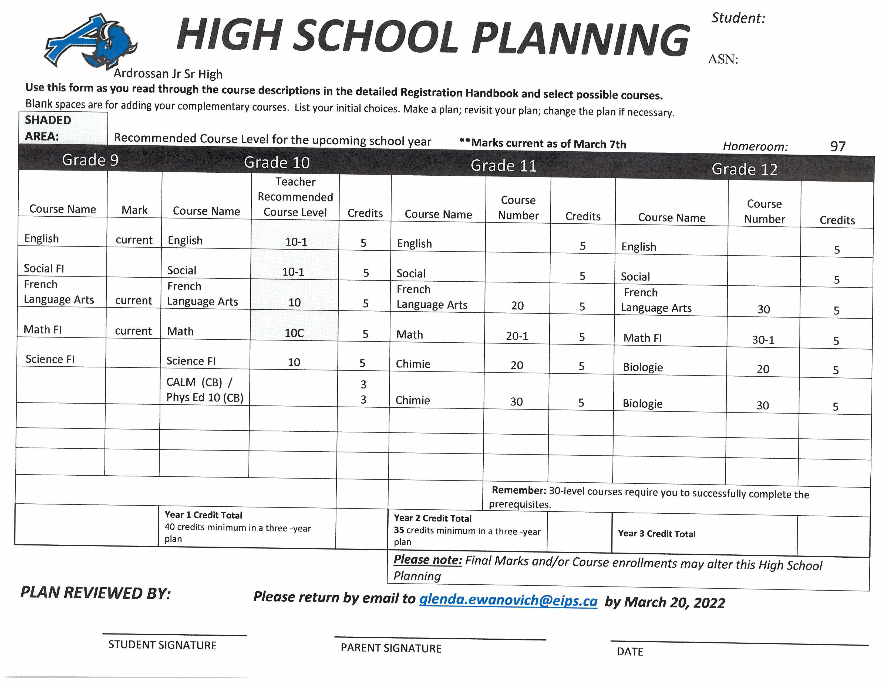
Remember – this is a PLAN, and after grade 10, your plan for courses may change. We just want you to look ahead at courses you will need or wish to take

Slide 16
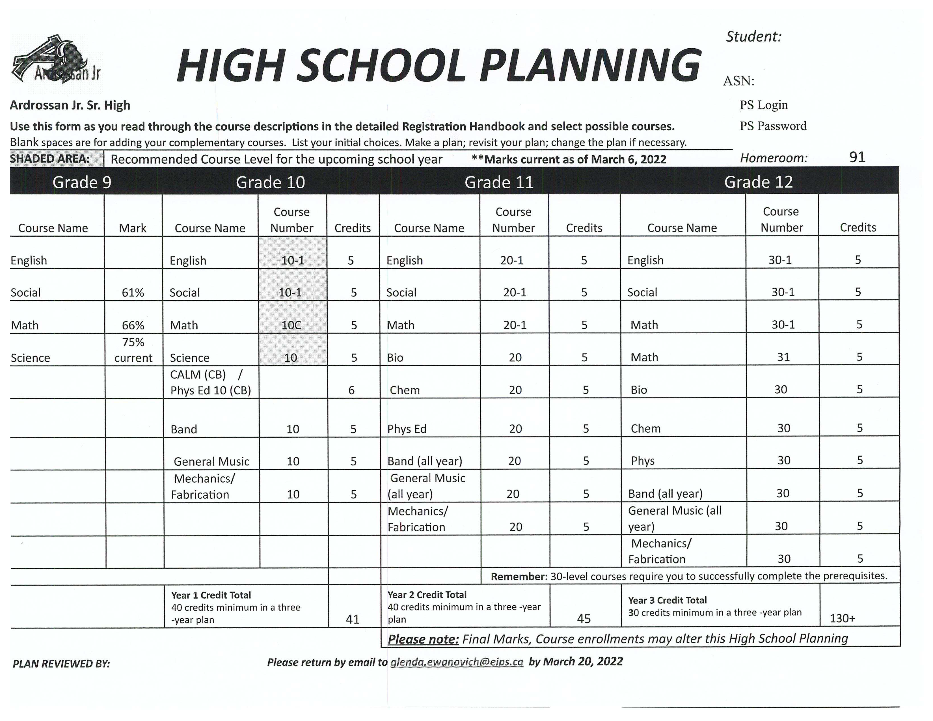

Slide 17
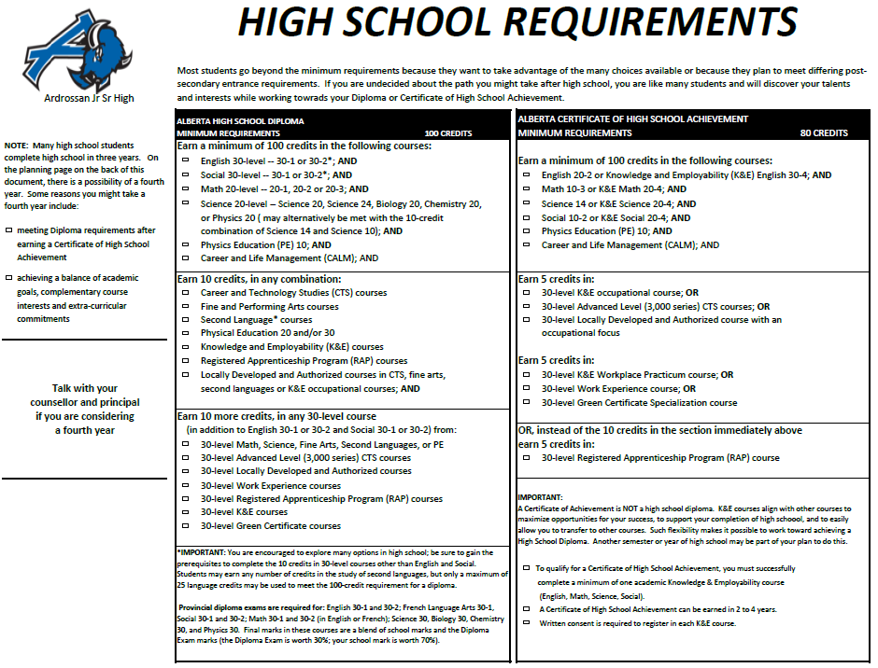

Slide 18
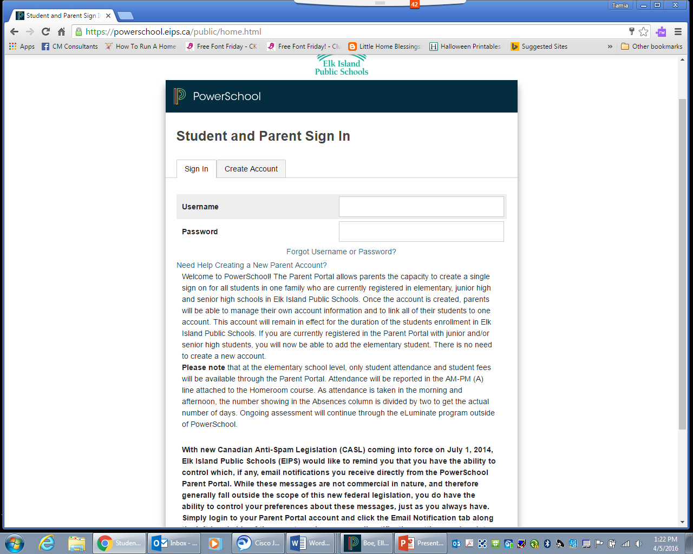
Go to the Ardrossan school website www.ardrossan.ca
Locate the link for PowerSchool Parent Portal on the homepage
Login to your PowerSchool account in the Parent Portal

Slide 19
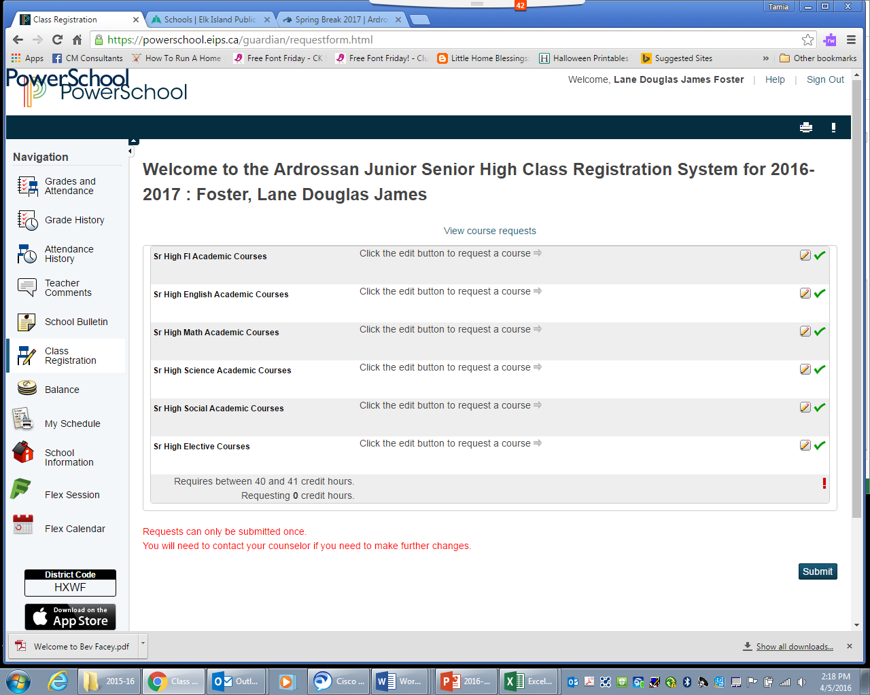
Click on Class Registration found on the left tab.

Slide 20
Click on the edit button to request a course
French Immersion students select Senior High FI Academic Courses
Students NOT in French immersion, students select courses for each subject area
Once you submit your course selections, any further changes will need to be discussed with your grade level counsellor. Your selections build the timetable.

Slide 21
TO DO
Where do you see yourself in 4 years?
College?
University?
Working?
Upgrading?
By March 25th - Submit by email to me: tamia.richardson@eips.ca
KEEP UP THE GOOD WORK!

Slide 22
ACTION ITEMS
Review the course recommendations for next year
Review the course (core and options) descriptions in the registration handbook
Discuss those recommendations with your parents and your current teachers
Email your completed (gr. 10, 11 & 12) and signed High School Planner form to glenda.ewanovich@eips.ca by March 20th
Login to your PowerSchool Parent Portal; click on Class Registration; complete your registration through PowerSchool
Submit your paragraph by March 25th

