Slide 1
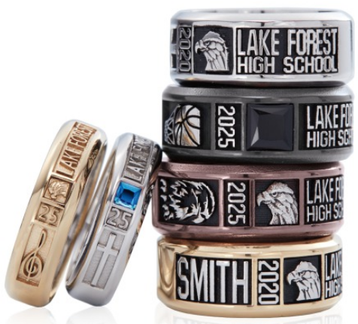
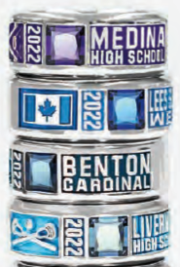
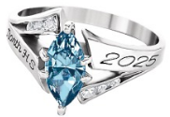
Class of 2021 - Celebrate Your Graduation!
Chromacast
New This Year!
Order @ www.jostens.com & Save $50.00
USE DISCOUNT CODE
FEBRUARY50CAD
Offer valid from February 1 to February 28
(excludes certain ring designs & previous purchases)
Your GRADUATION is important! COVID-19 means we are not able to hold a display at your school this year BUT we’ve made sure you don’t have to MISS OUT.
You can DESIGN & ORDER your CUSTOM graduation jewelry @
www.jostens.com
Questions? Please contact me, Angela Moore-1-844-750-9050 or 780-242-2168 angela.moore@jostens.com

