Slide 1
Elk Island Public Schools SECONDARY FRENCH IMMERSION Information Night

Slide 2
Le 20 février, 2019
Bienvenue et bonsoir!
Welcome and Good Evening!
Notes:
Land and People Acknowledgement
We acknowledge with respect the history and culture of the peoples with whom Treaty 6 was signed and the land upon which Elk Island Public Schools reside. We also acknowledge the traditional homeland of the Métis Nation.
We recognize our responsibility as Treaty members and honour the heritage and gifts of the First Peoples.
We commit to moving forward in partnership with Indigenous communities in a spirit of collaboration and reconciliation

Slide 3
Miss MJ Nam, Principal, Ardrossan Jr. Sr. High
Mme Sheri Johnston, Assistant Principal, Sherwood Heights Jr. High
Mme Annie Garneau, EIPS French Immersion Consultant and Assistant Principal, École Campbelltown

Slide 4
Who should consider the EIPS French Immersion Secondary program?
Our current grade 6 and 9 French Immersion students can continue their investment in their learning.
Students wanting to enhance their French skills through French Language instruction.

Slide 5
French Immersion Junior High within Elk Island Public Schools
Sherwood Heights and Ardrossan both offer a French Immersion (FI) Program for Grades 7 to 9. Students currently enrolled in an elementary program are designated to one of the two schools for junior high. The junior high program includes French Language Arts, Science, Social Studies, Math and English Language Arts. Students in the FI Program can take advantage of cultural activities and exchanges, important educational aspects of the program.

Slide 6
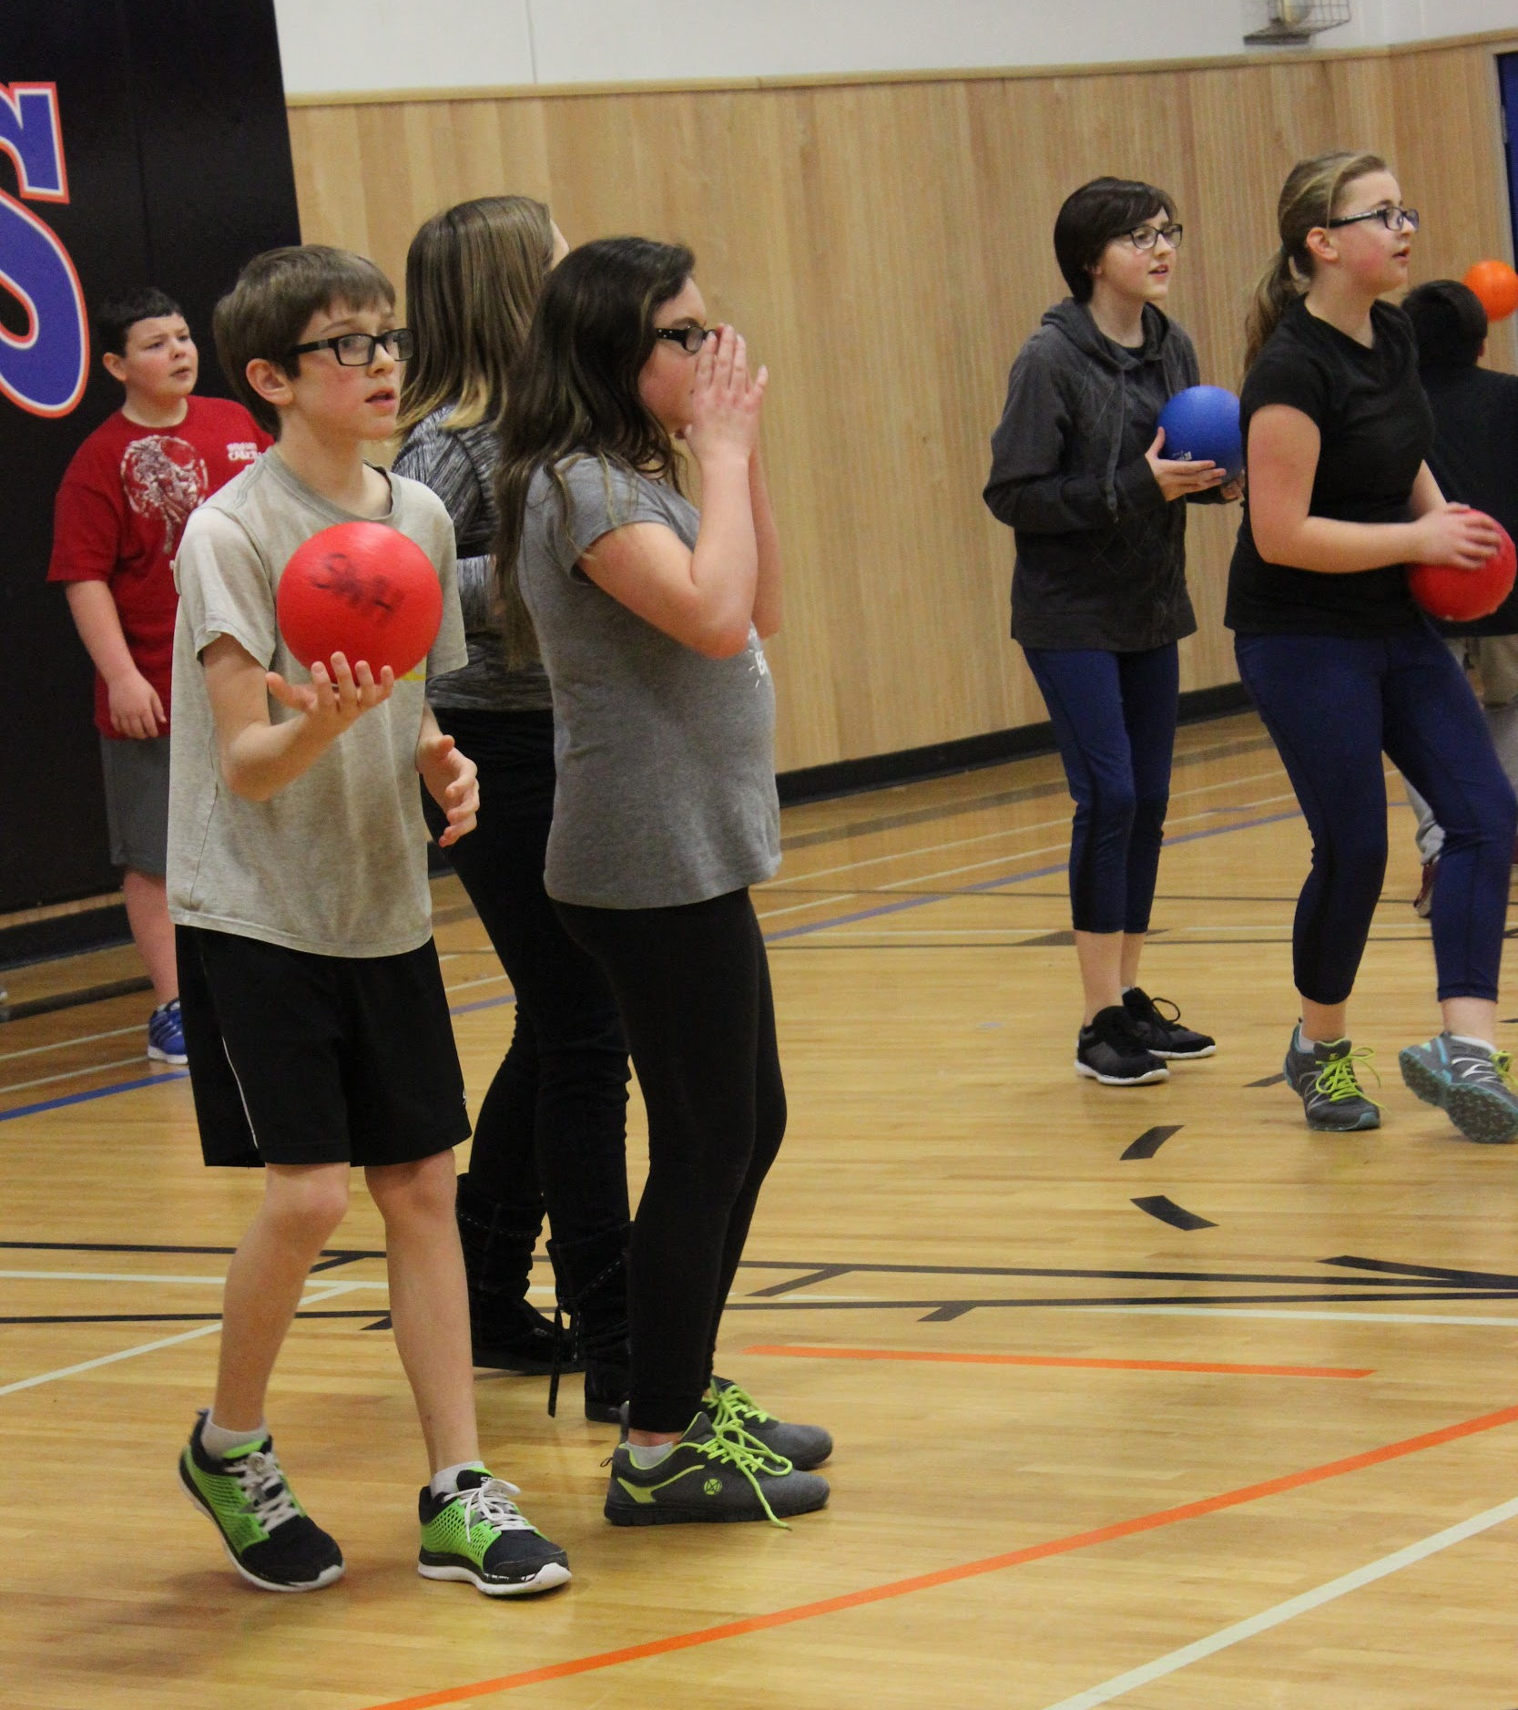
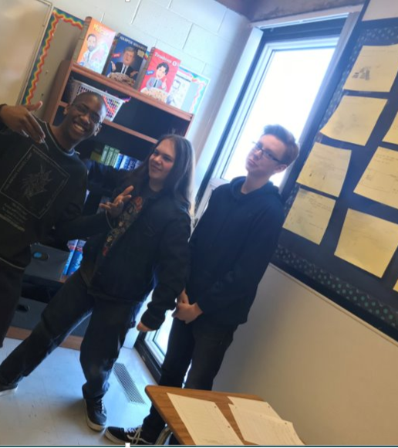
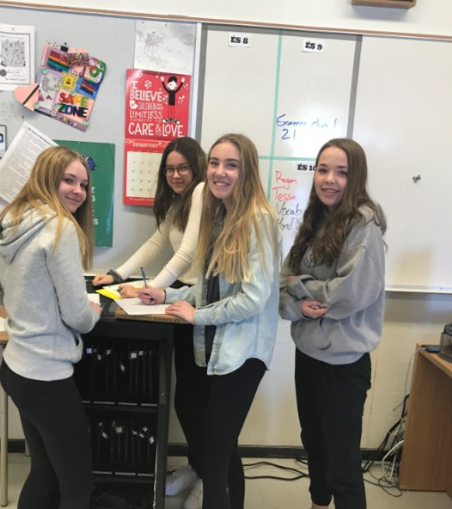
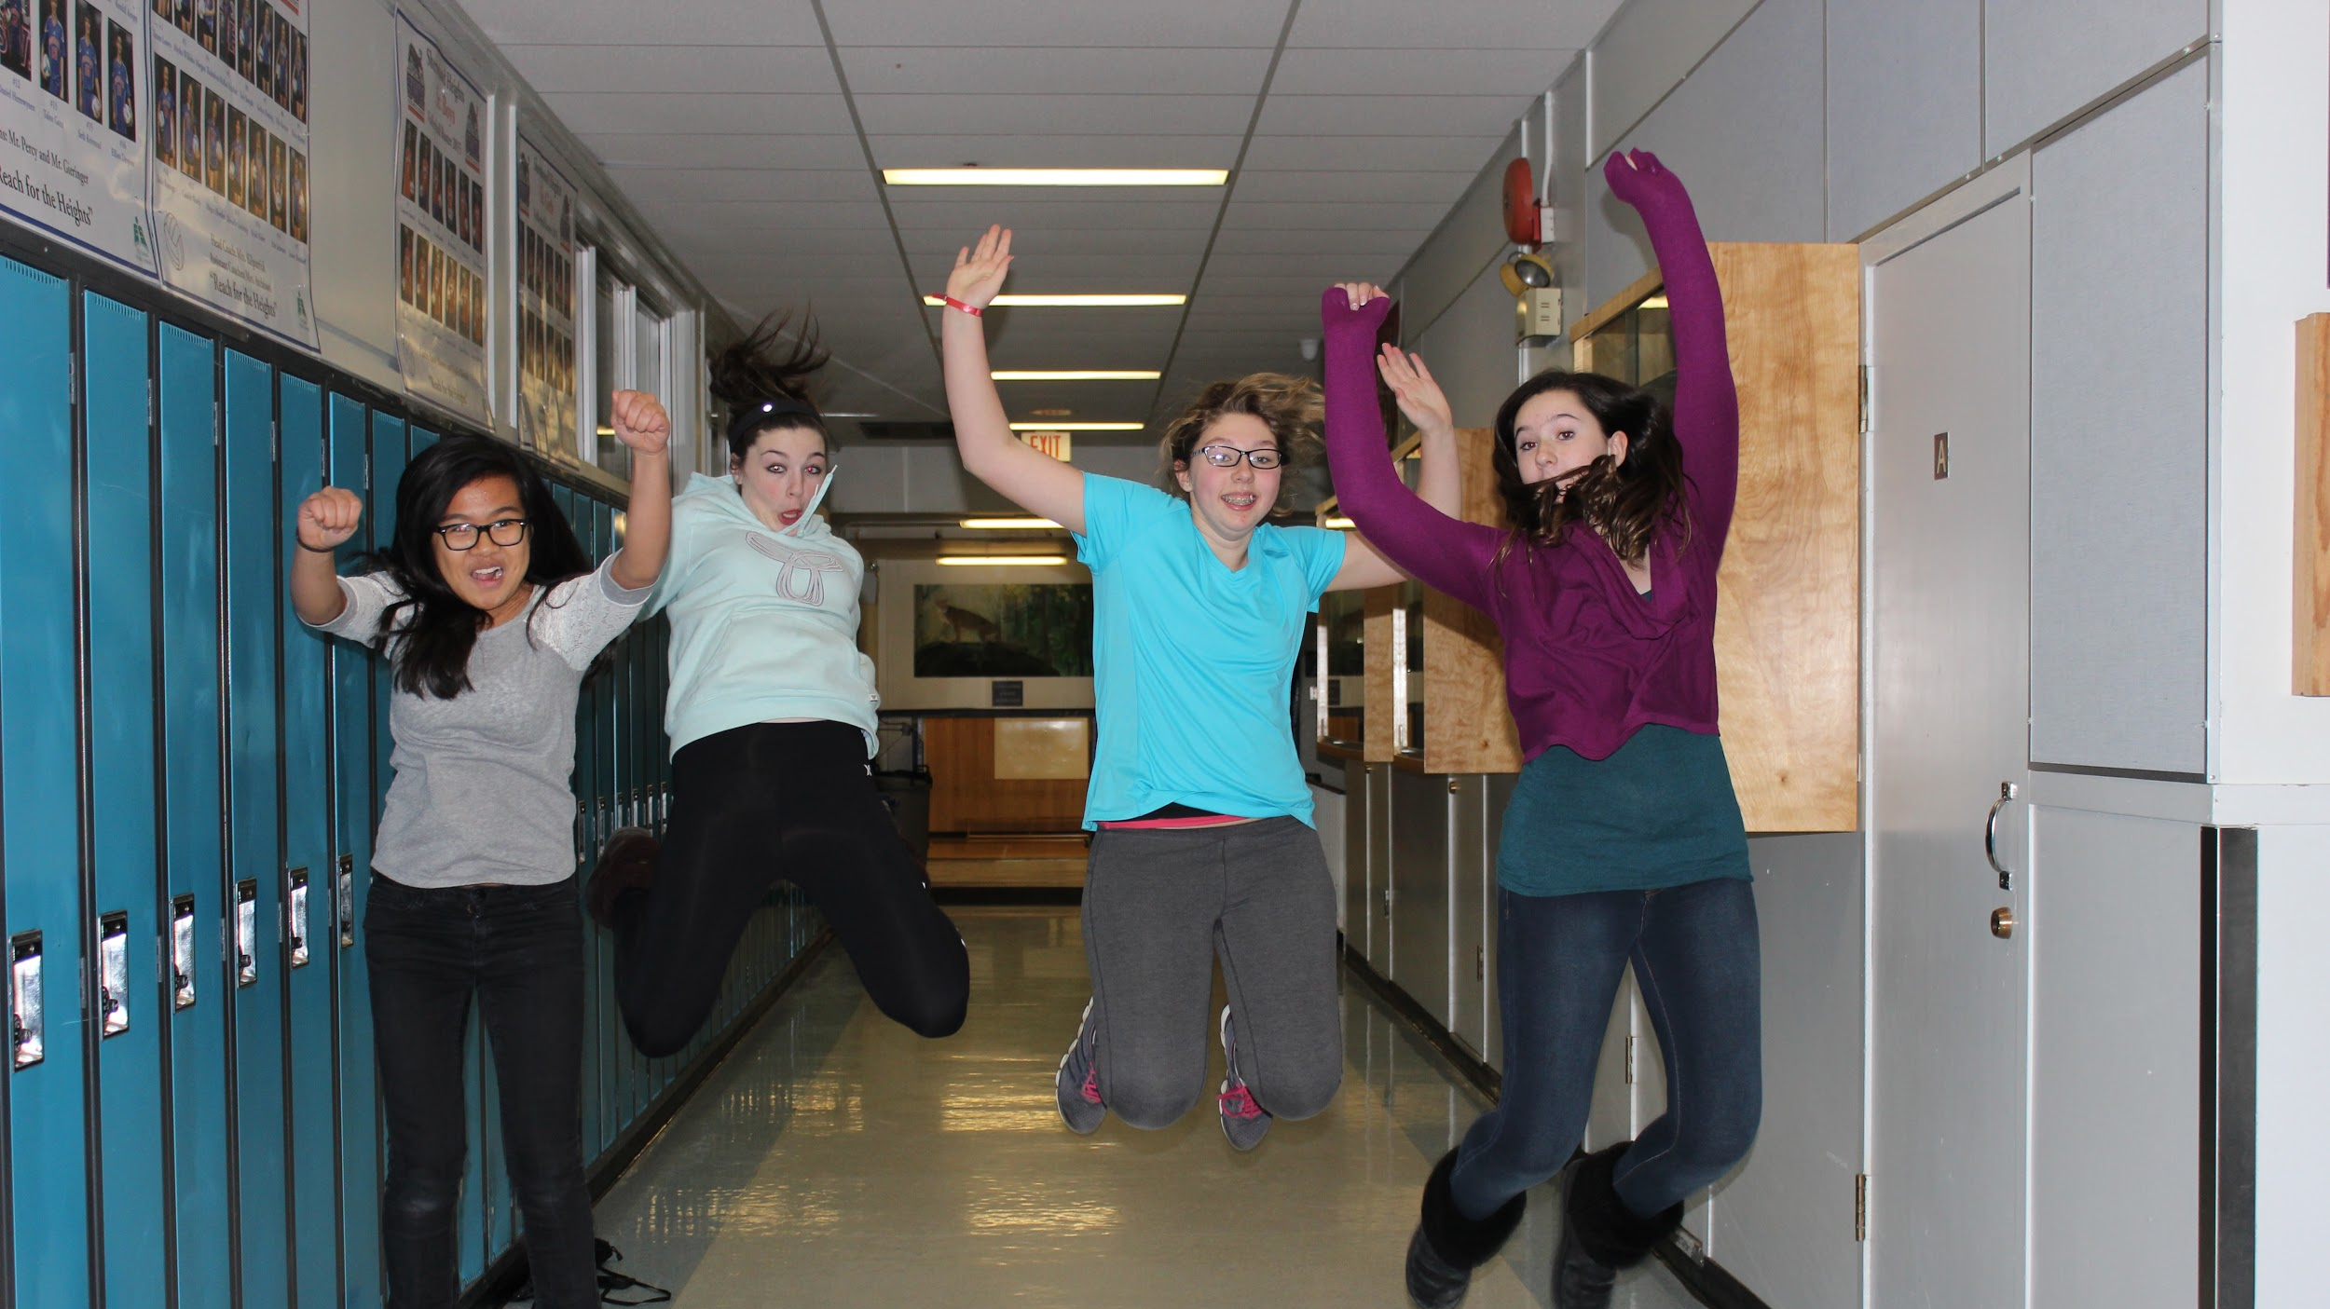
Life at Junior High

Slide 7
Schedule...what does that mean?
Different teachers and different classrooms for different subjects.

Slide 8
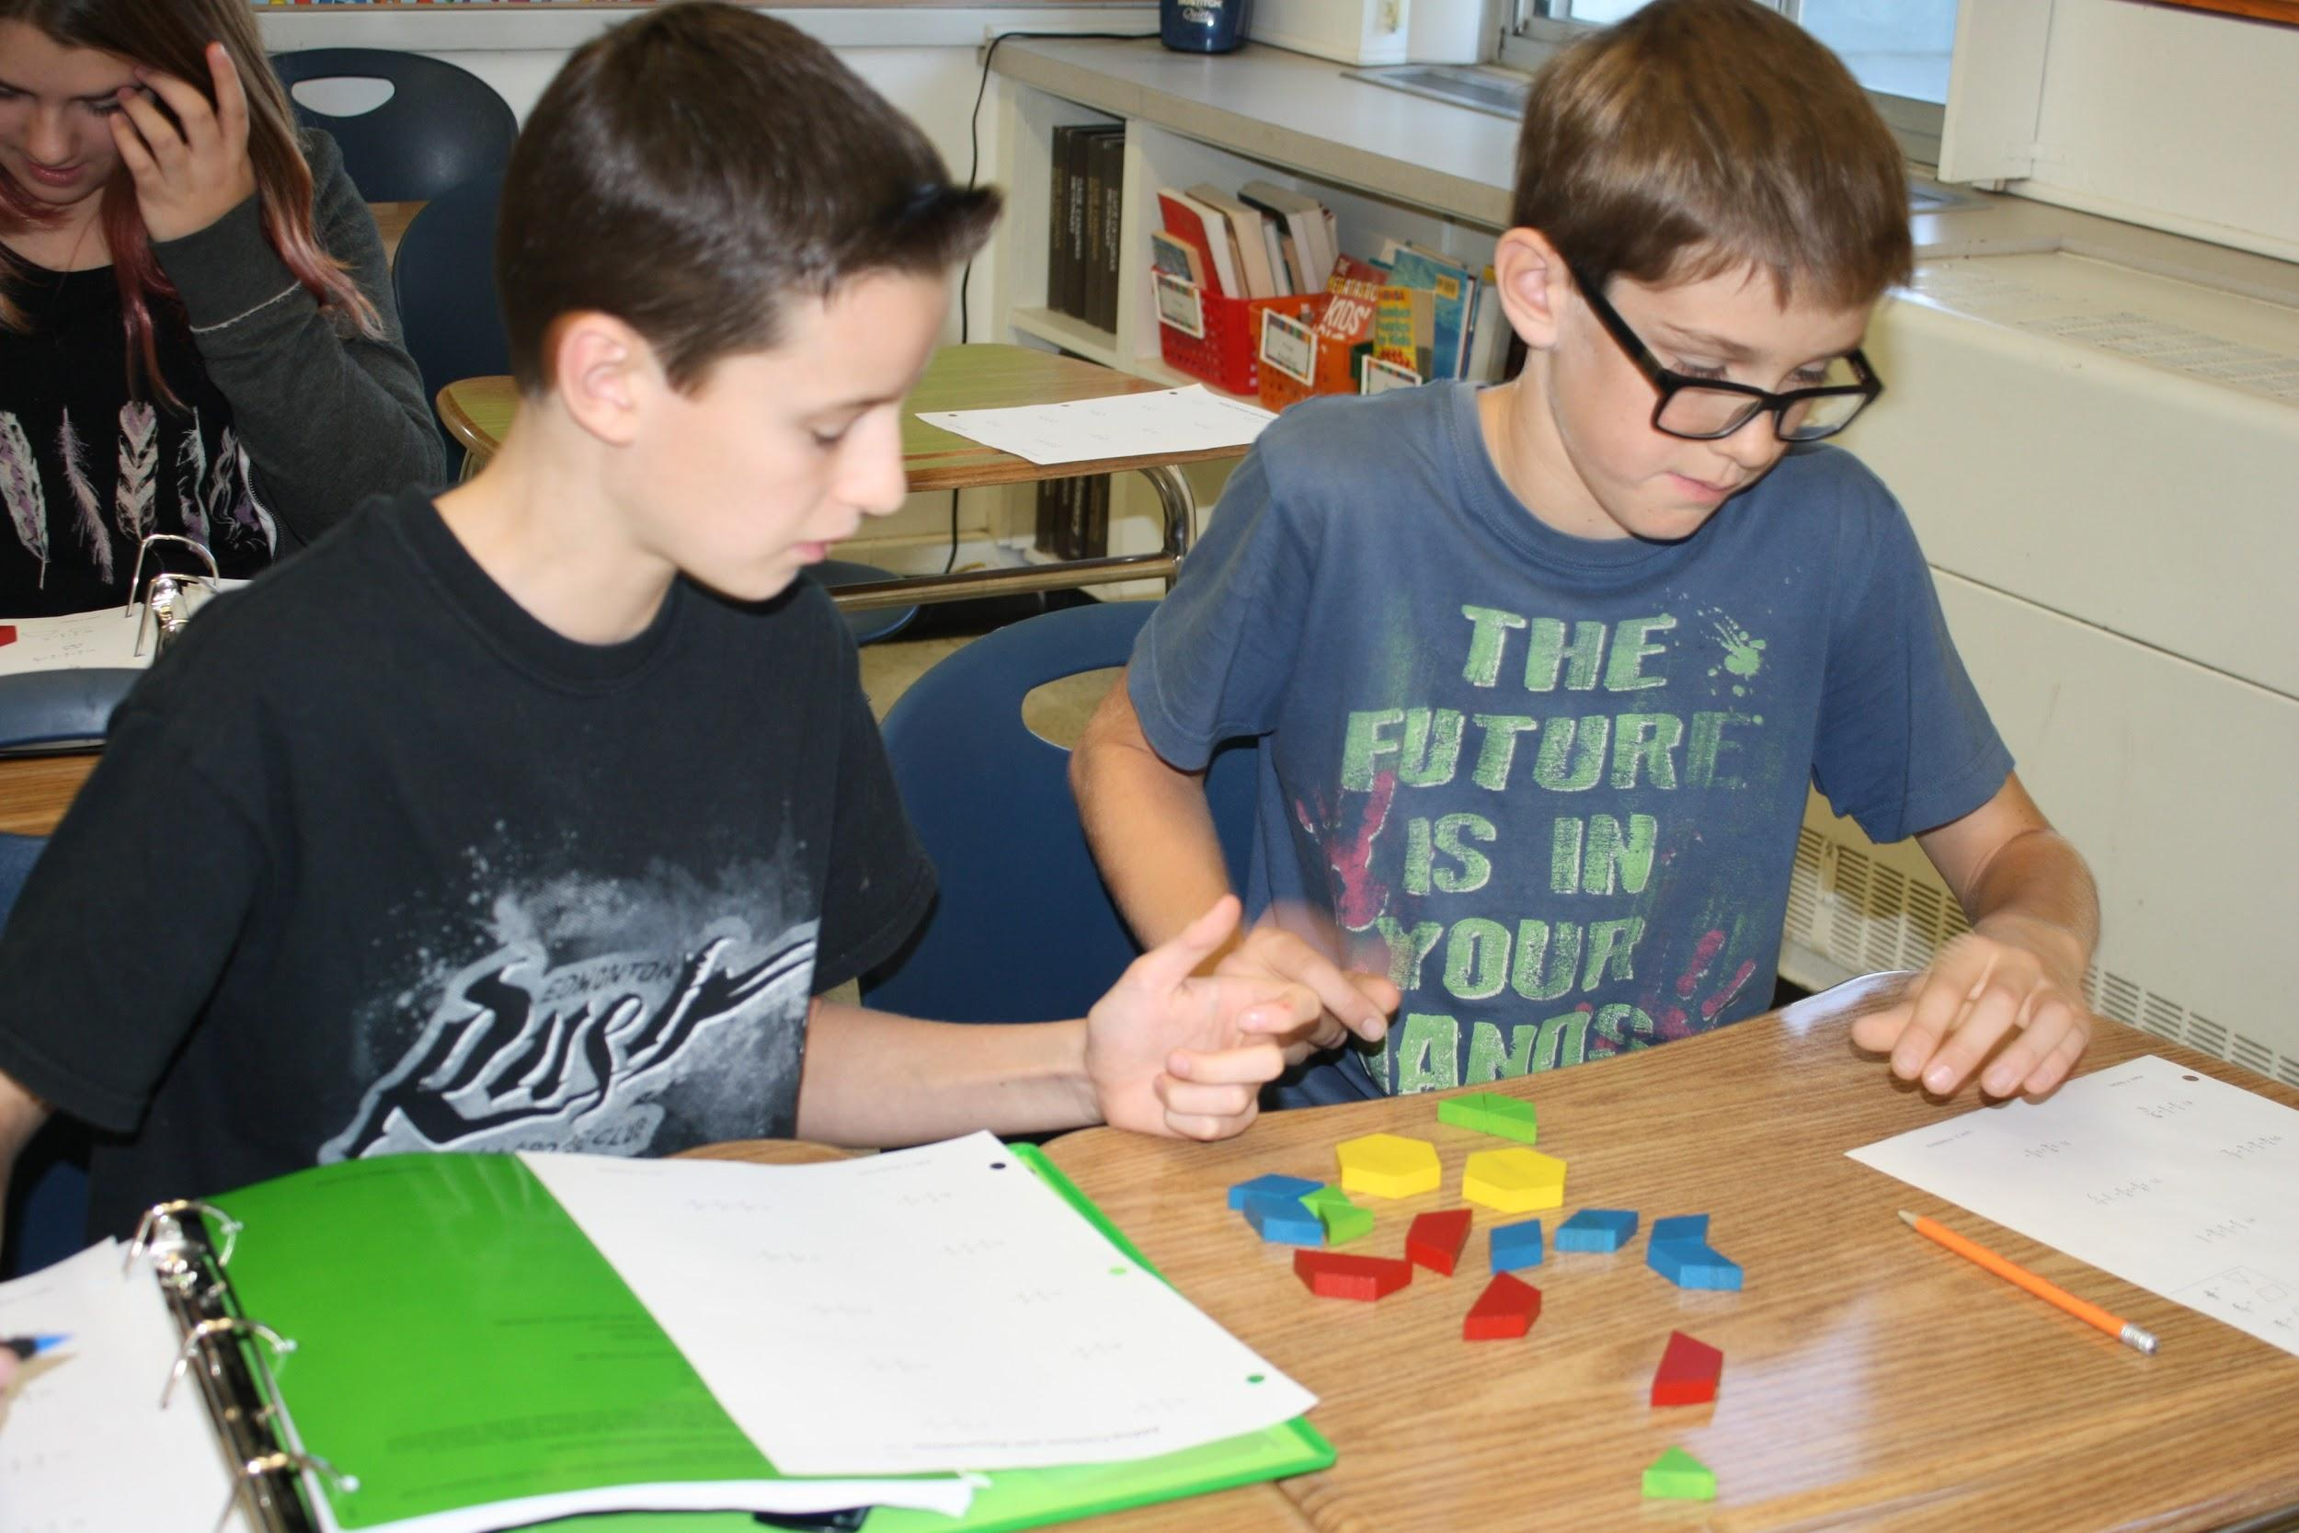
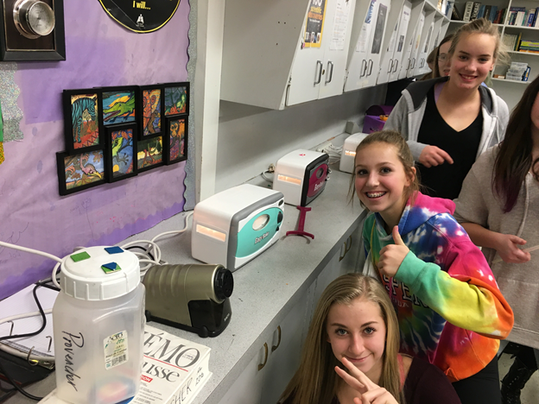
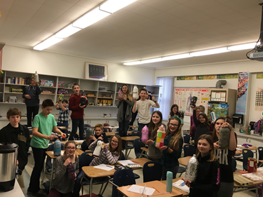
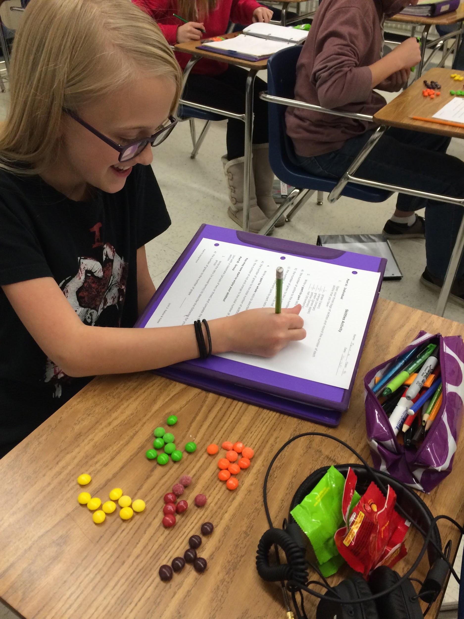
Core Classes

Slide 9
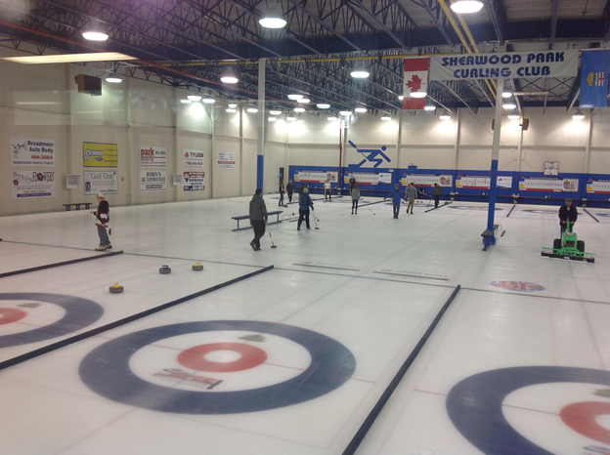
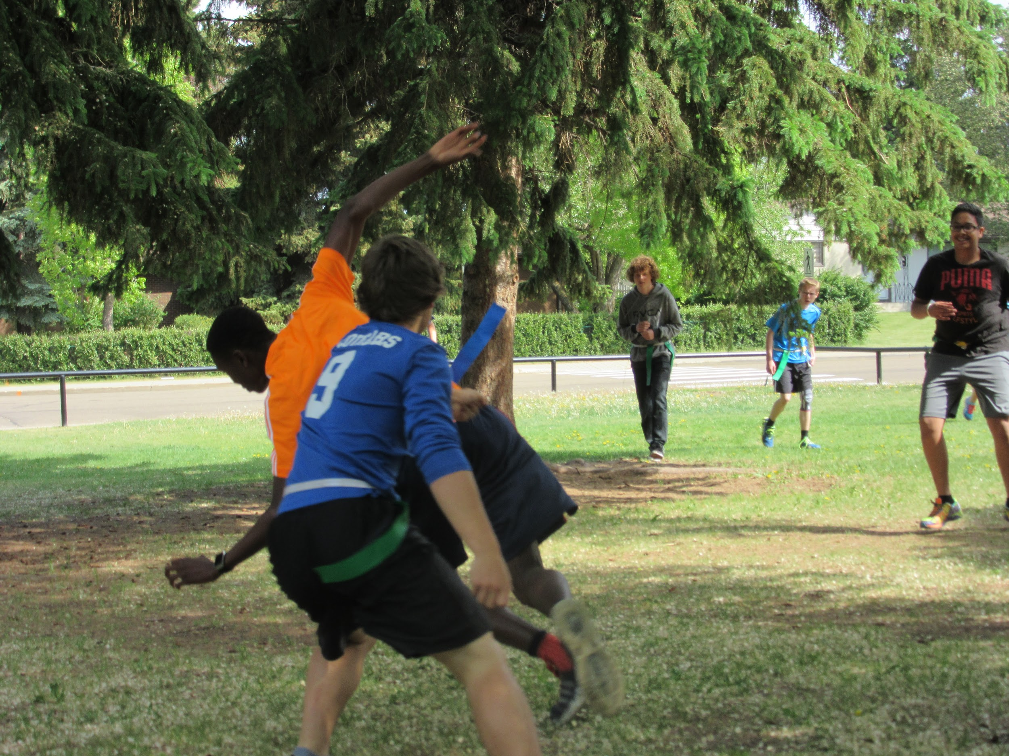
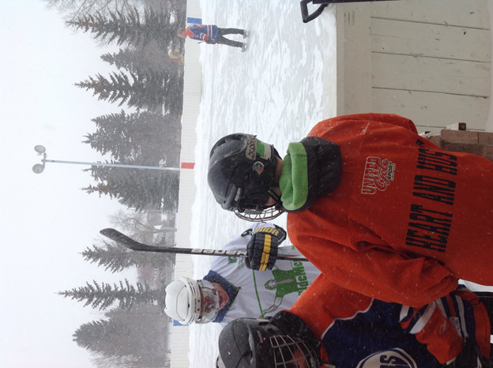
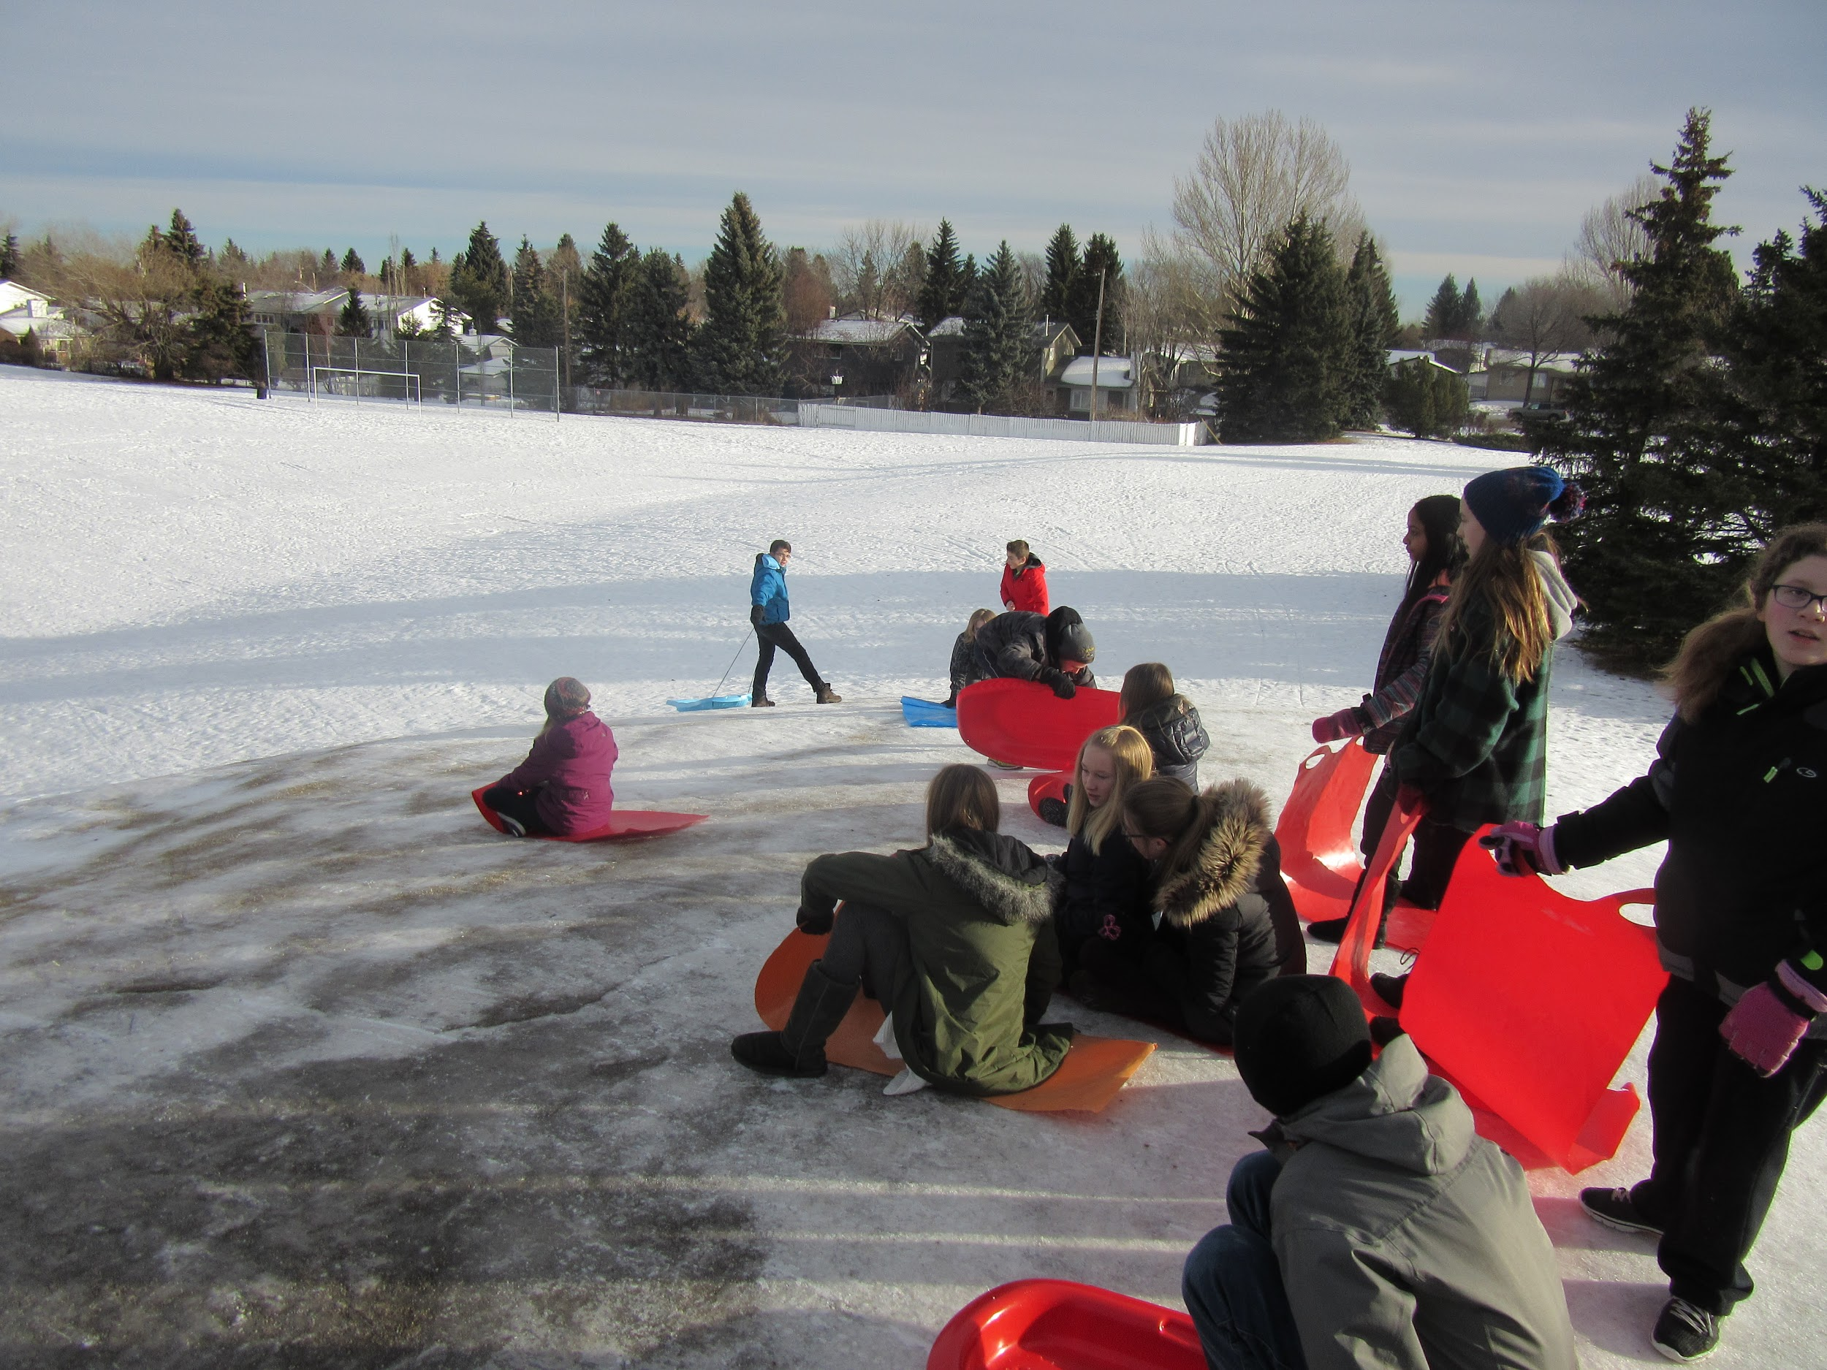
Physical Education
Cross Country
Volleyball
Pickleball
Basketball
Floor Hockey
Ringette
Handball
Badminton
Track and Field
Ping Pong
Soccer
Softball
Football
Ultimate Frisbee
Games
Fitness

Slide 10
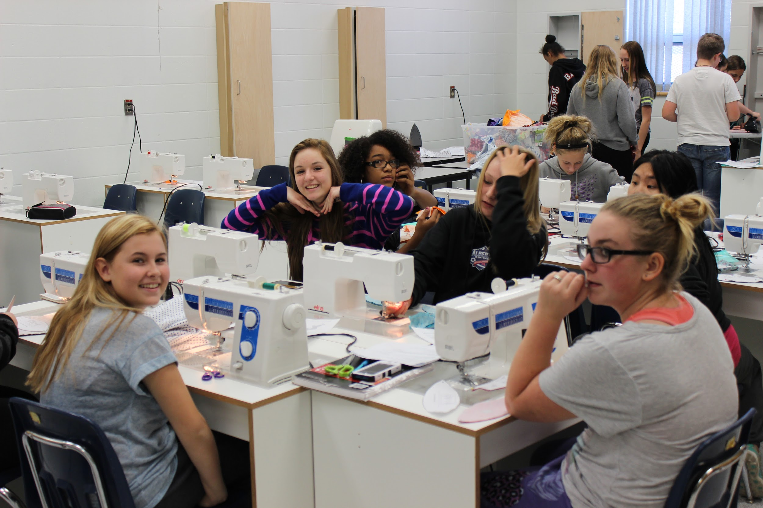
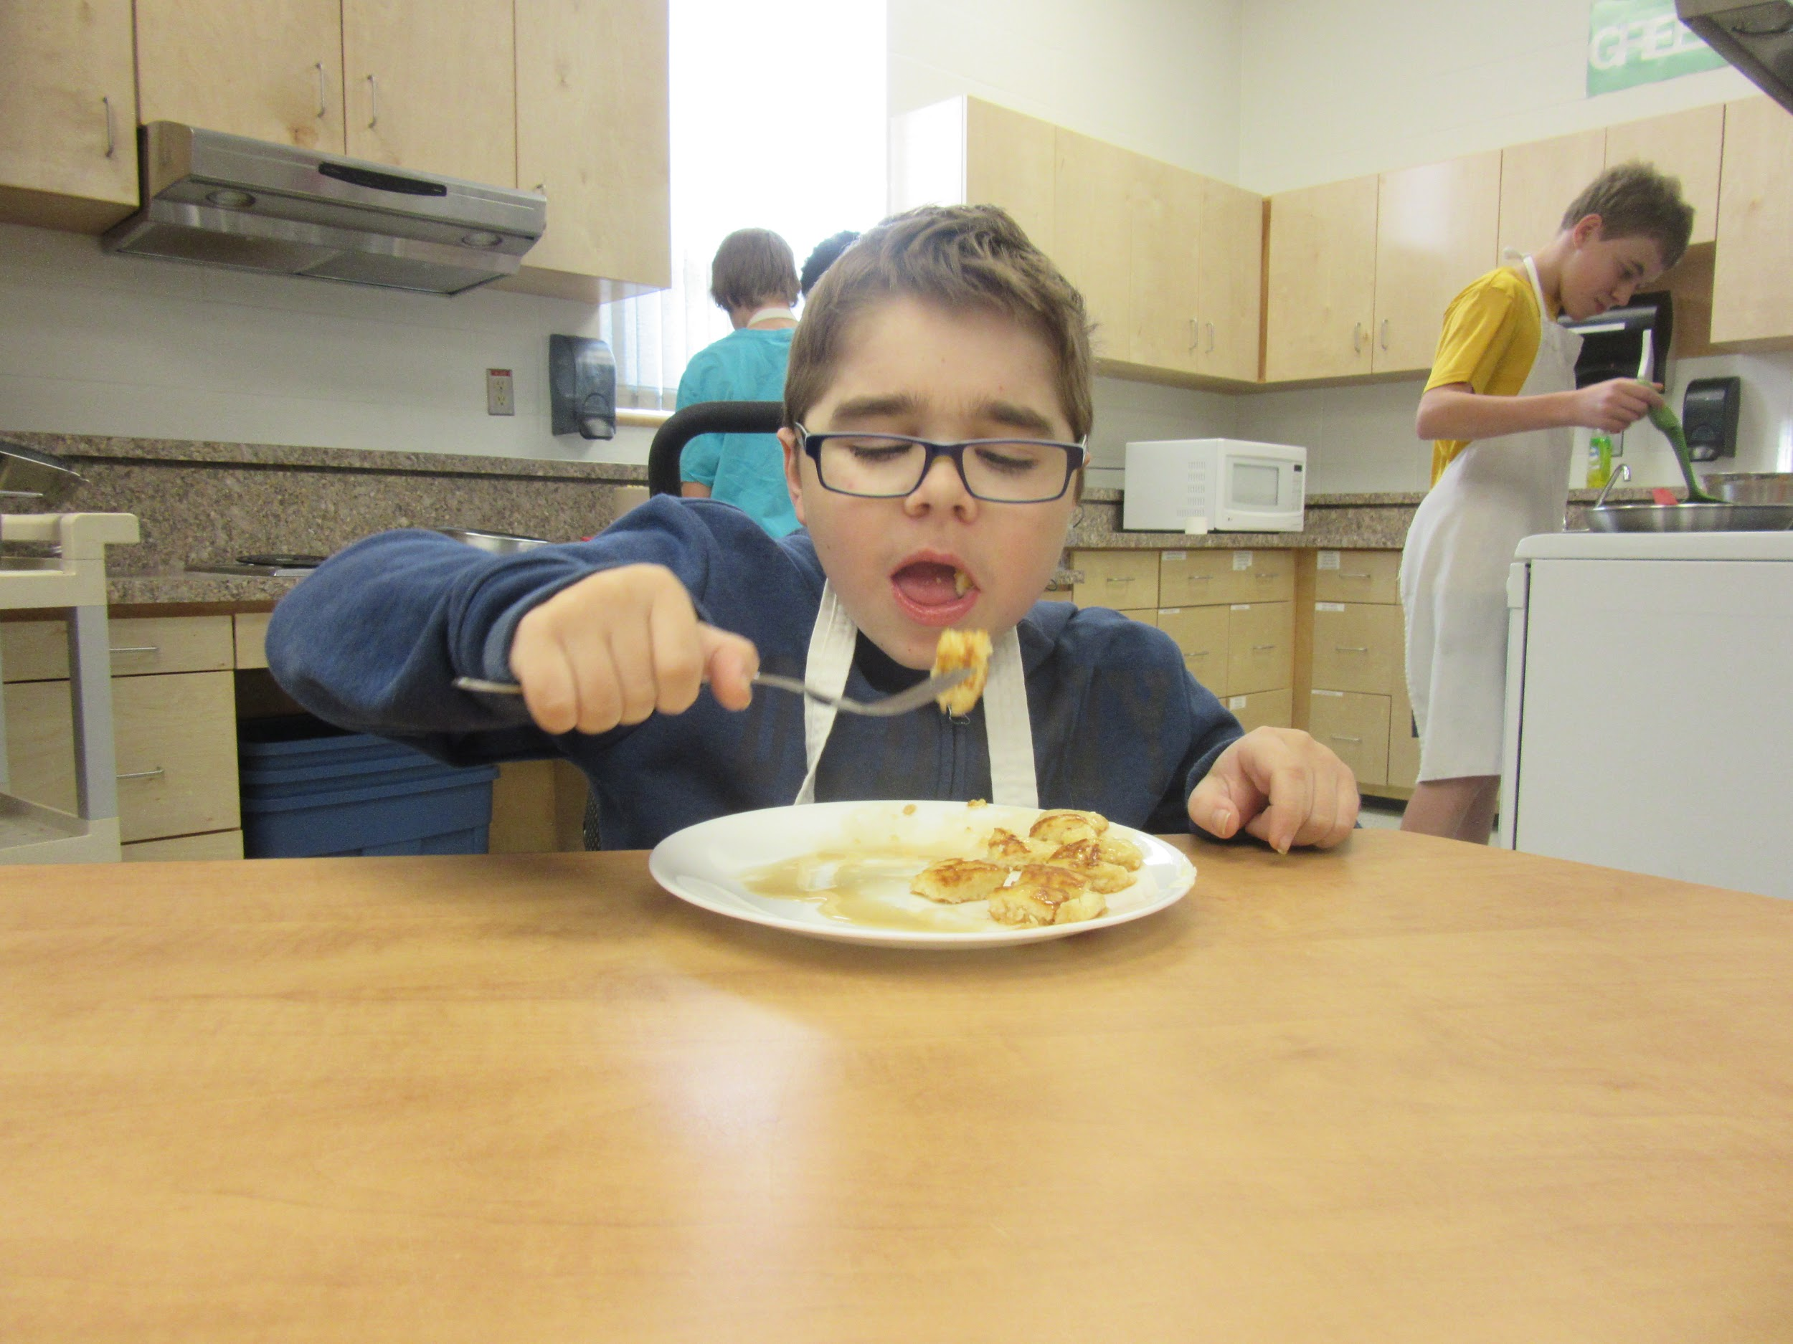
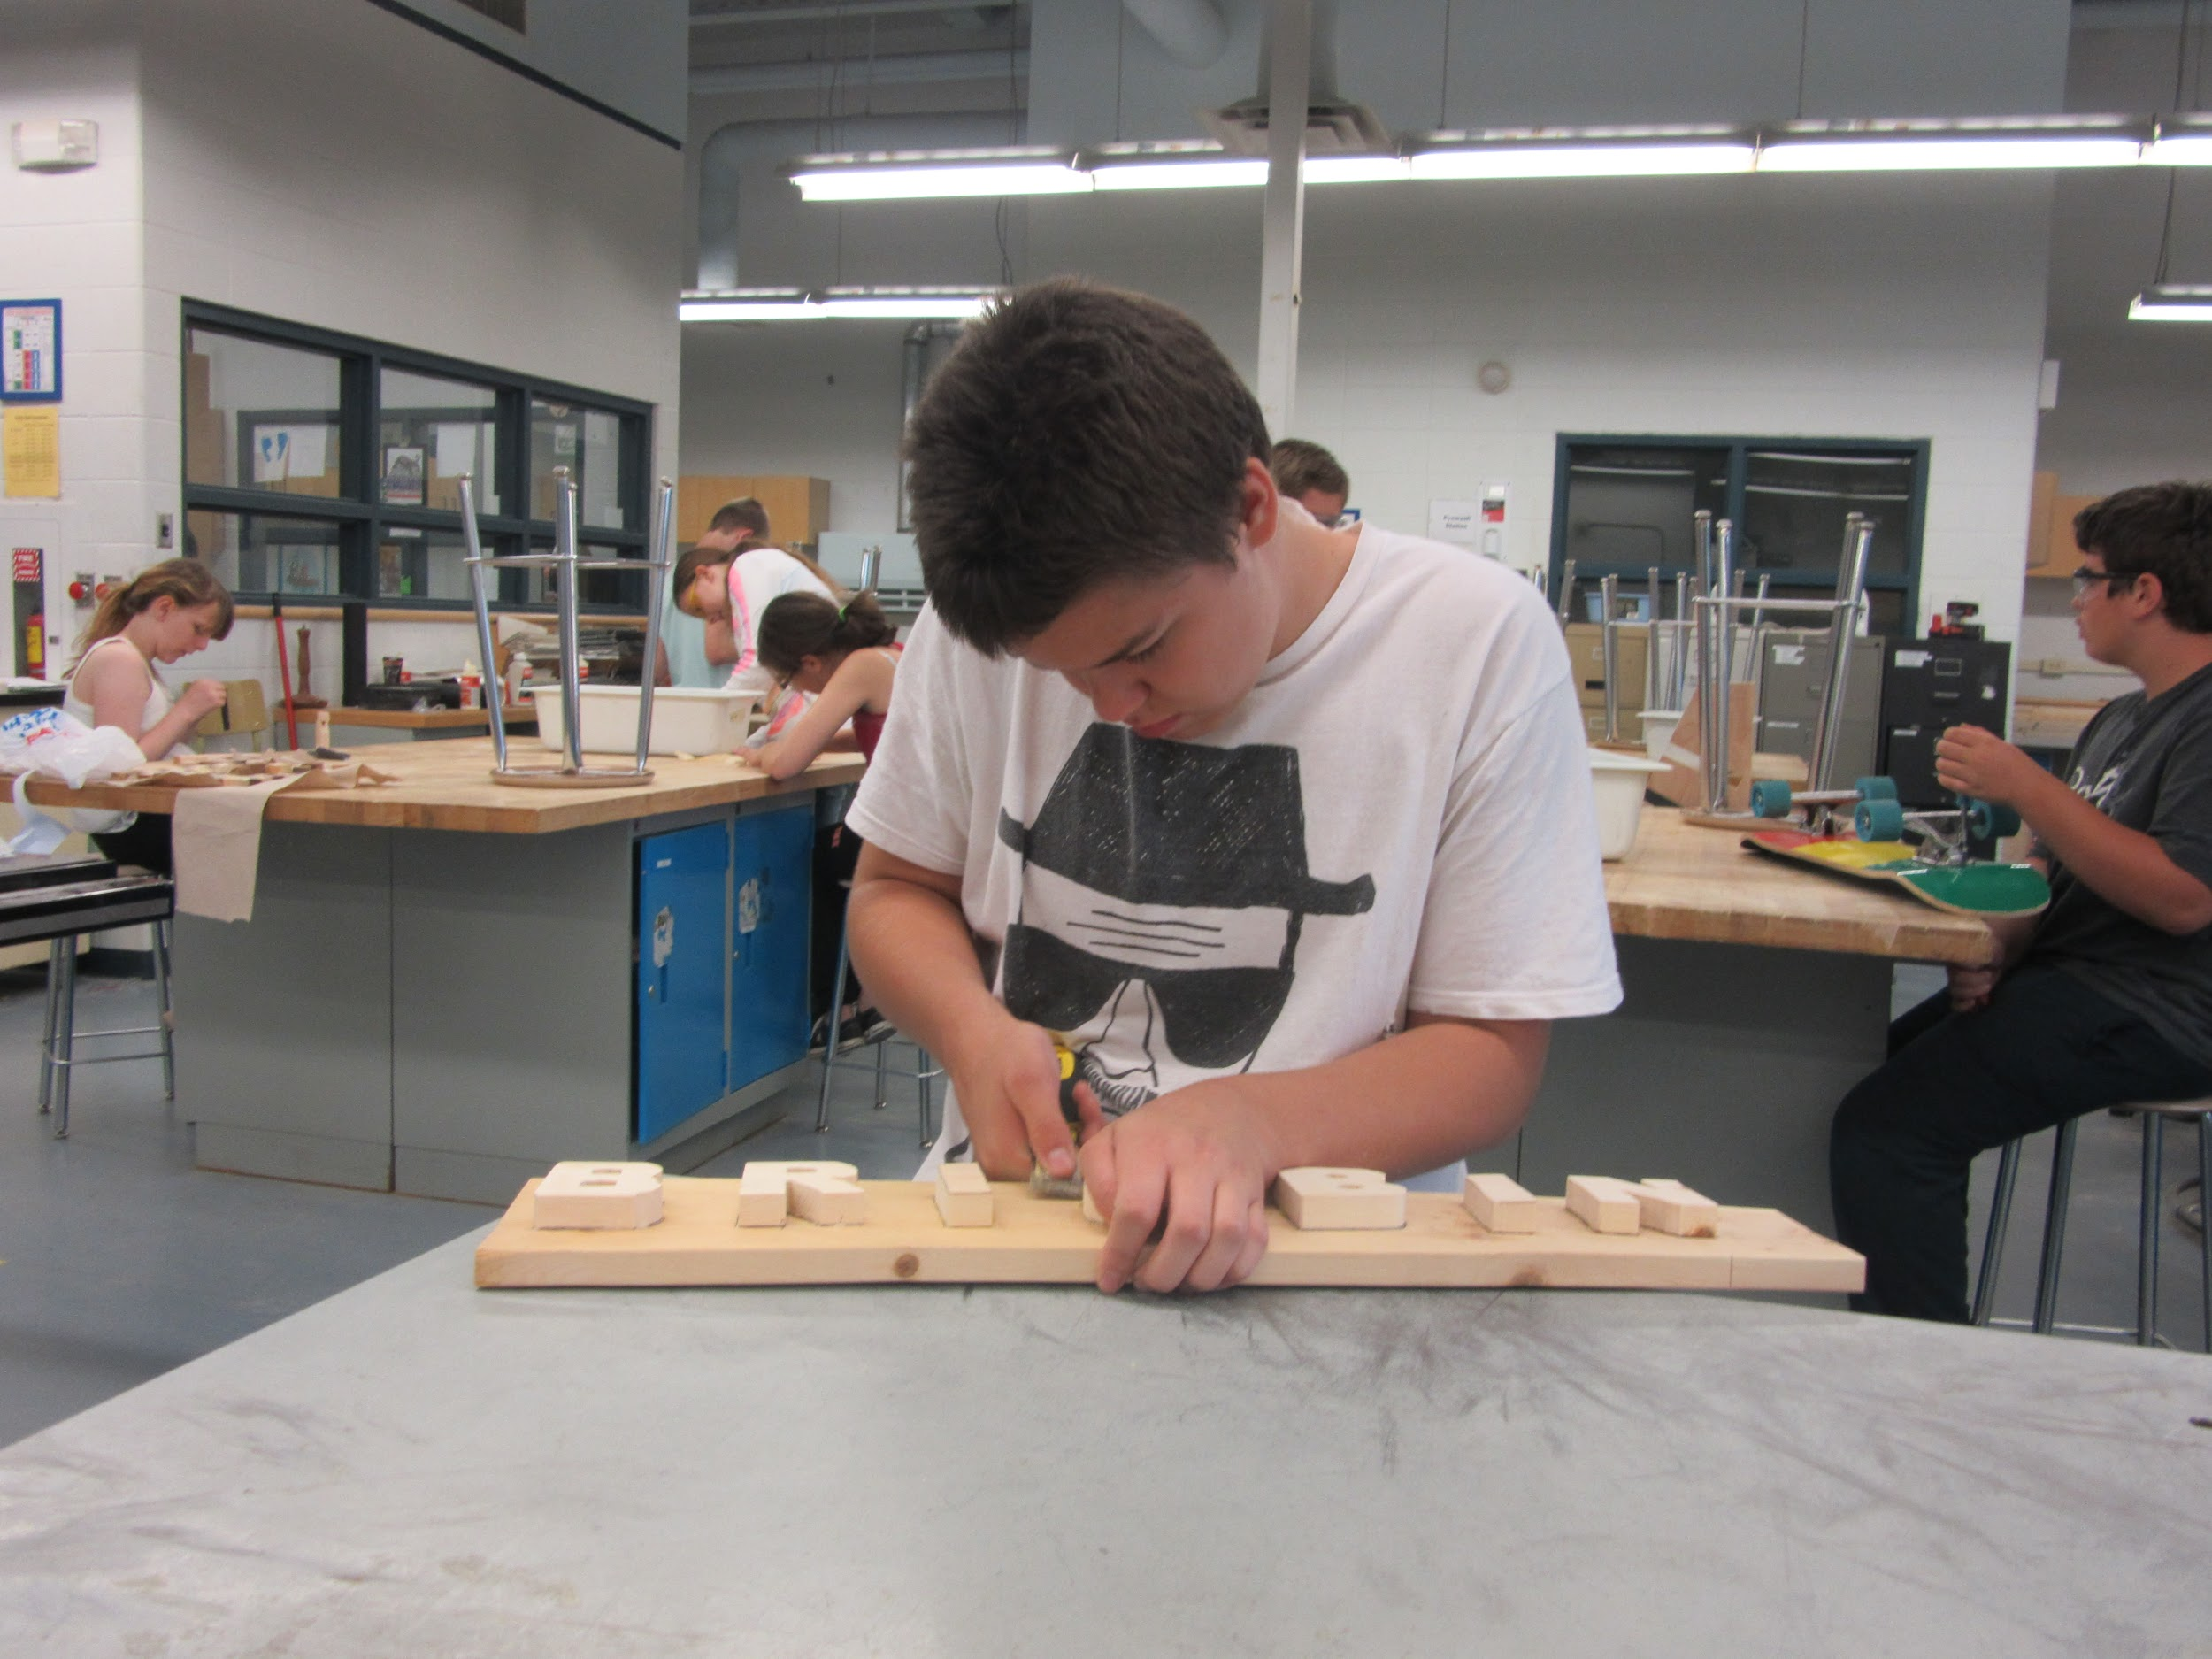
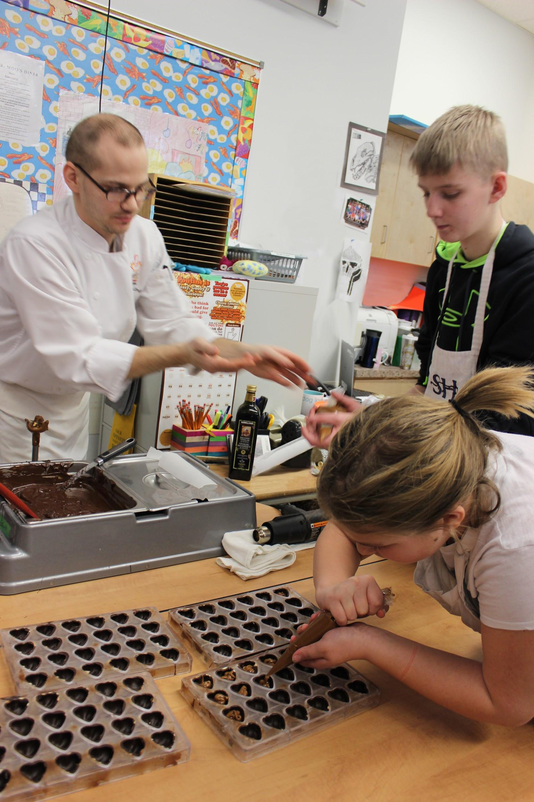
CTF Courses
Construction
Communication Technologies
Foods and Fashion

Slide 11
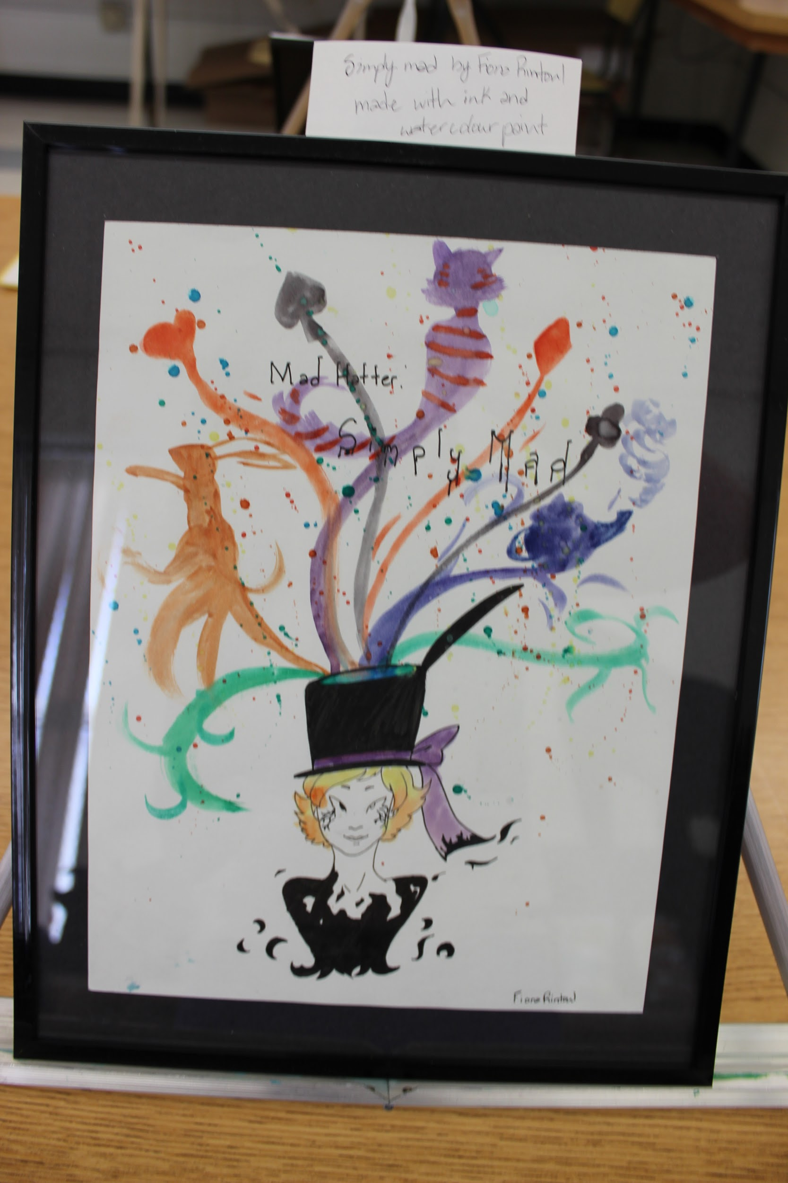
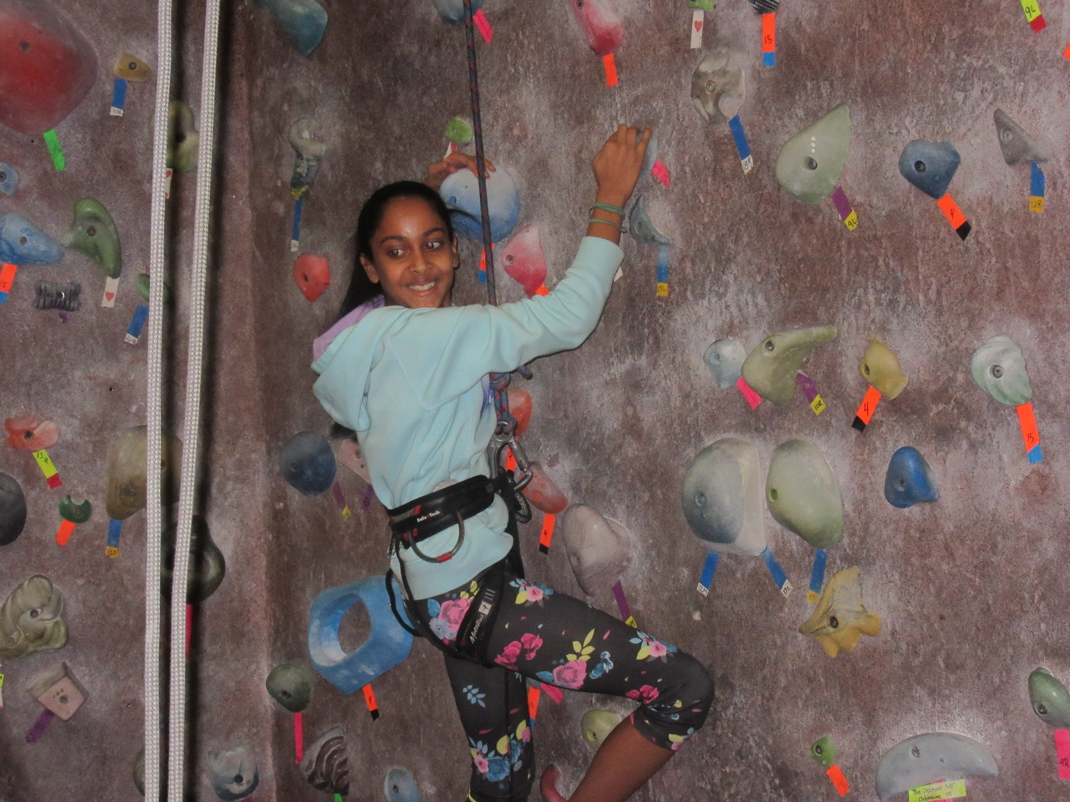
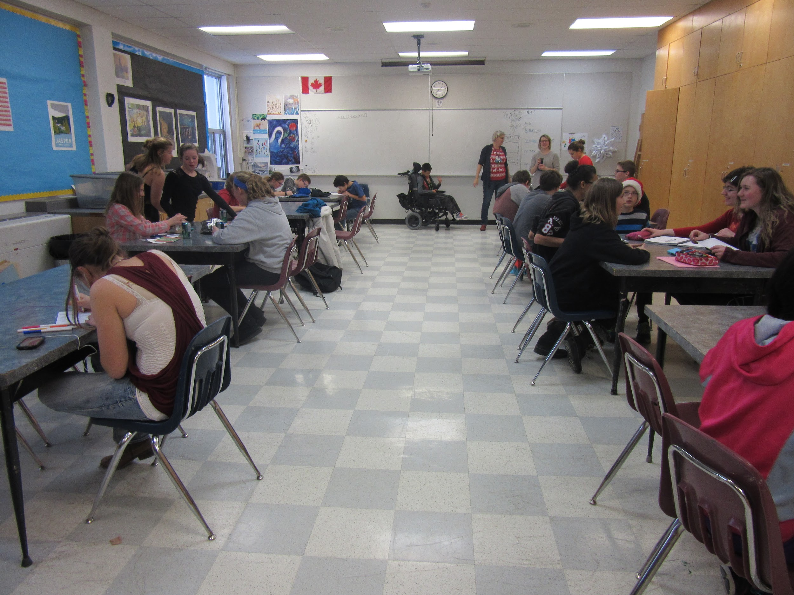
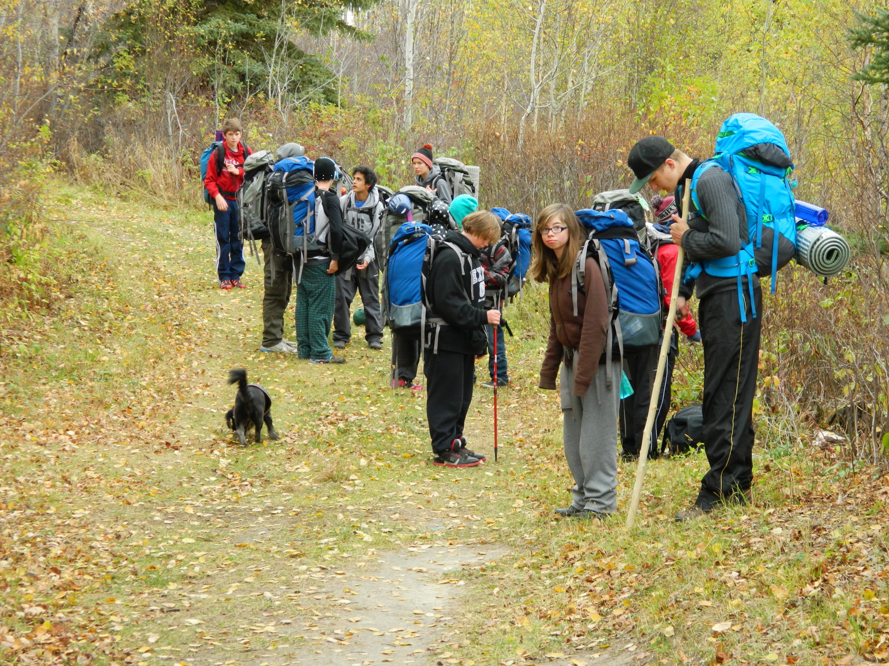
Option Courses
Art
Band
French as a Second Language
Environmental Outdoor Education
Recreation Fitness

Slide 12
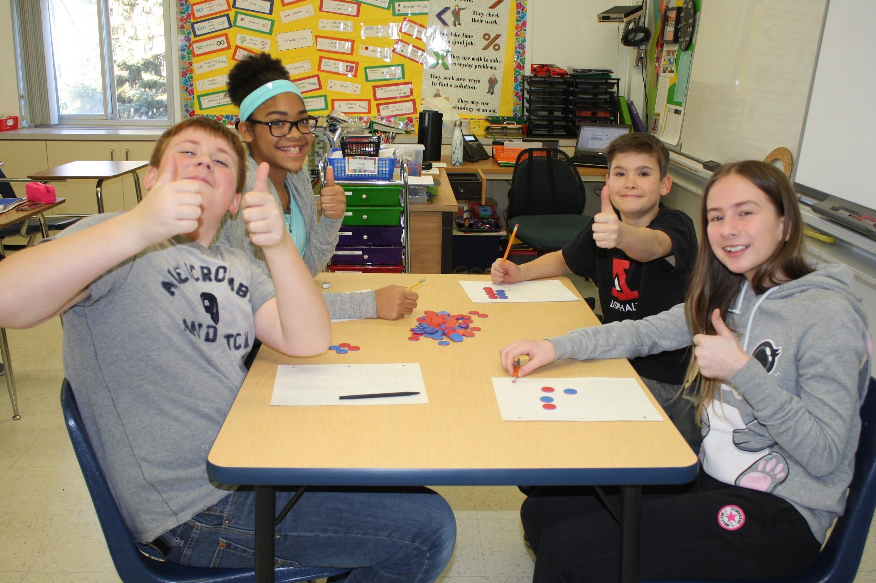
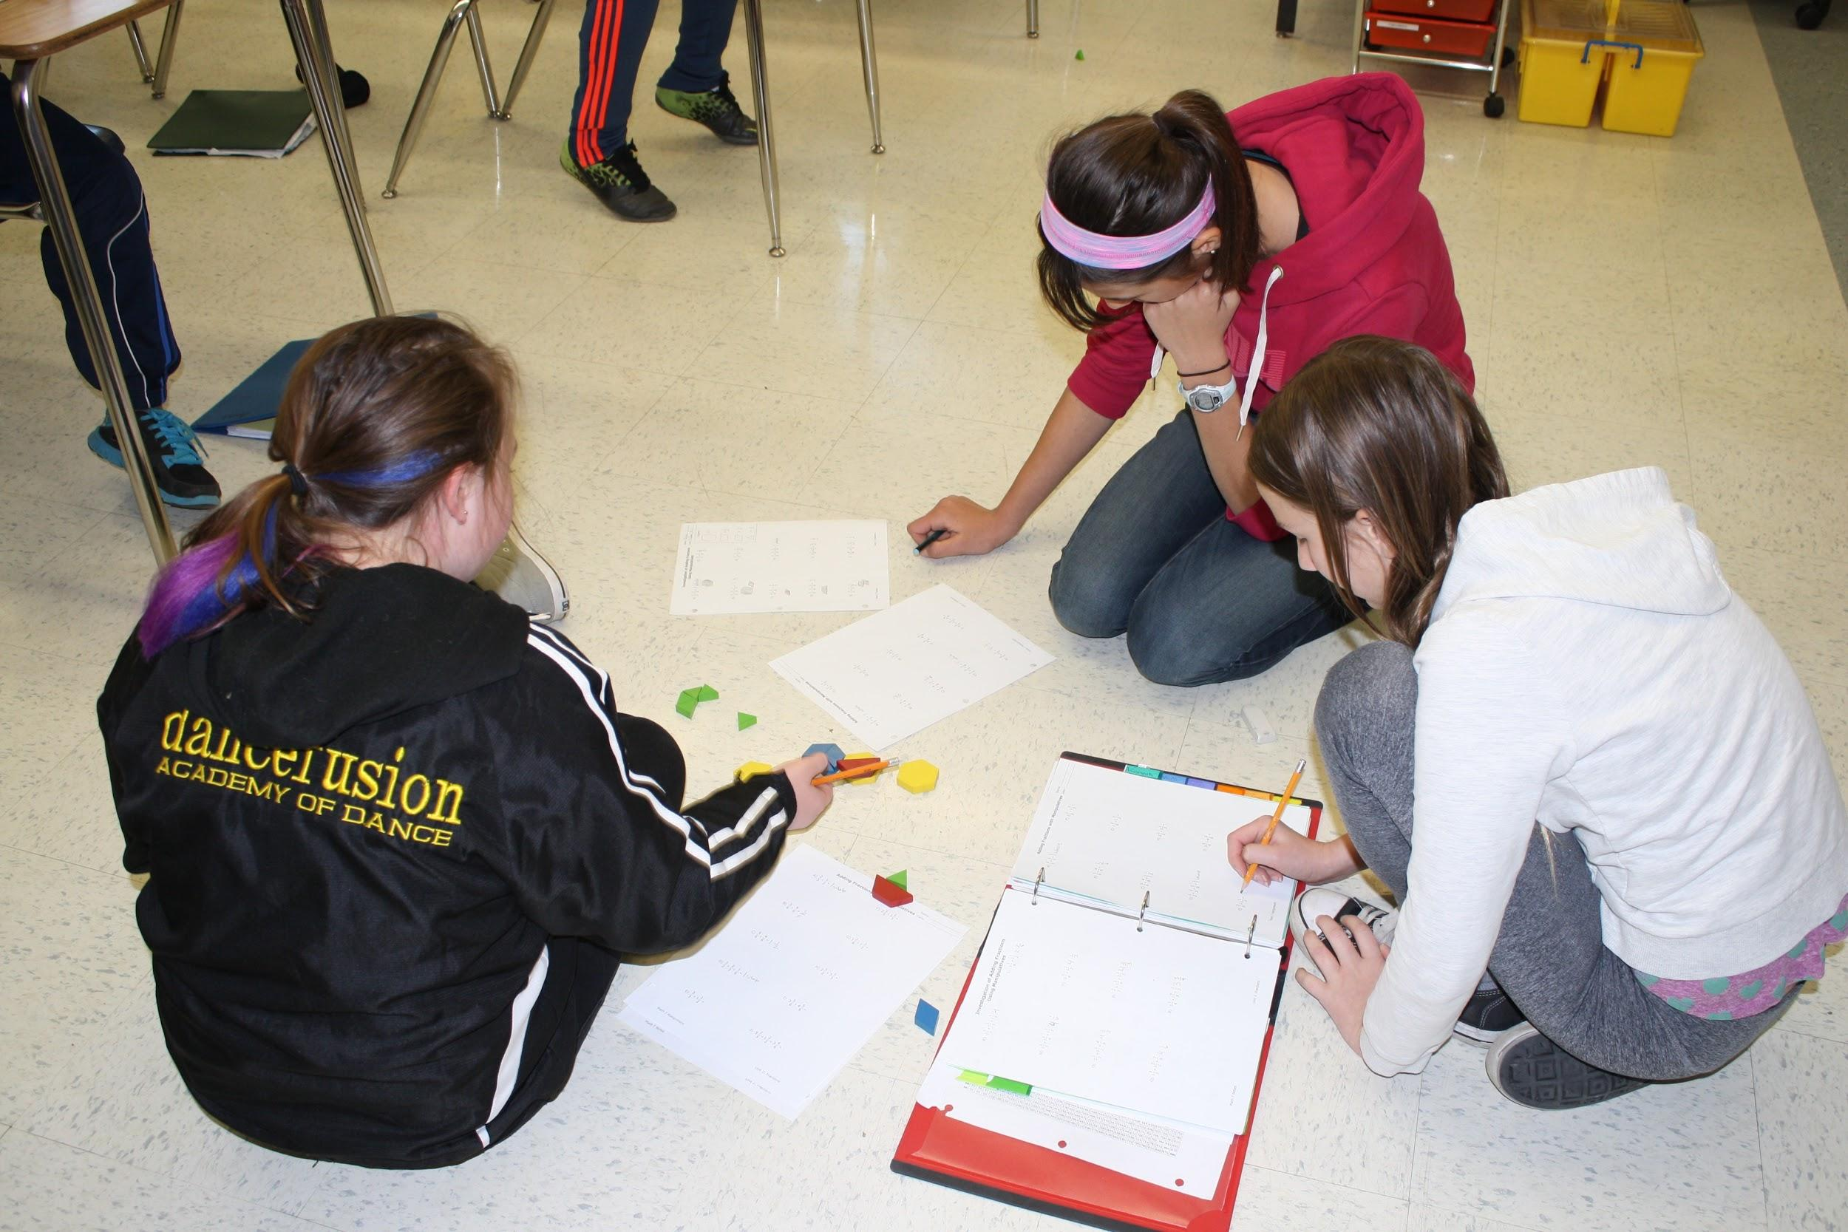
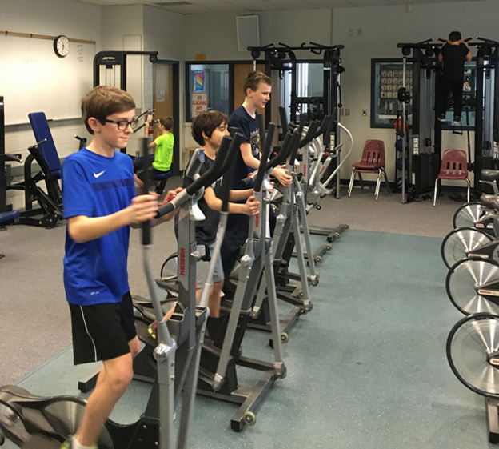
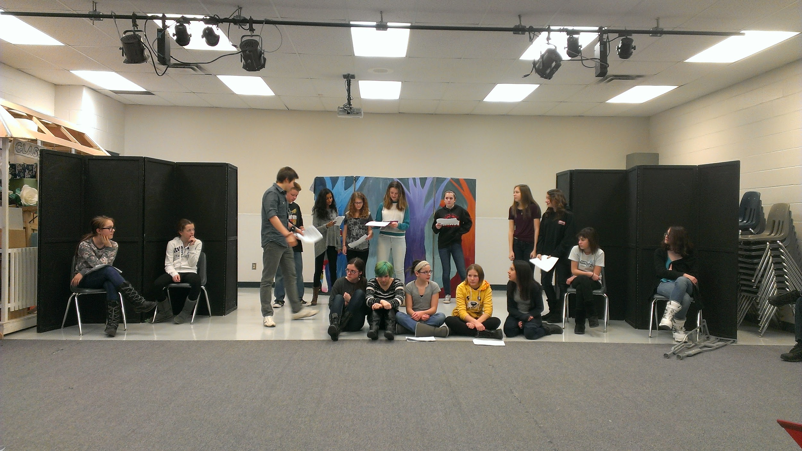
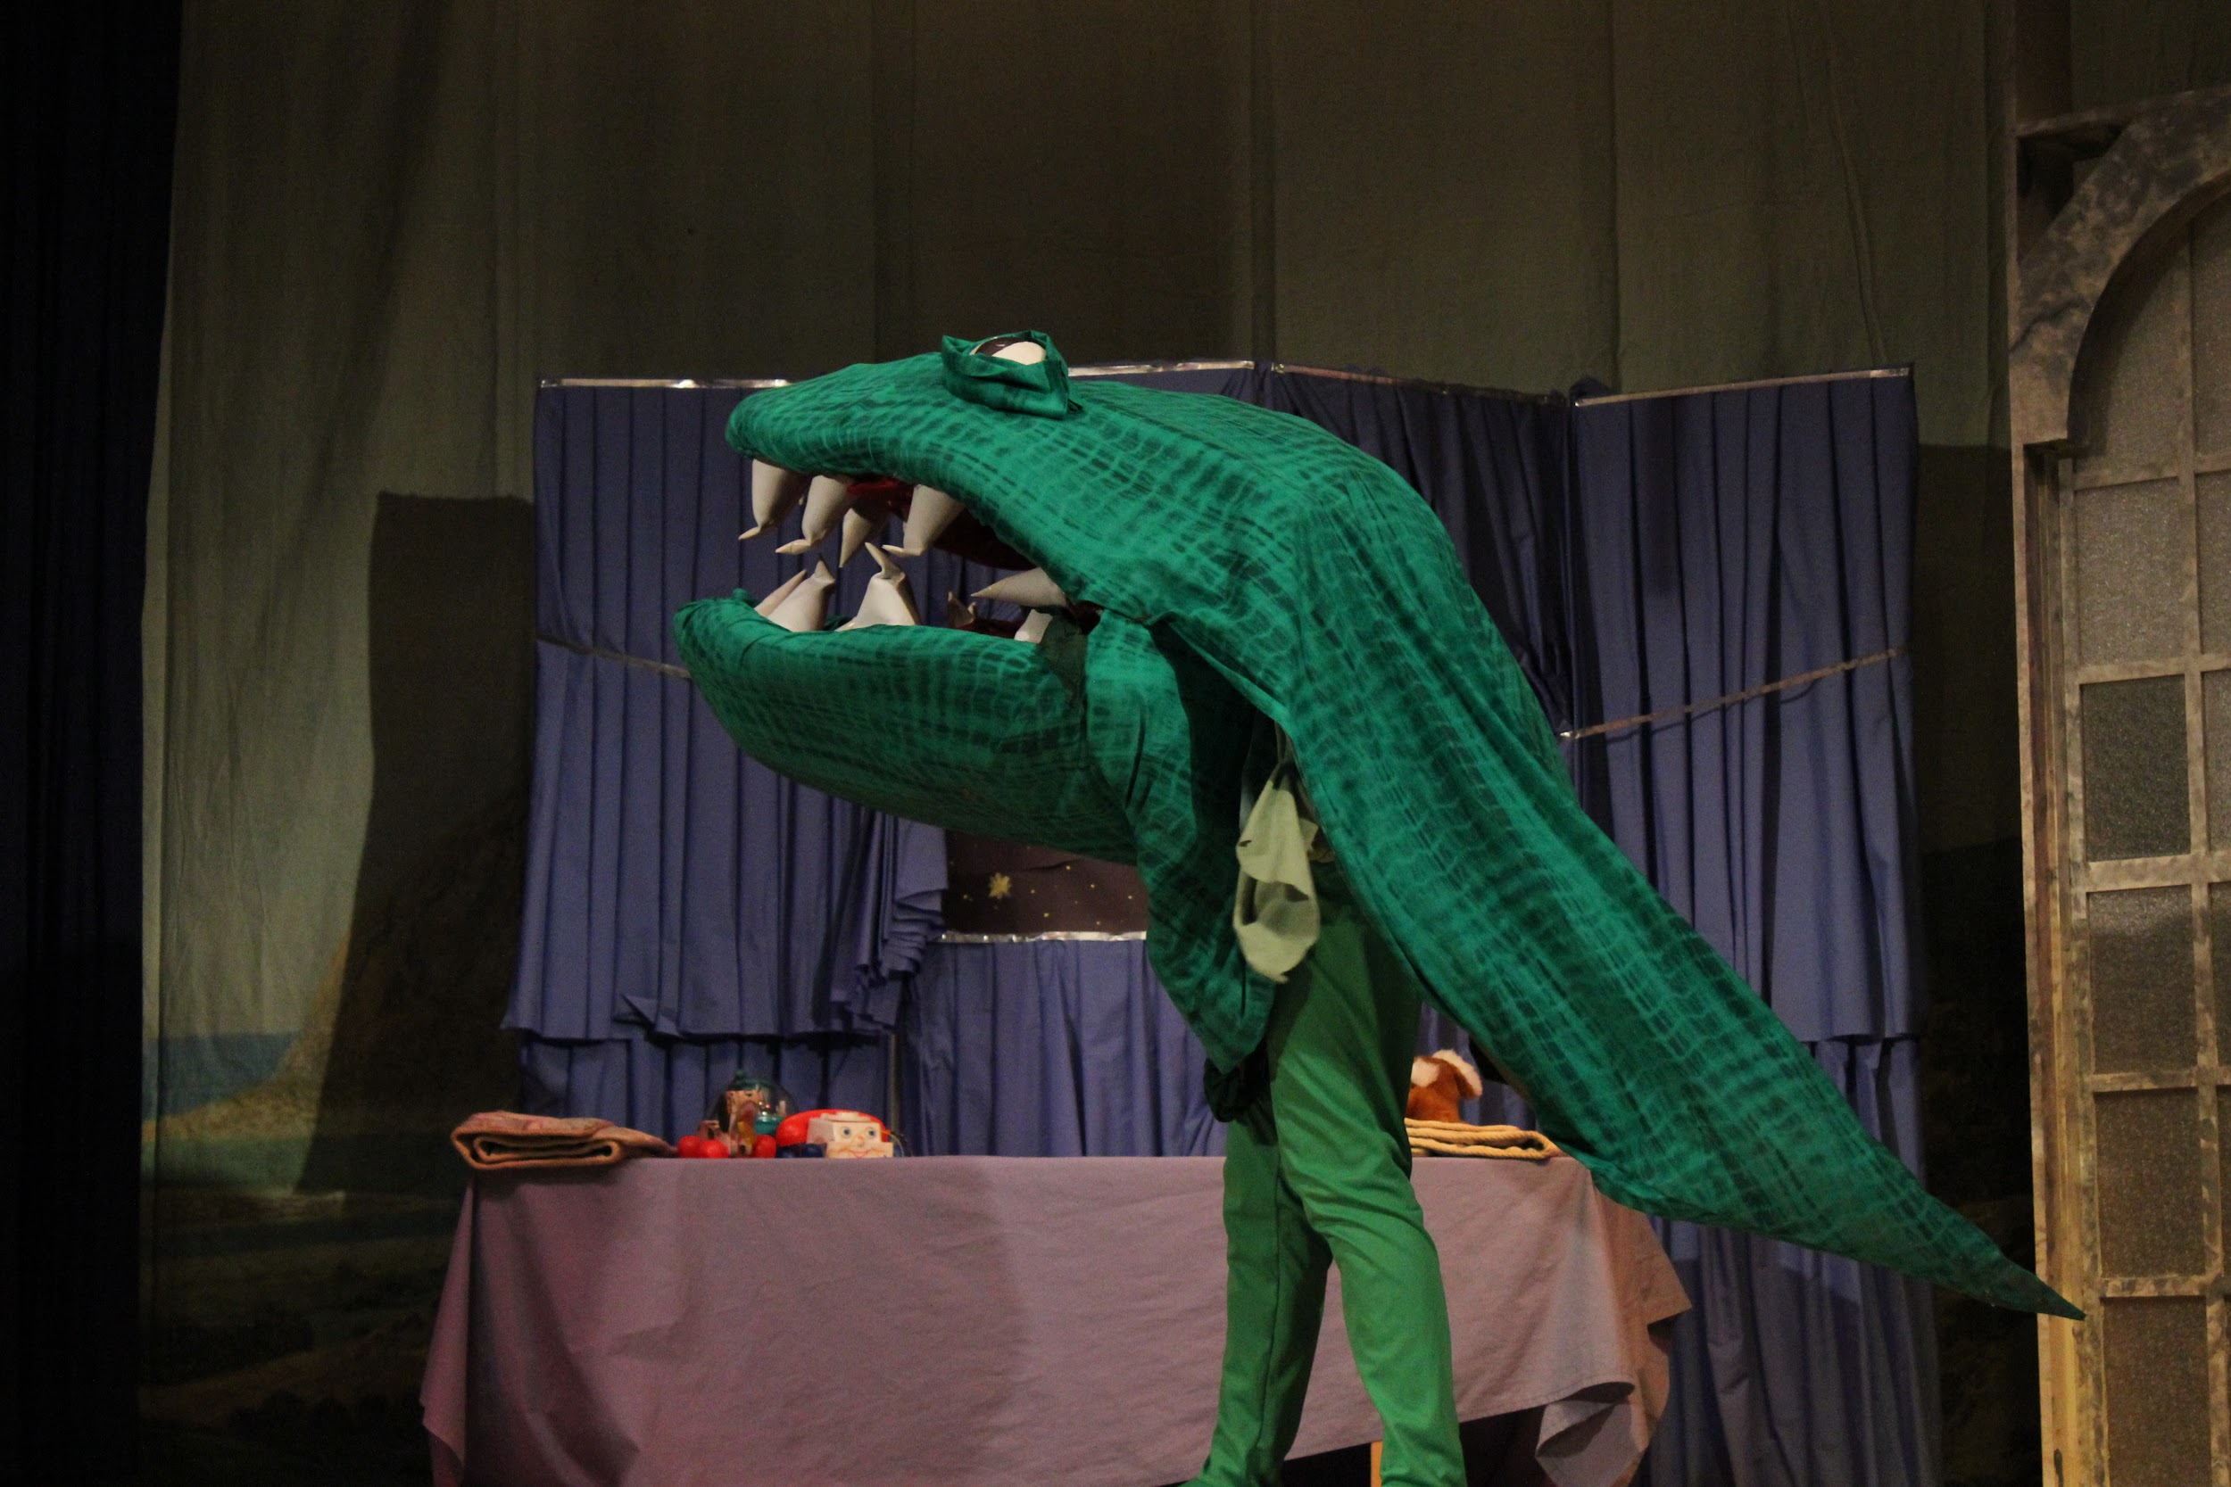
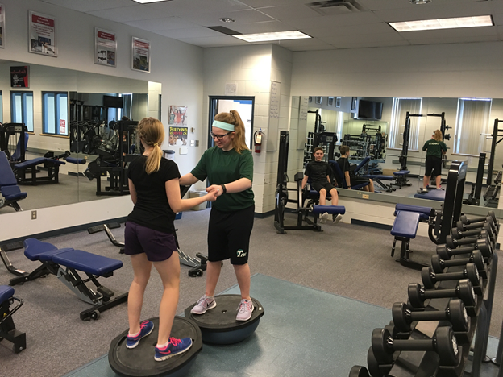
Option Courses
Creative Writing
Drama
Sports Accel
Learning Strategies

Slide 13
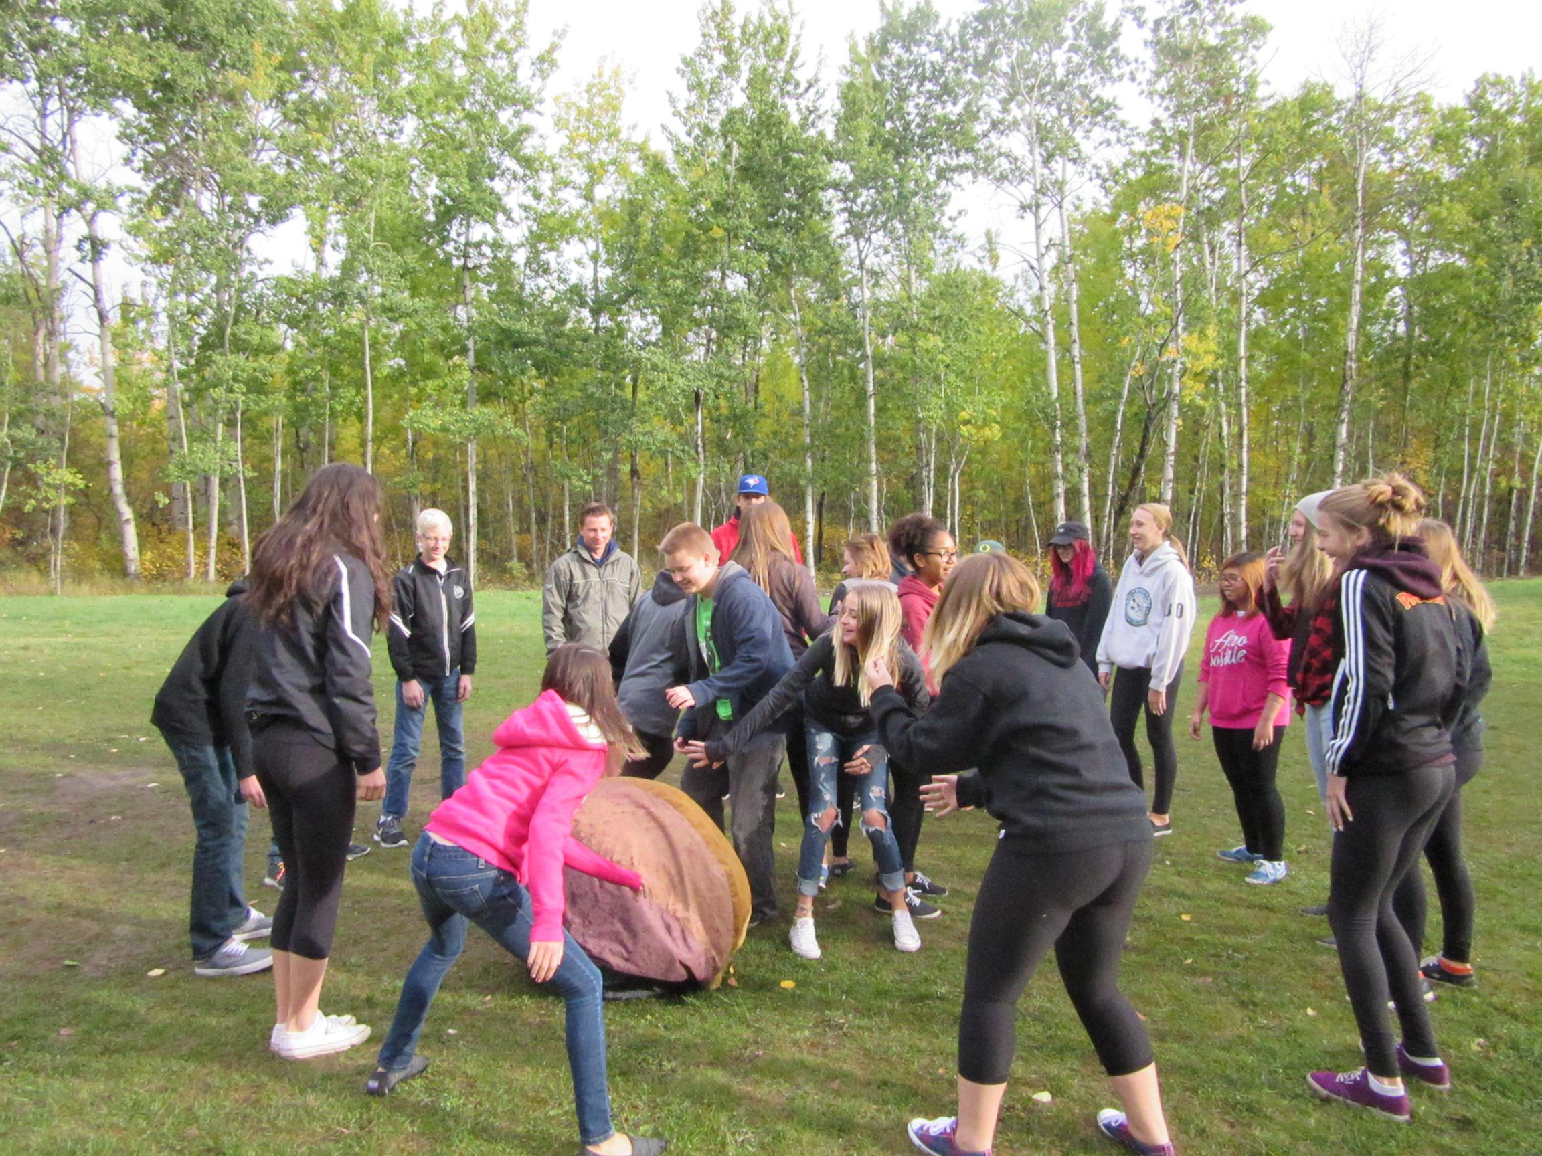
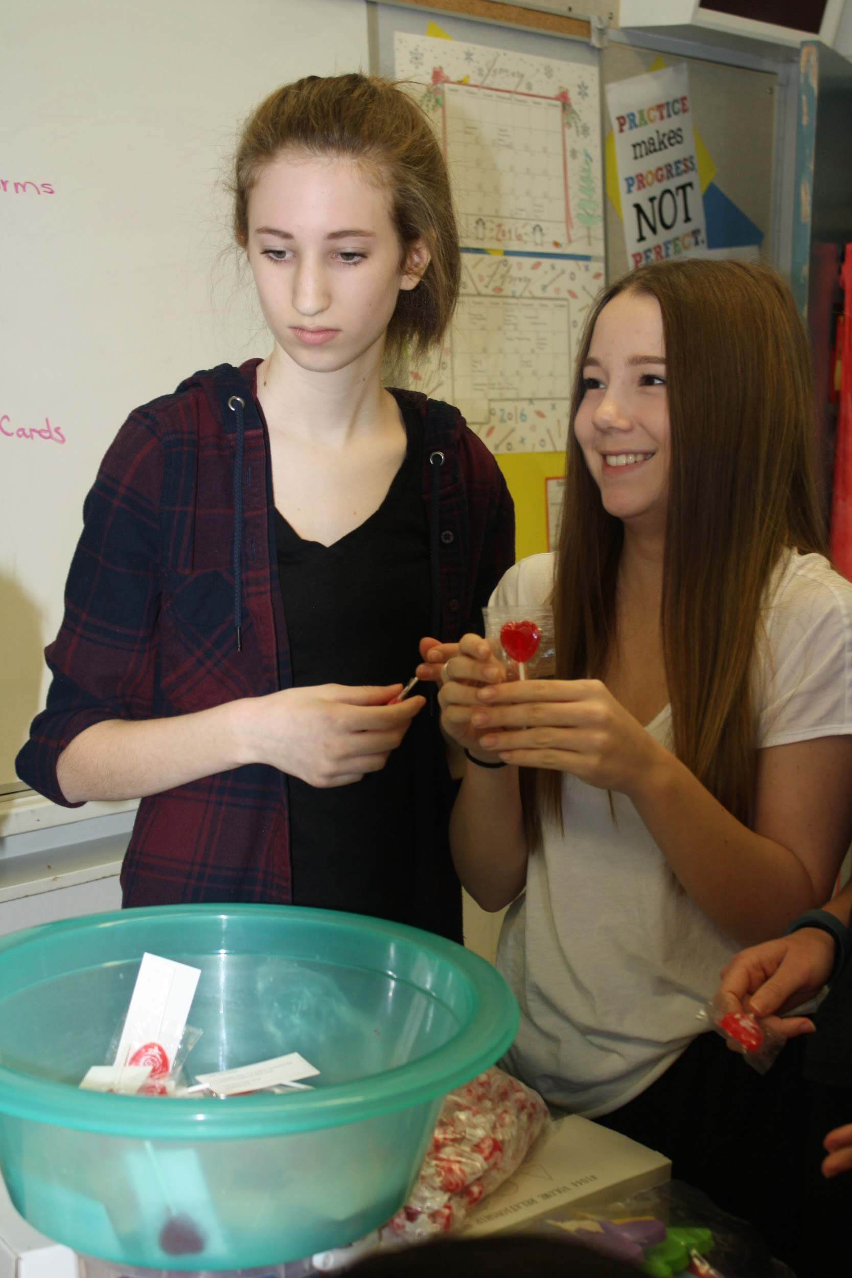
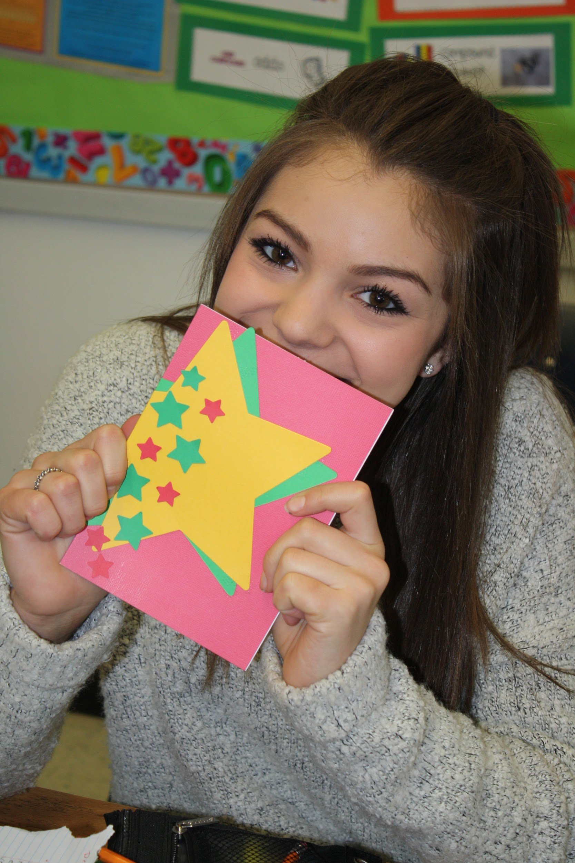
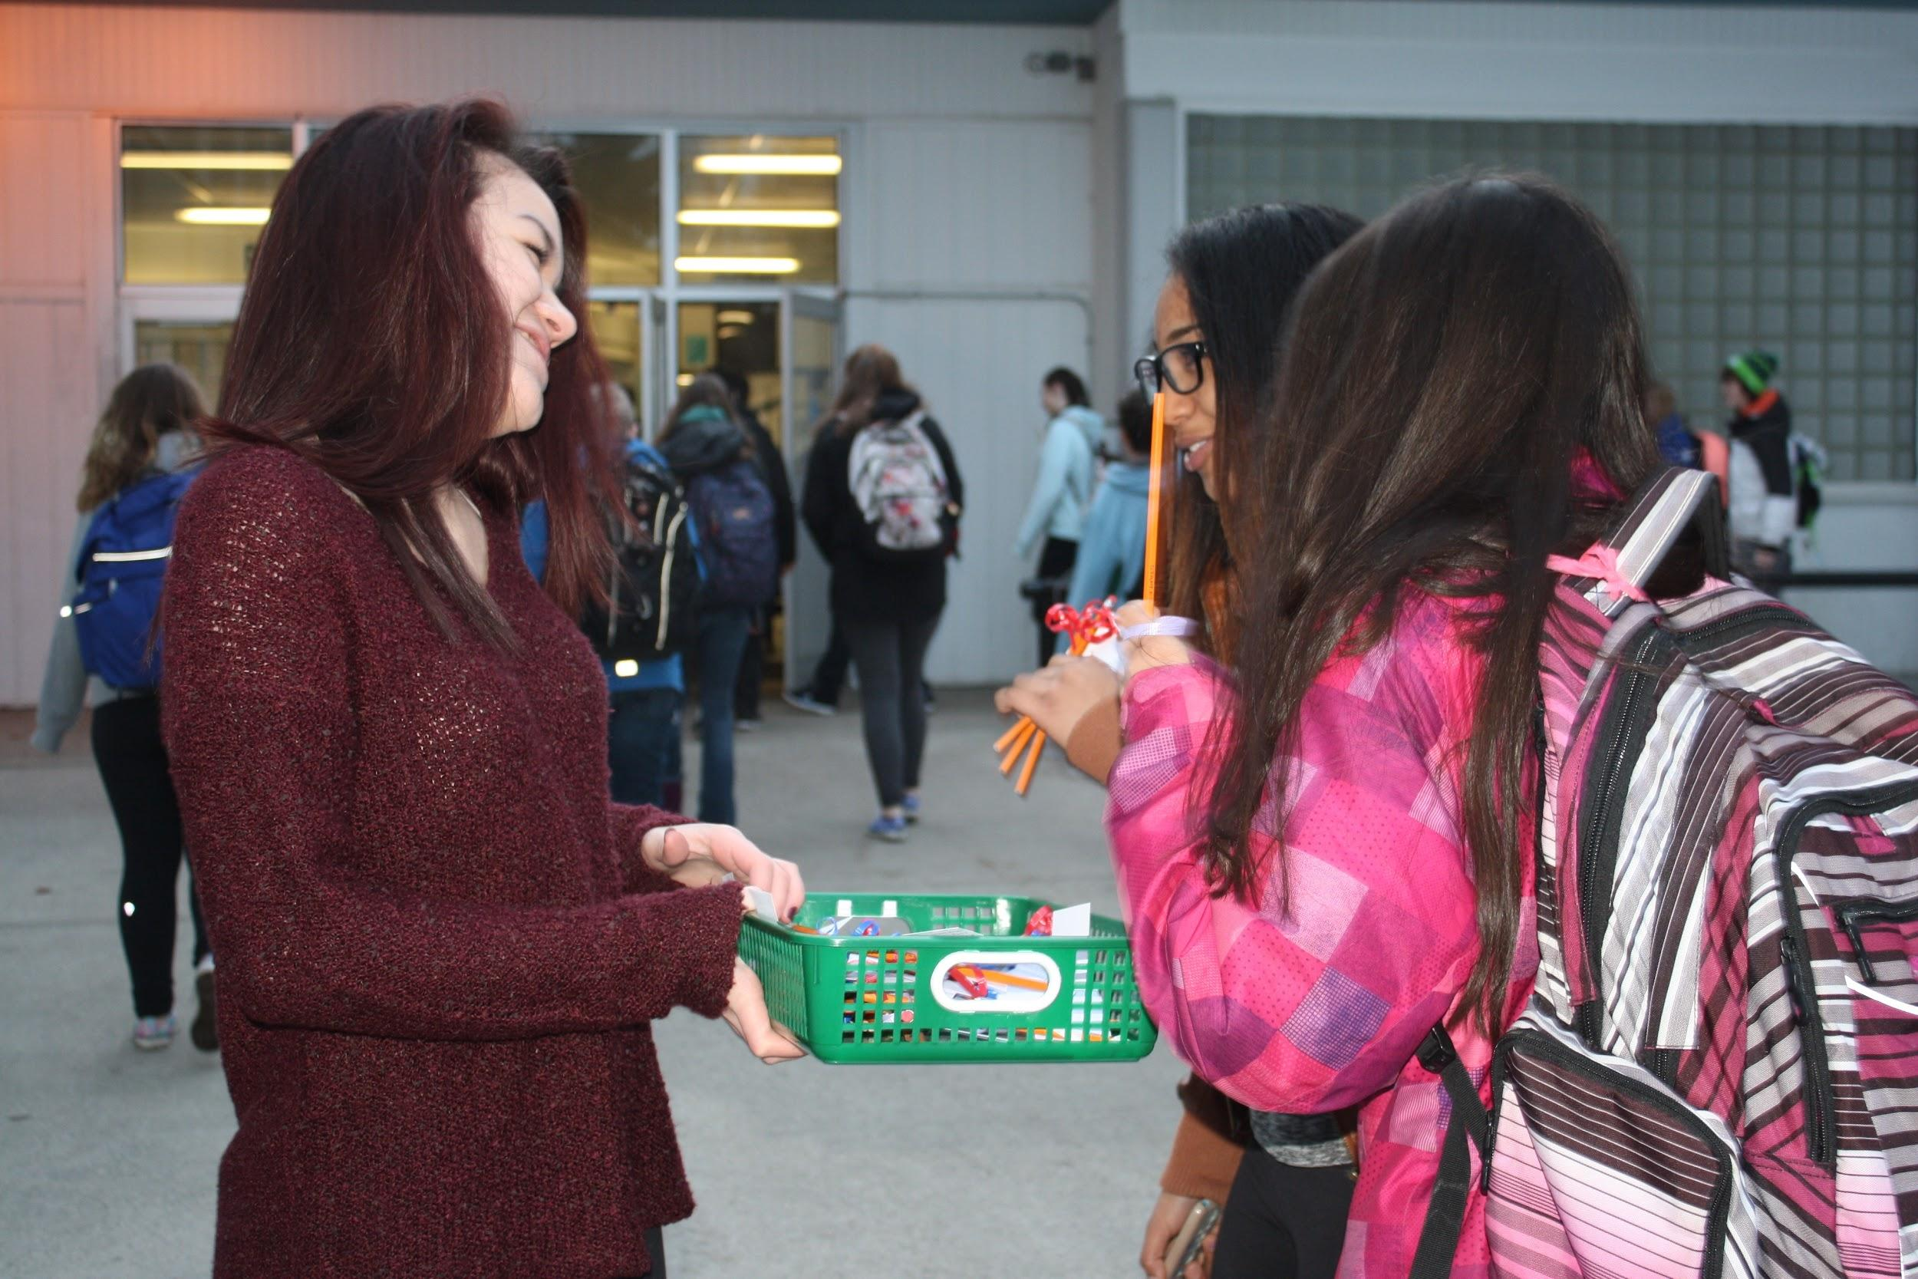
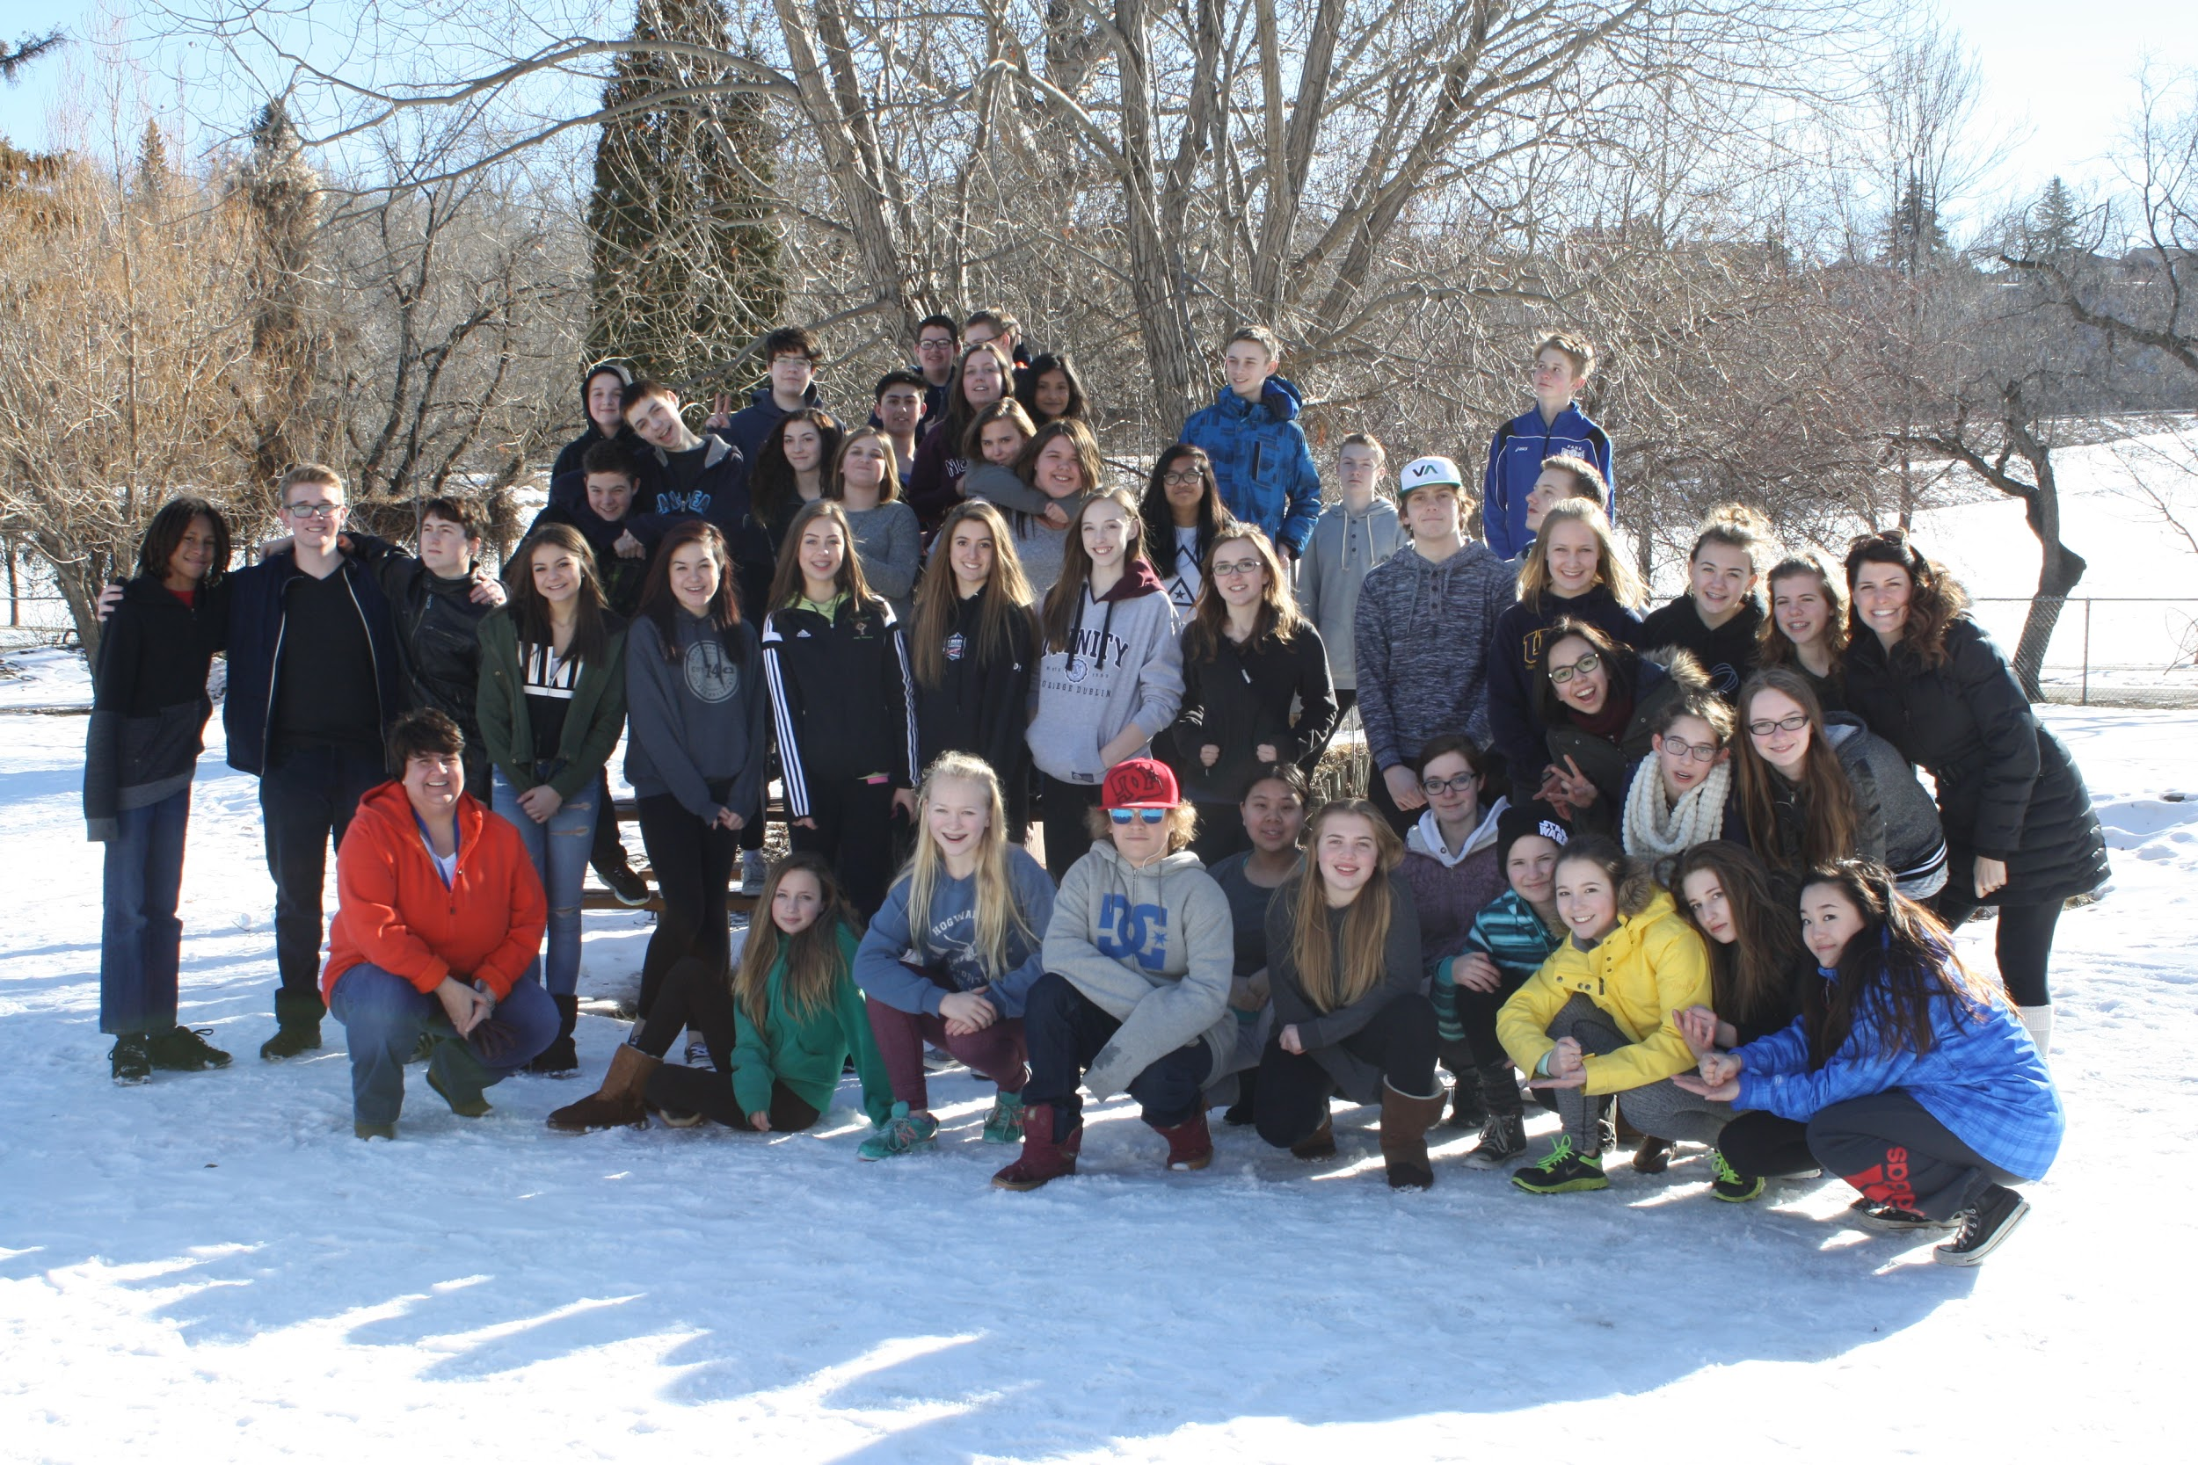
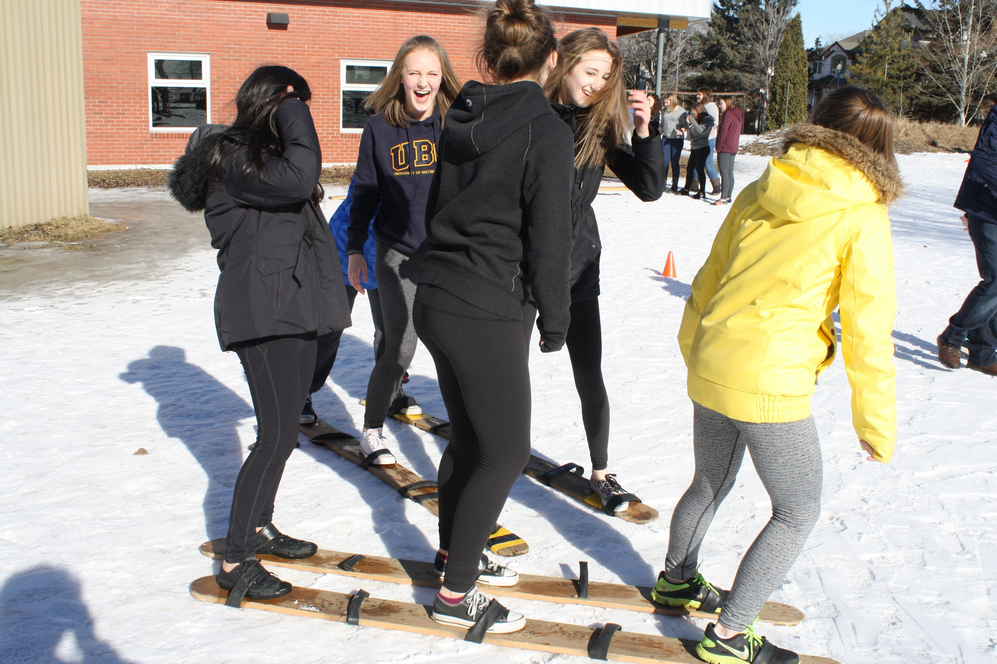
Option Courses
Volunteerism
In school activities
Community Activities
Leadership retreats
Leadership

Slide 14
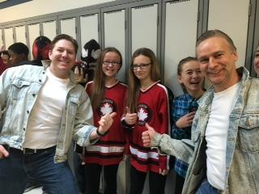
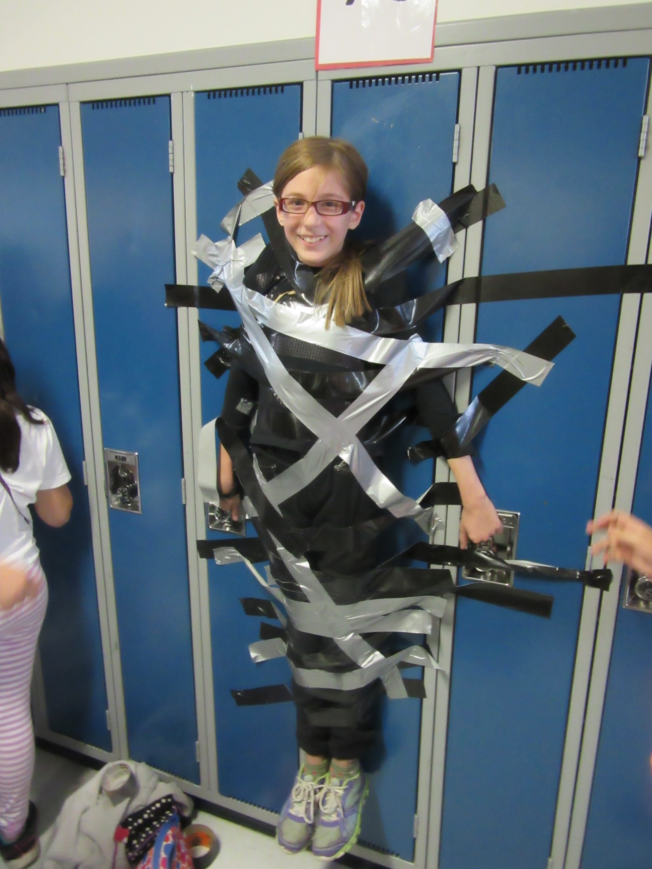
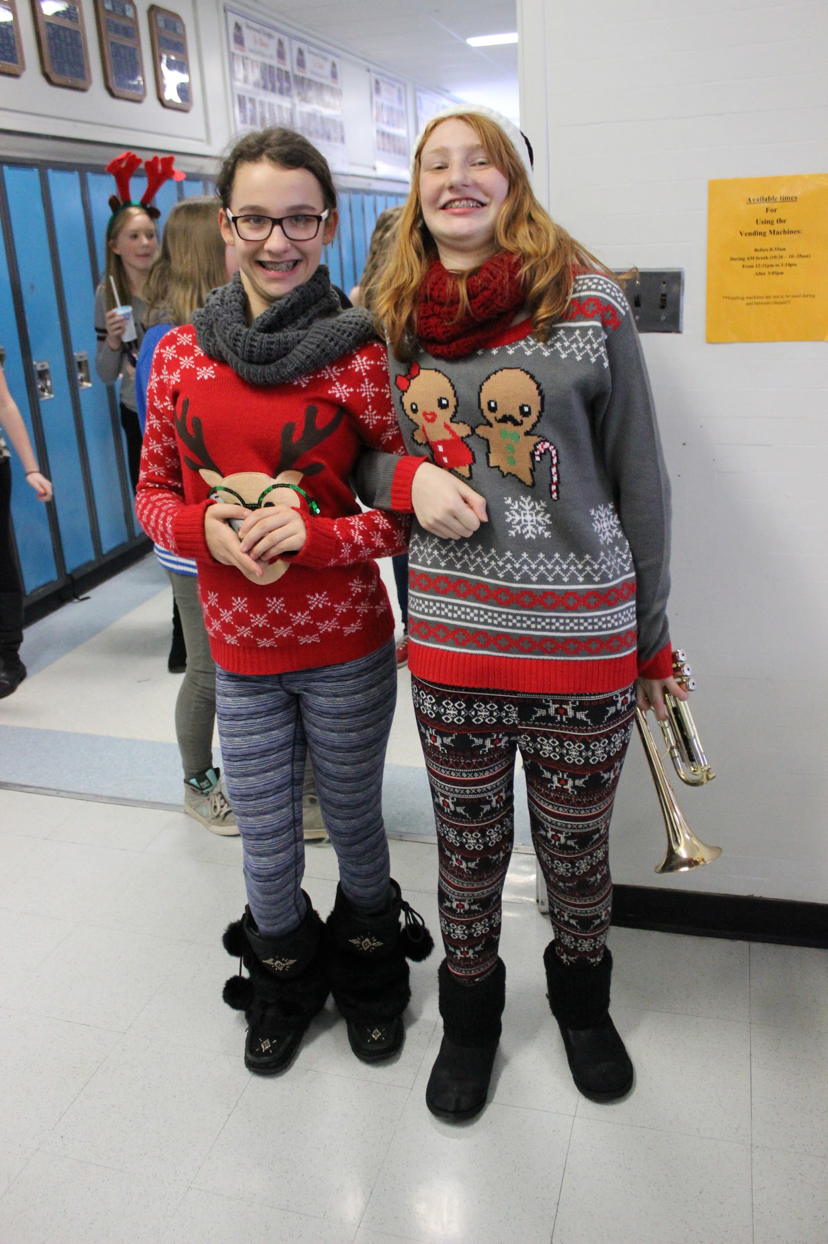
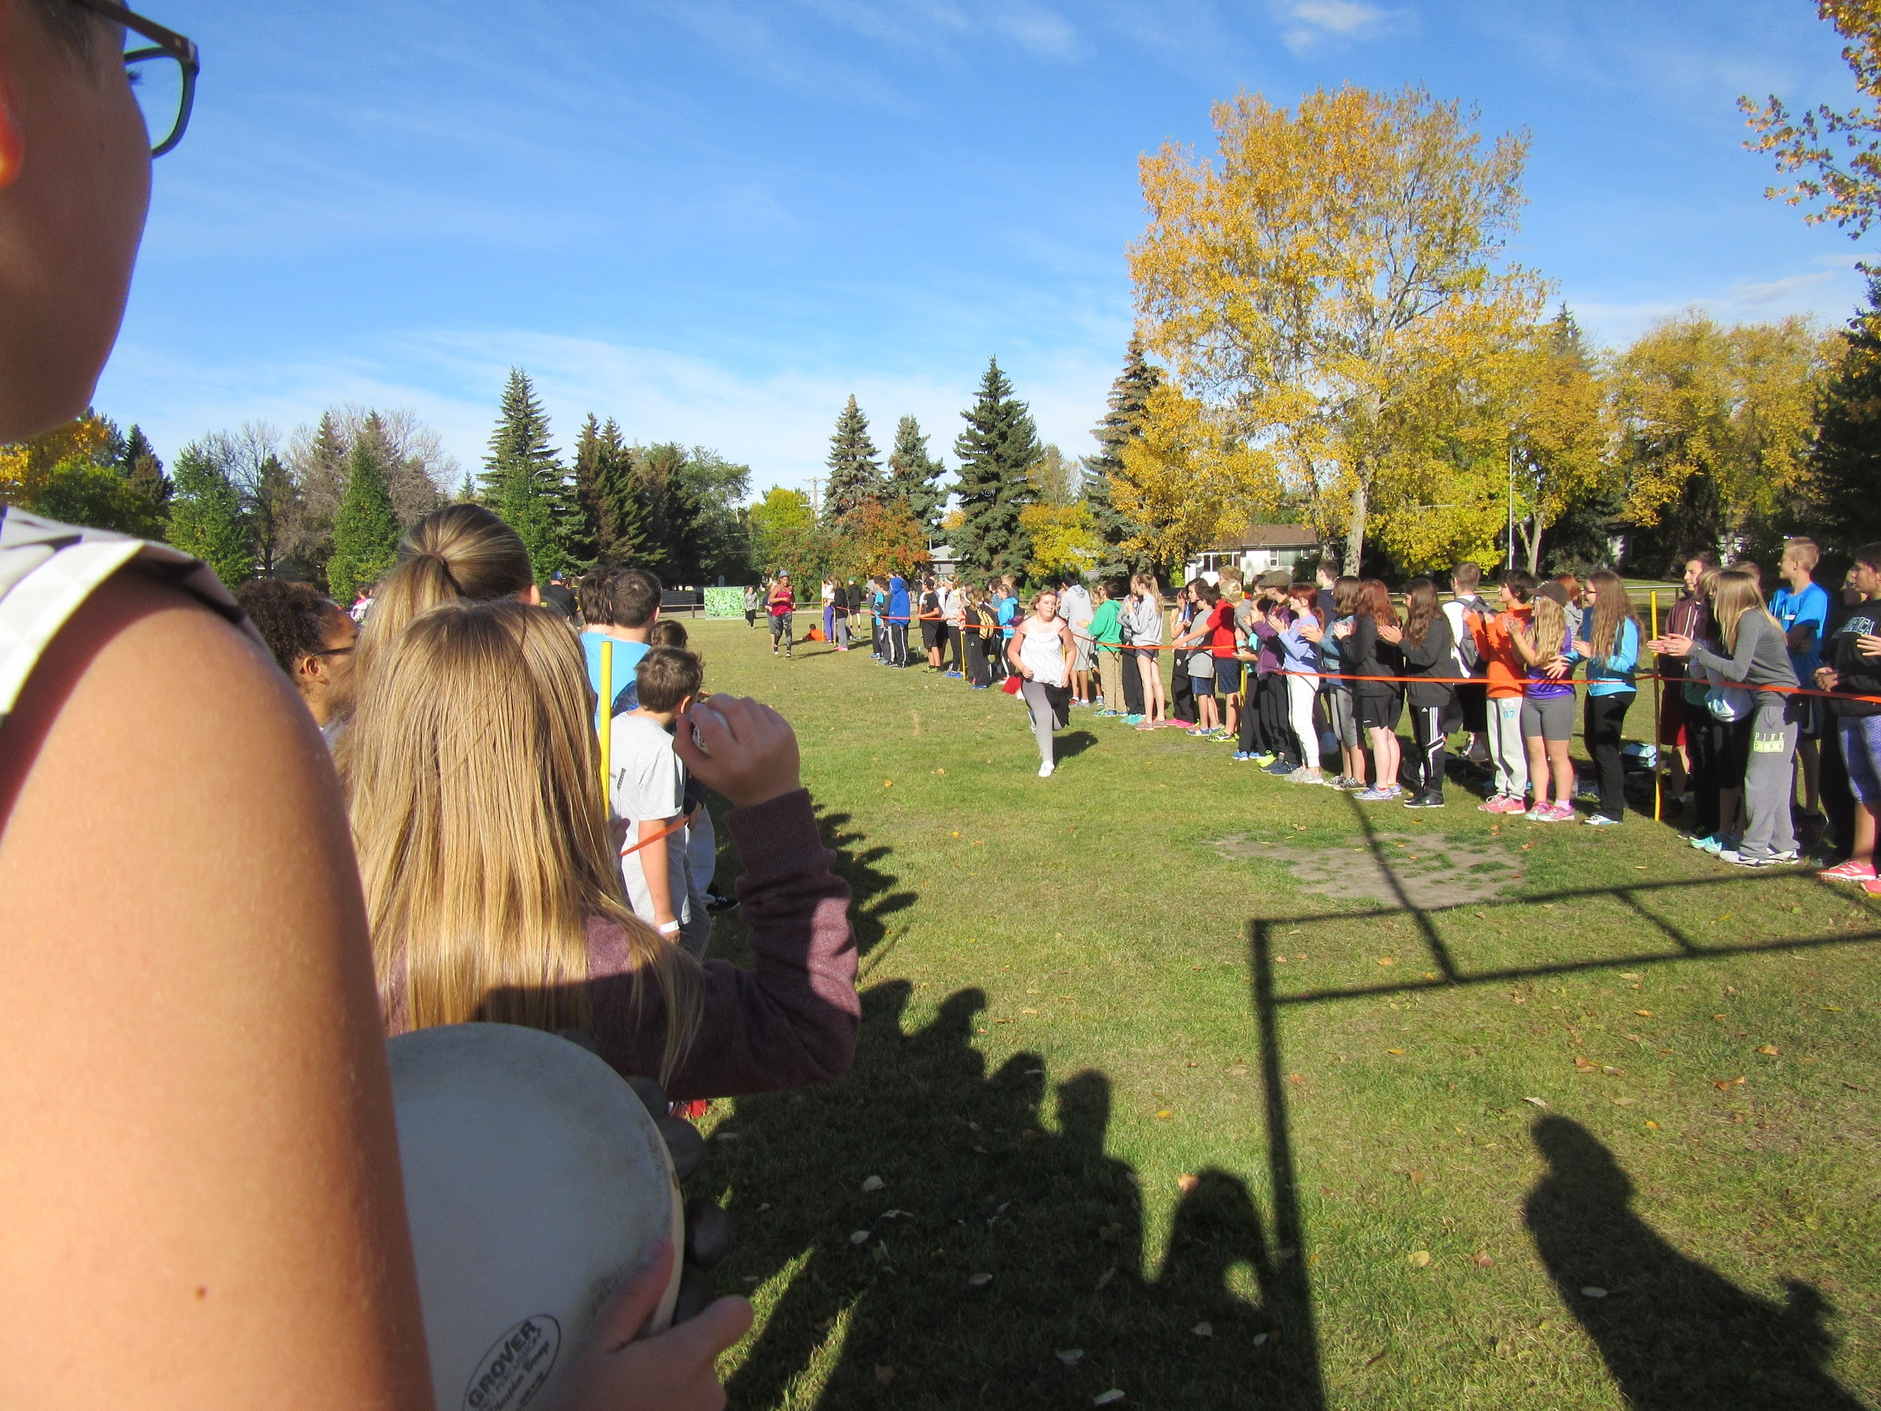
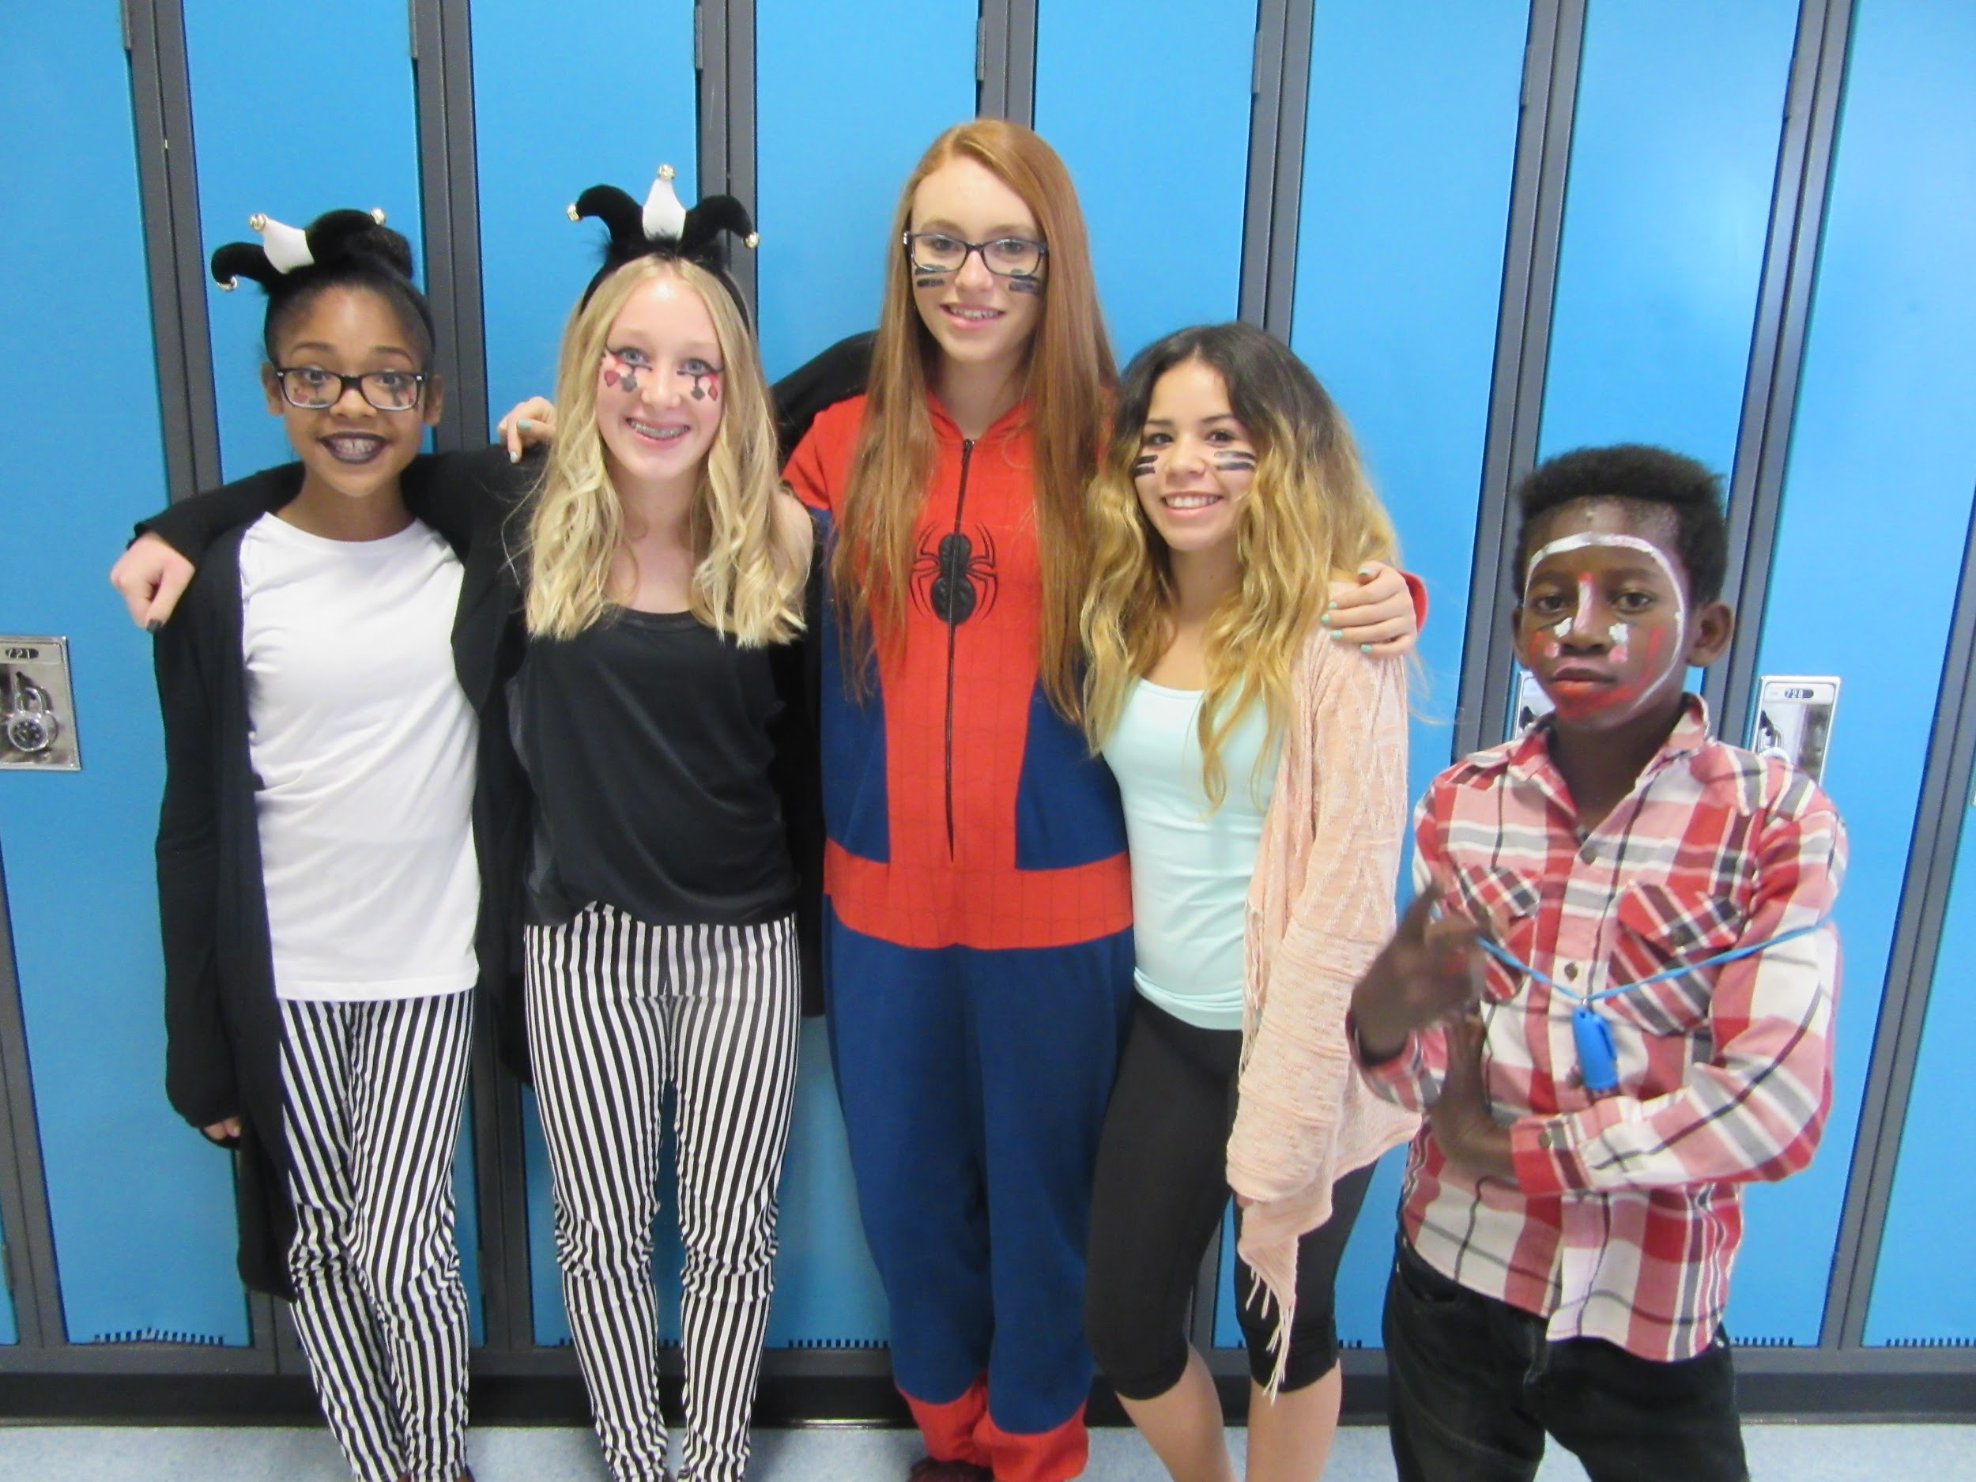
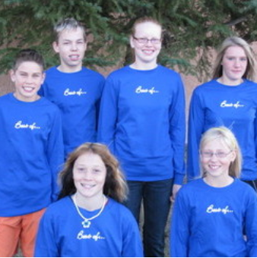
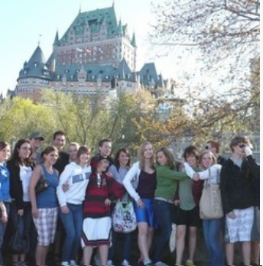
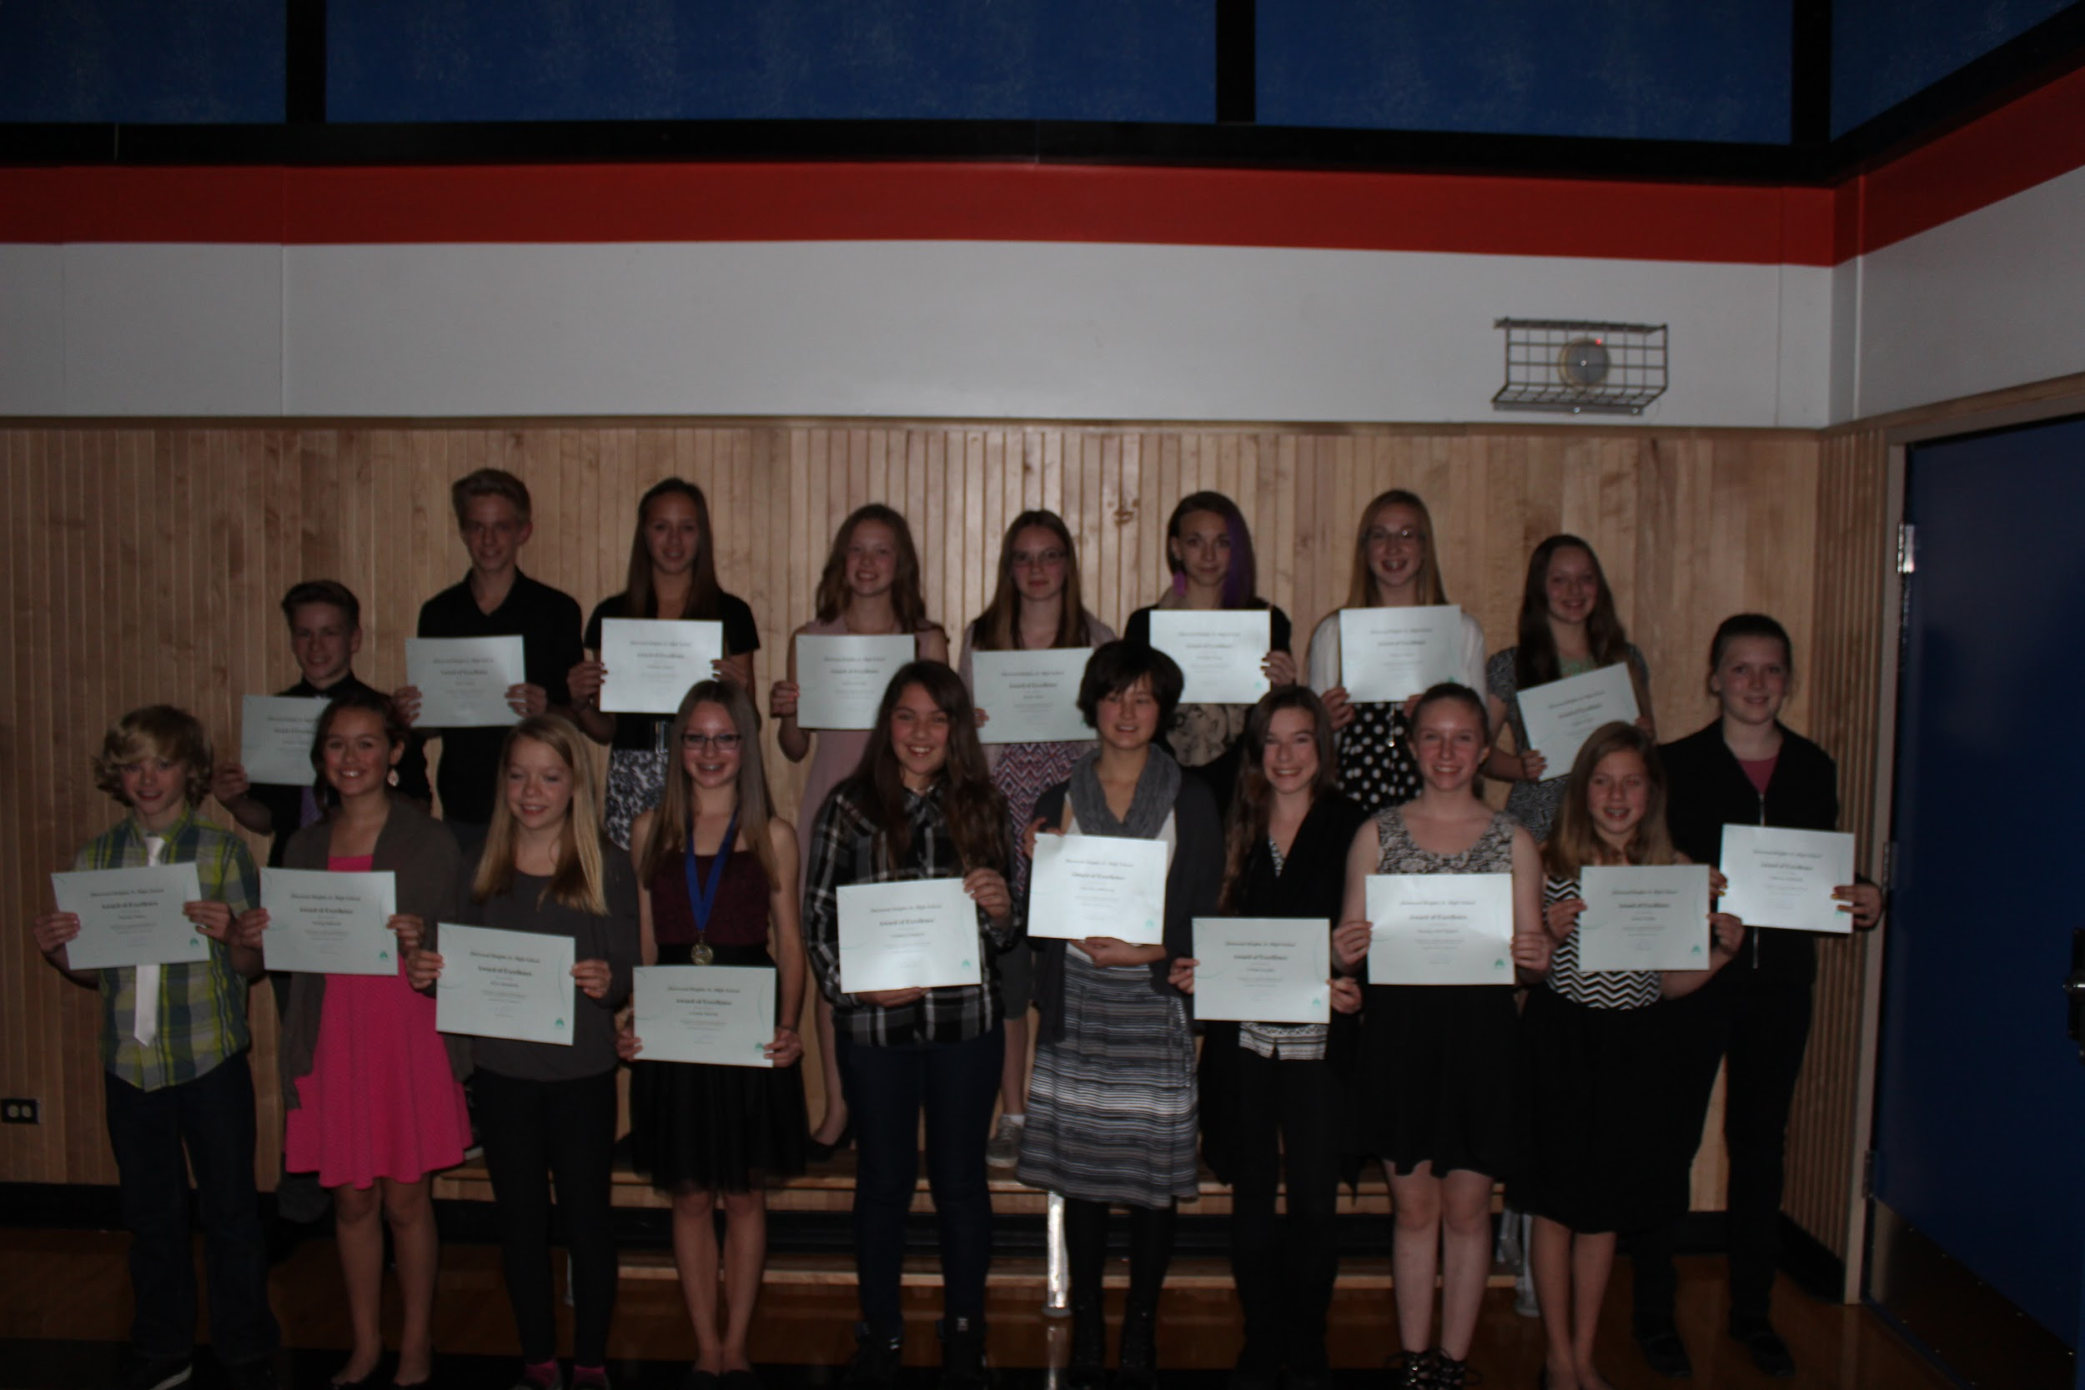
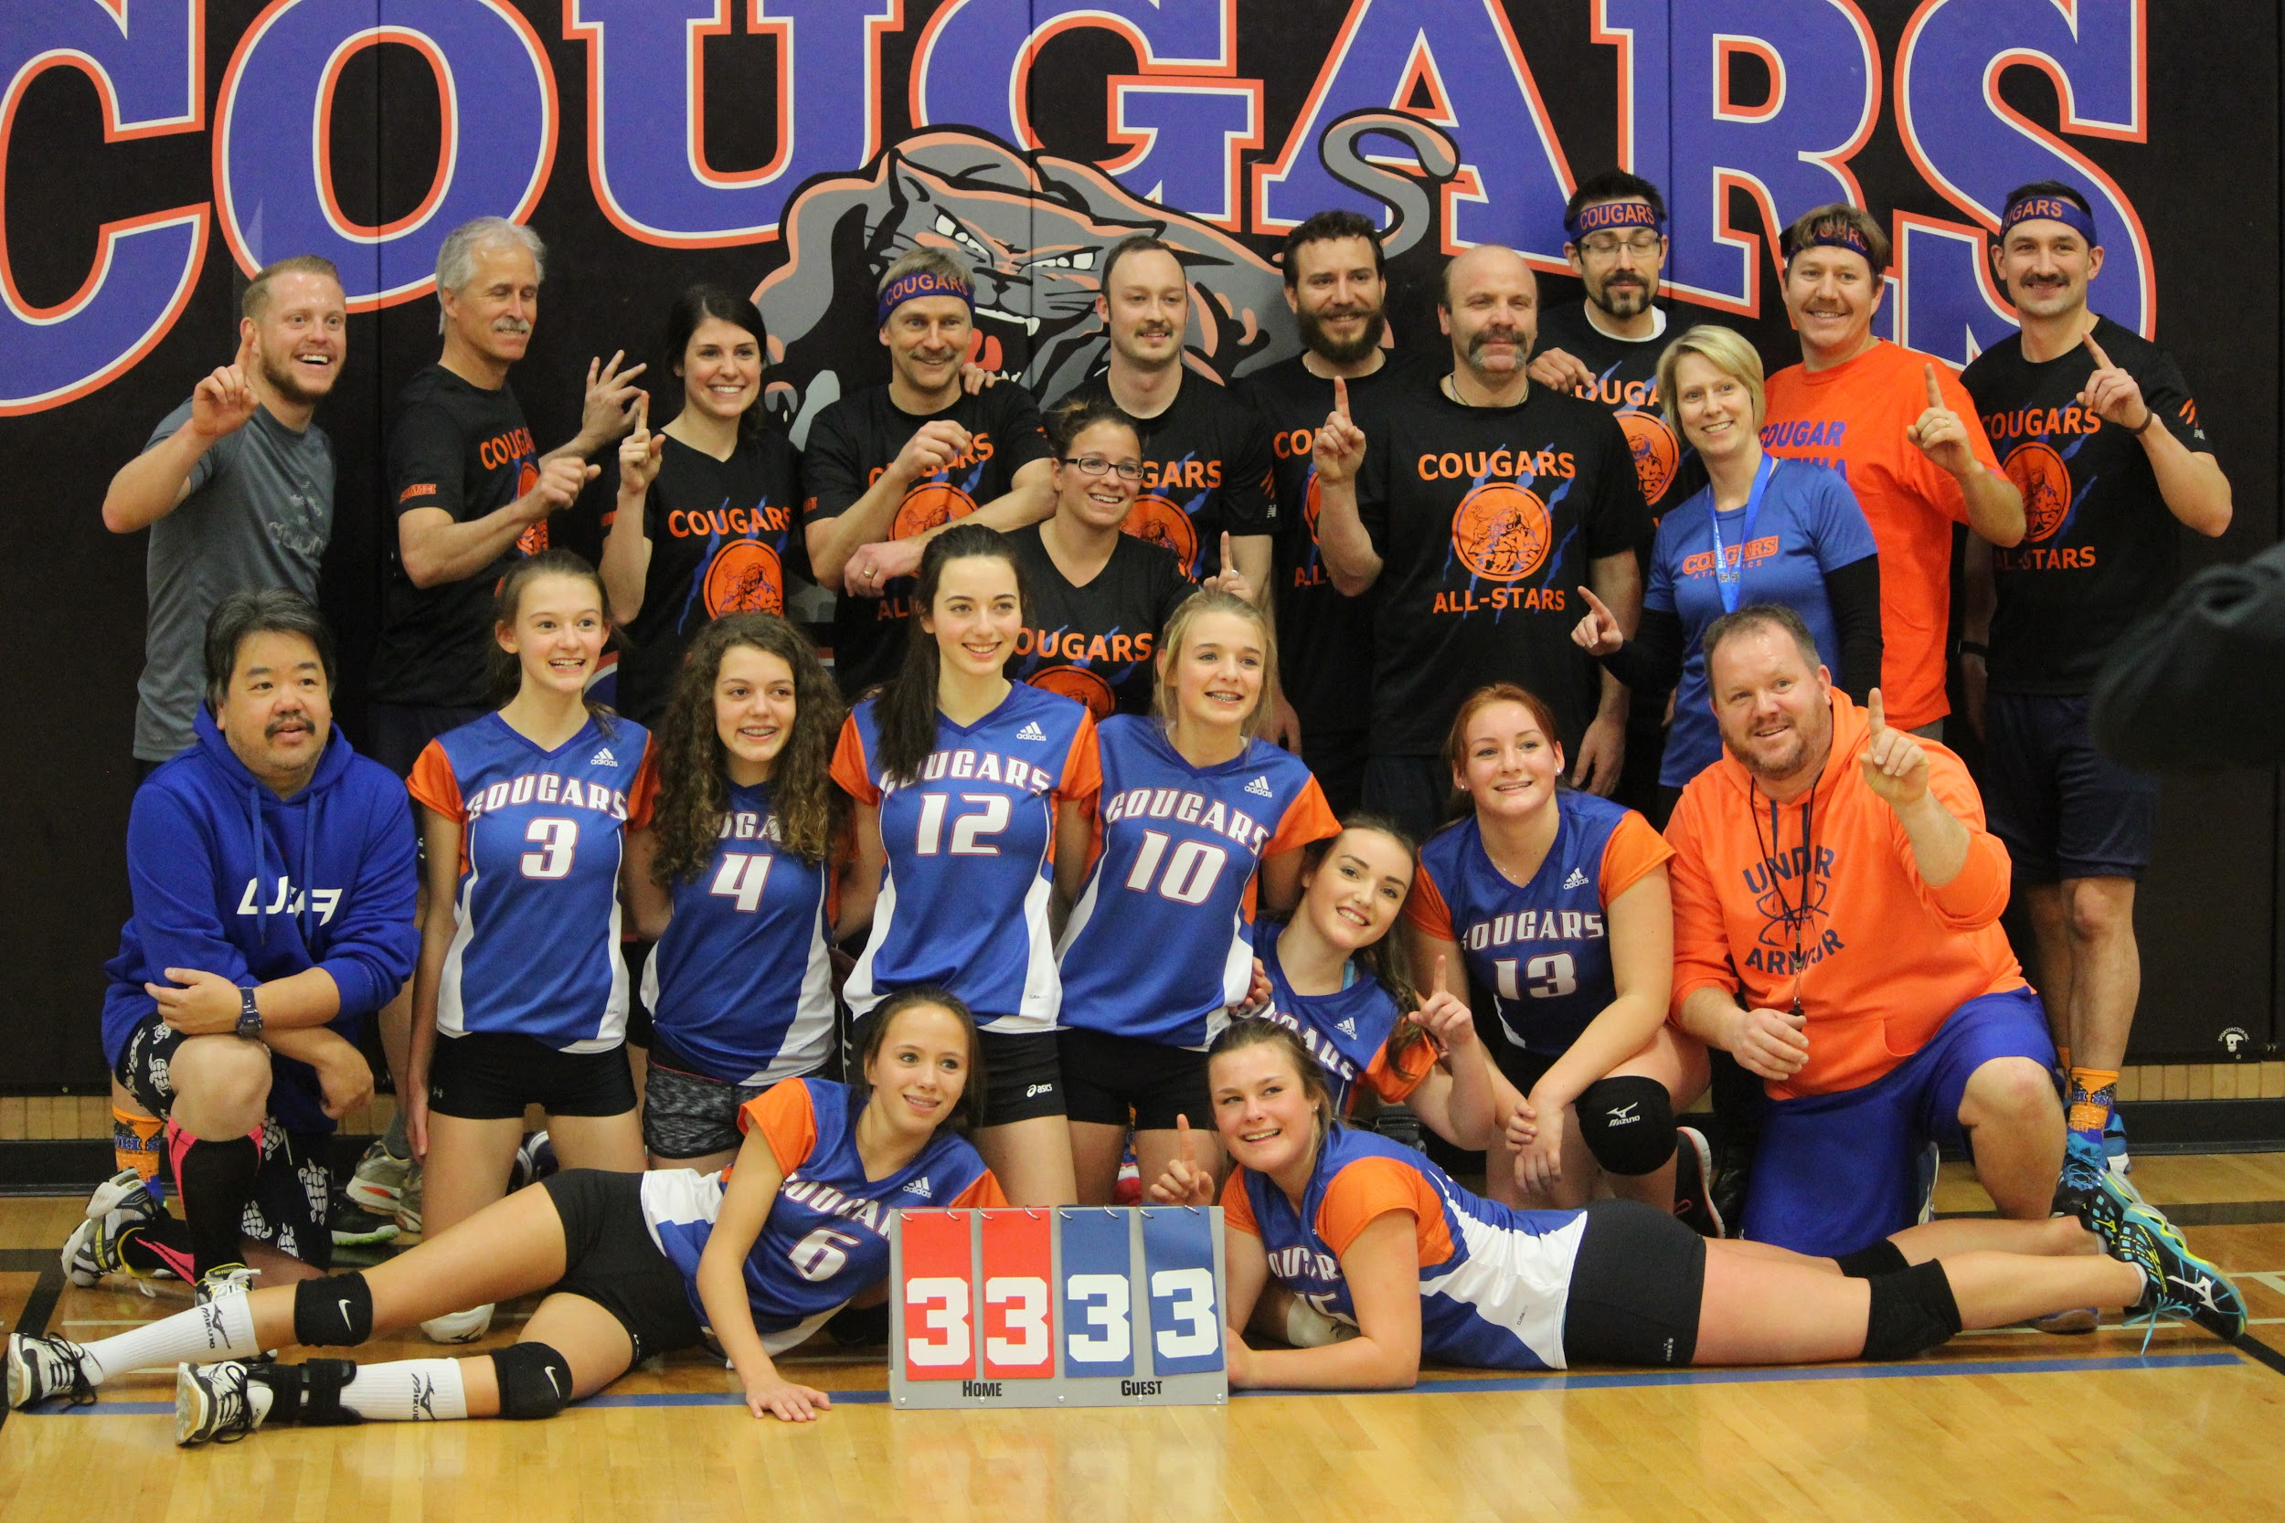
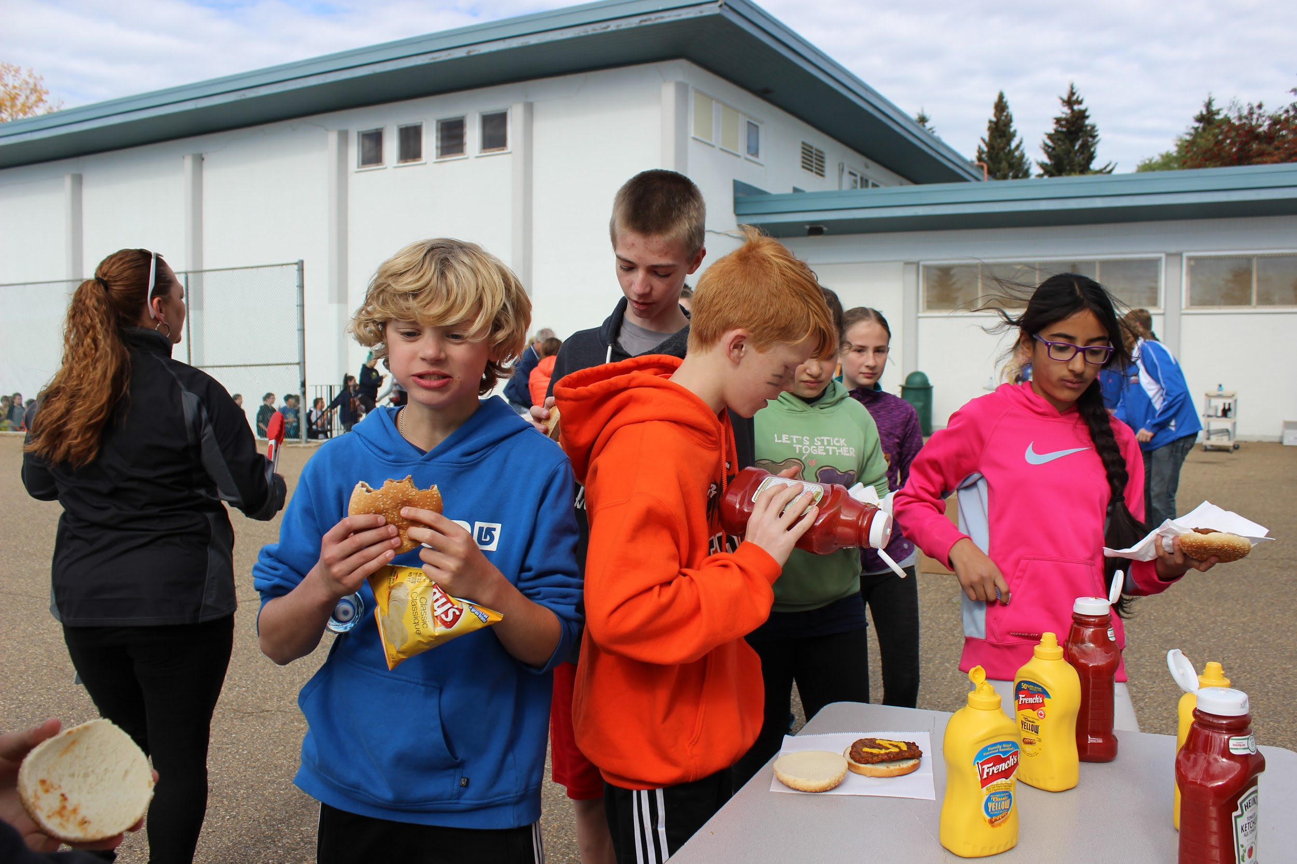
Events
Welcome Week
Awards
Halloween
Dances
Staff vs Students
Intramurals
Twin Day
Quebec Trip

Slide 15
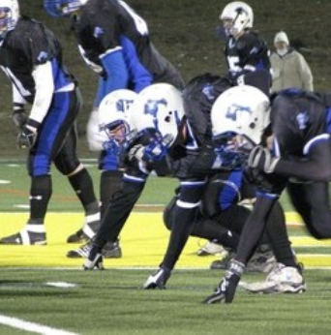
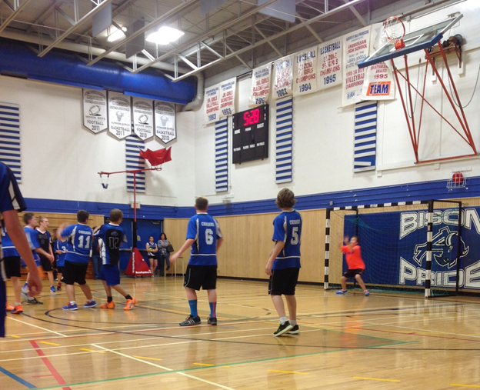
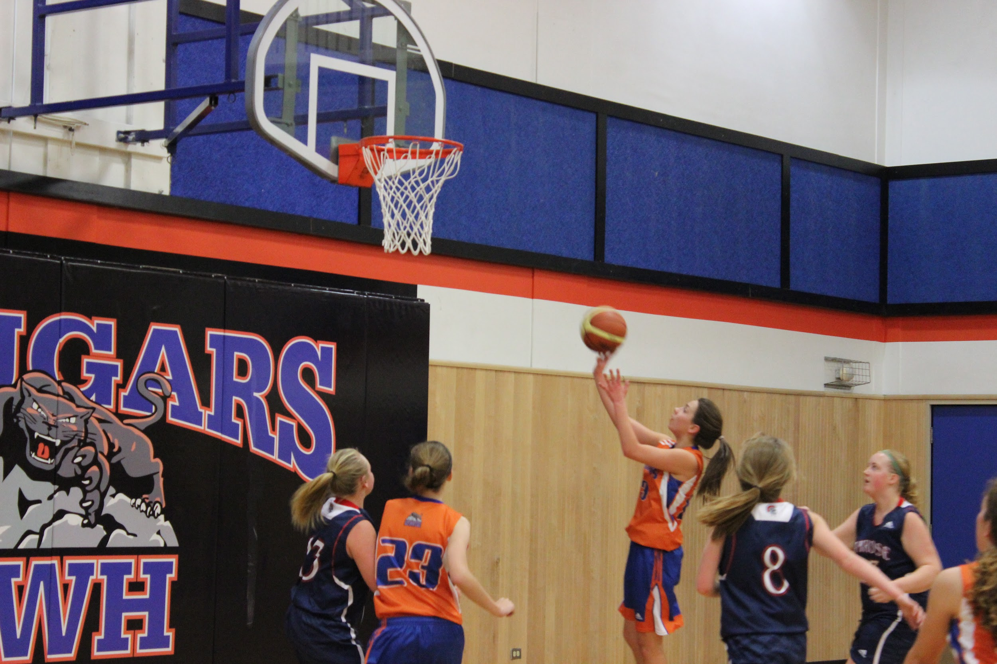
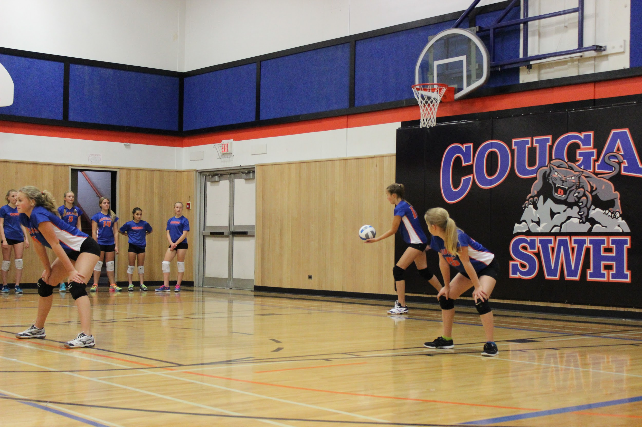
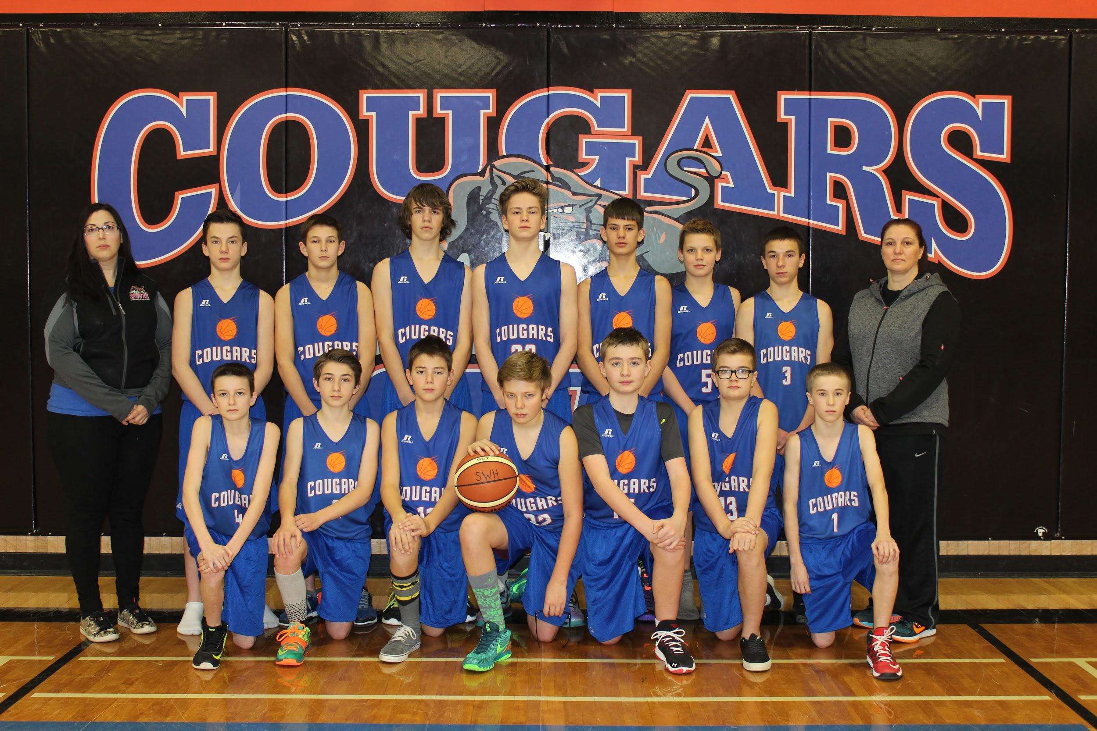
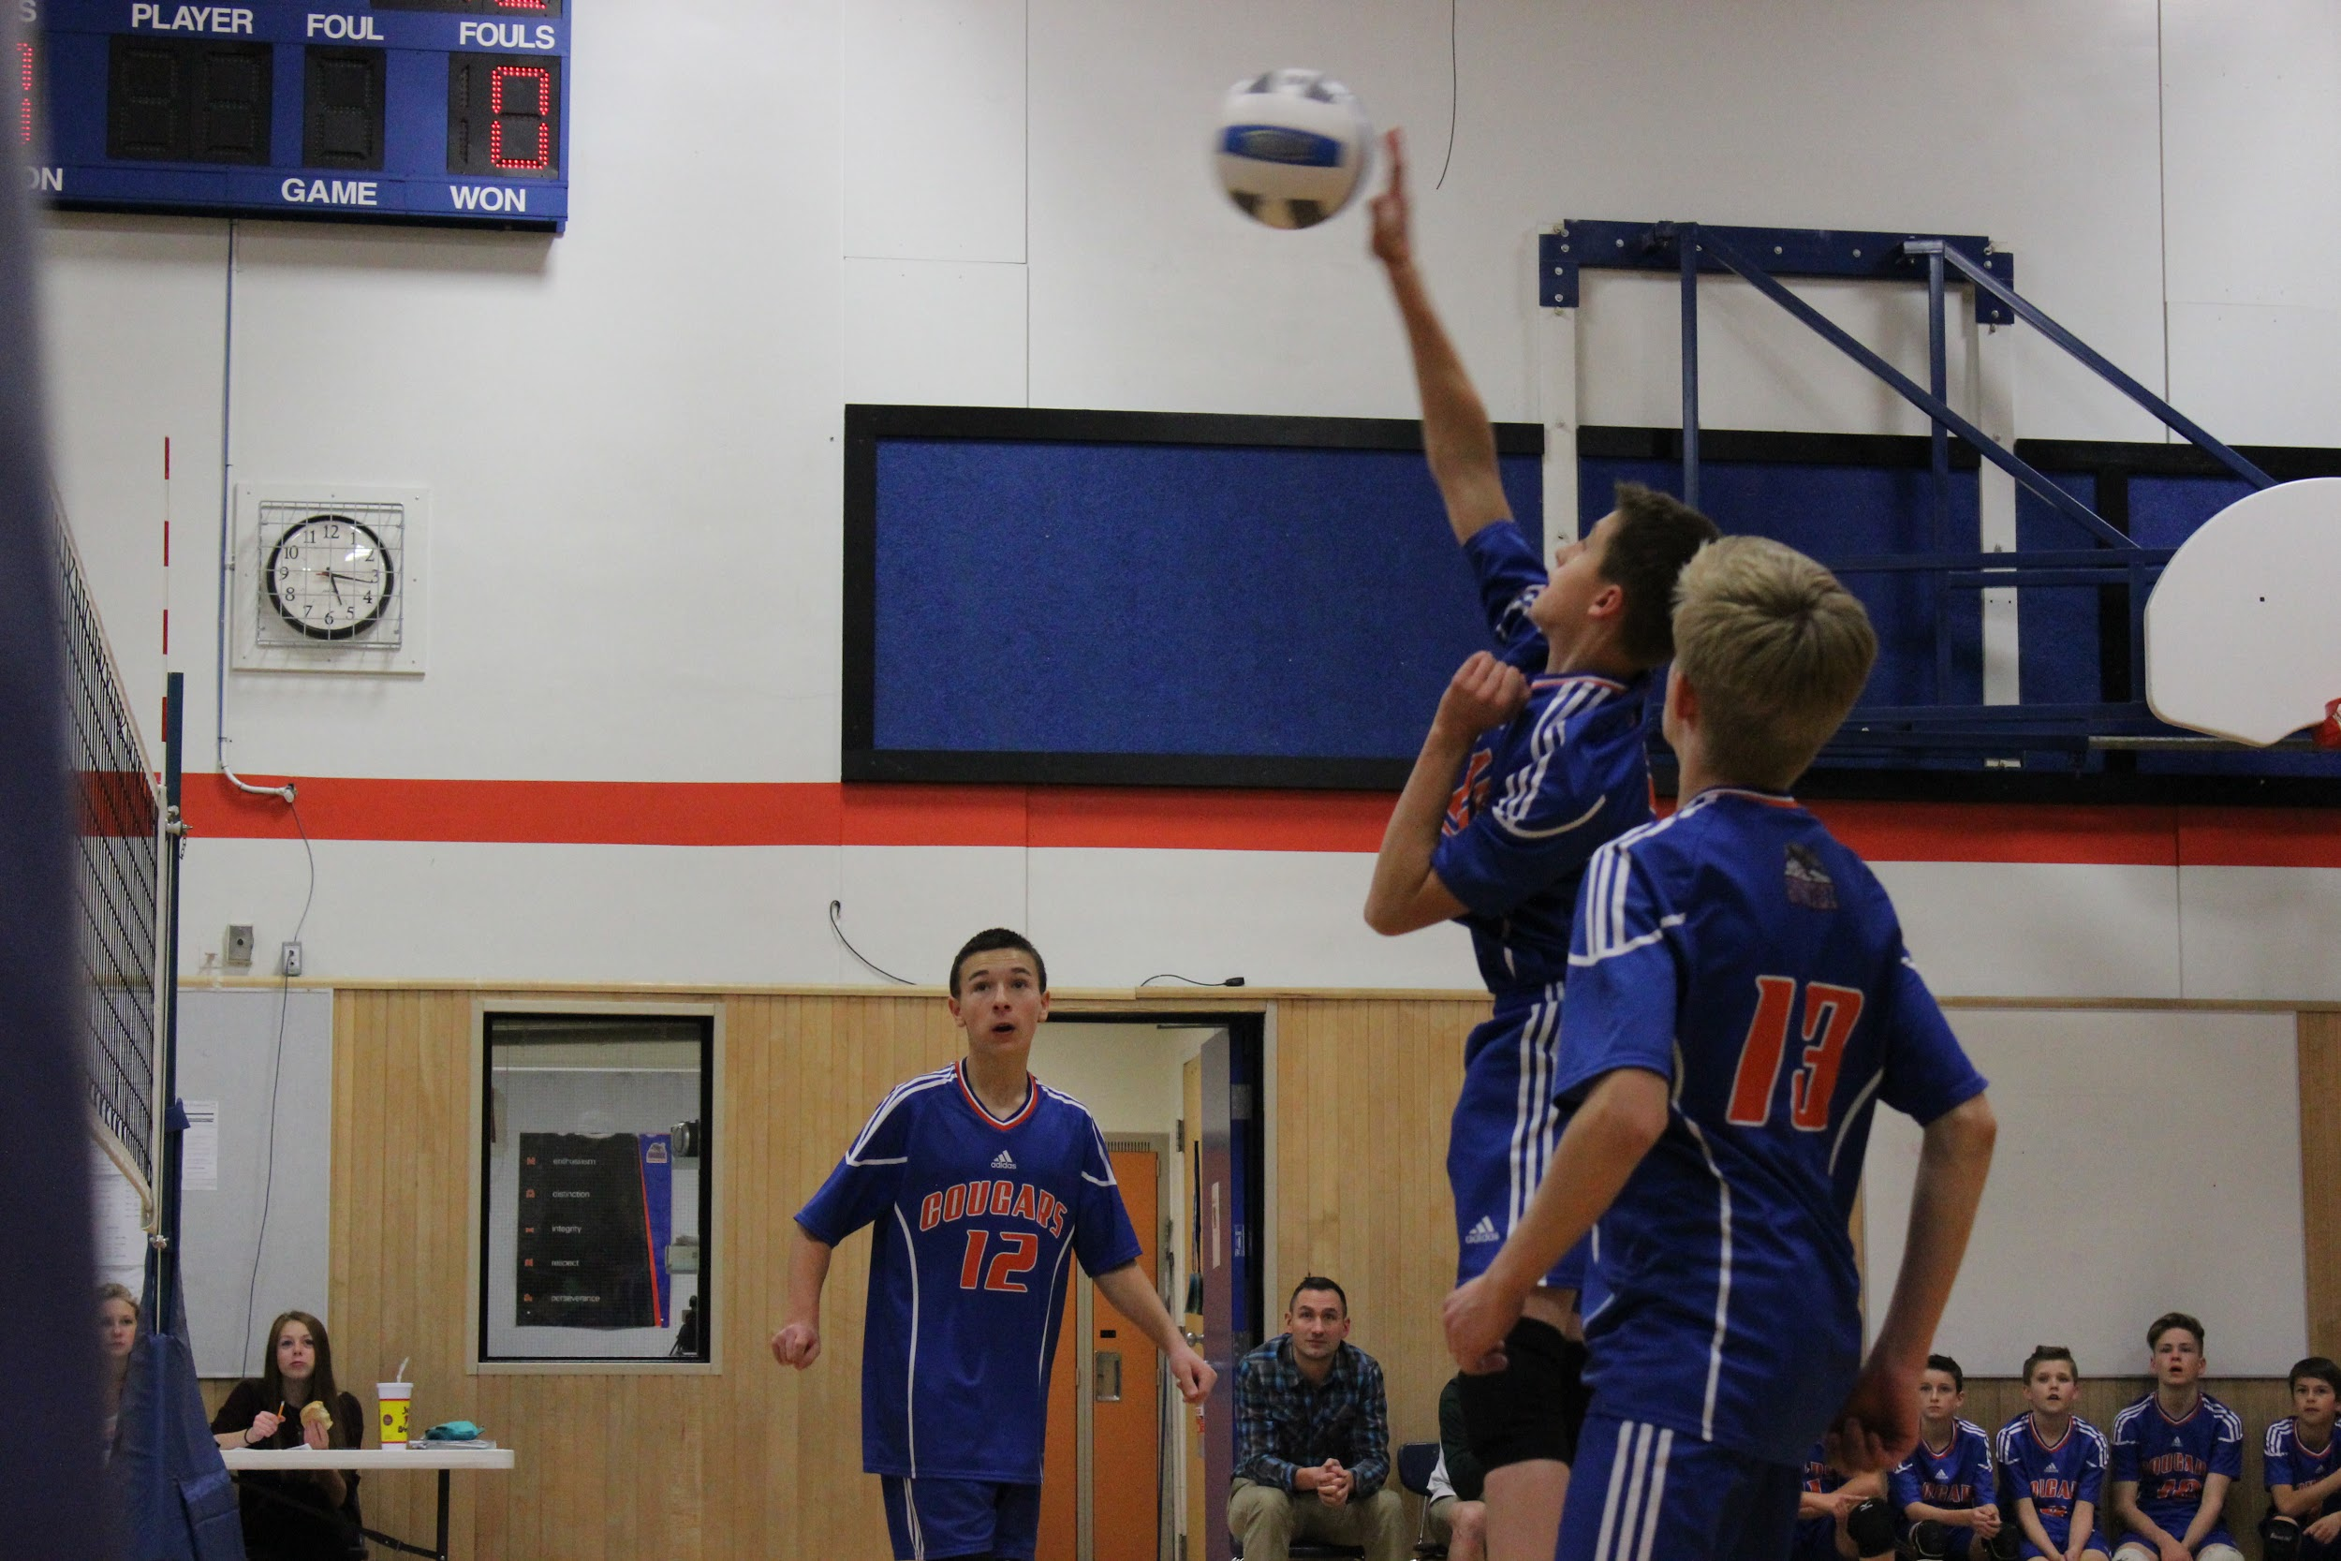
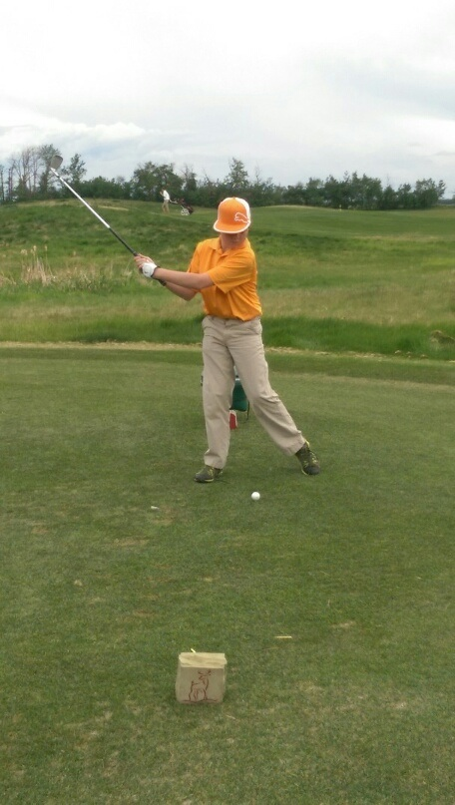
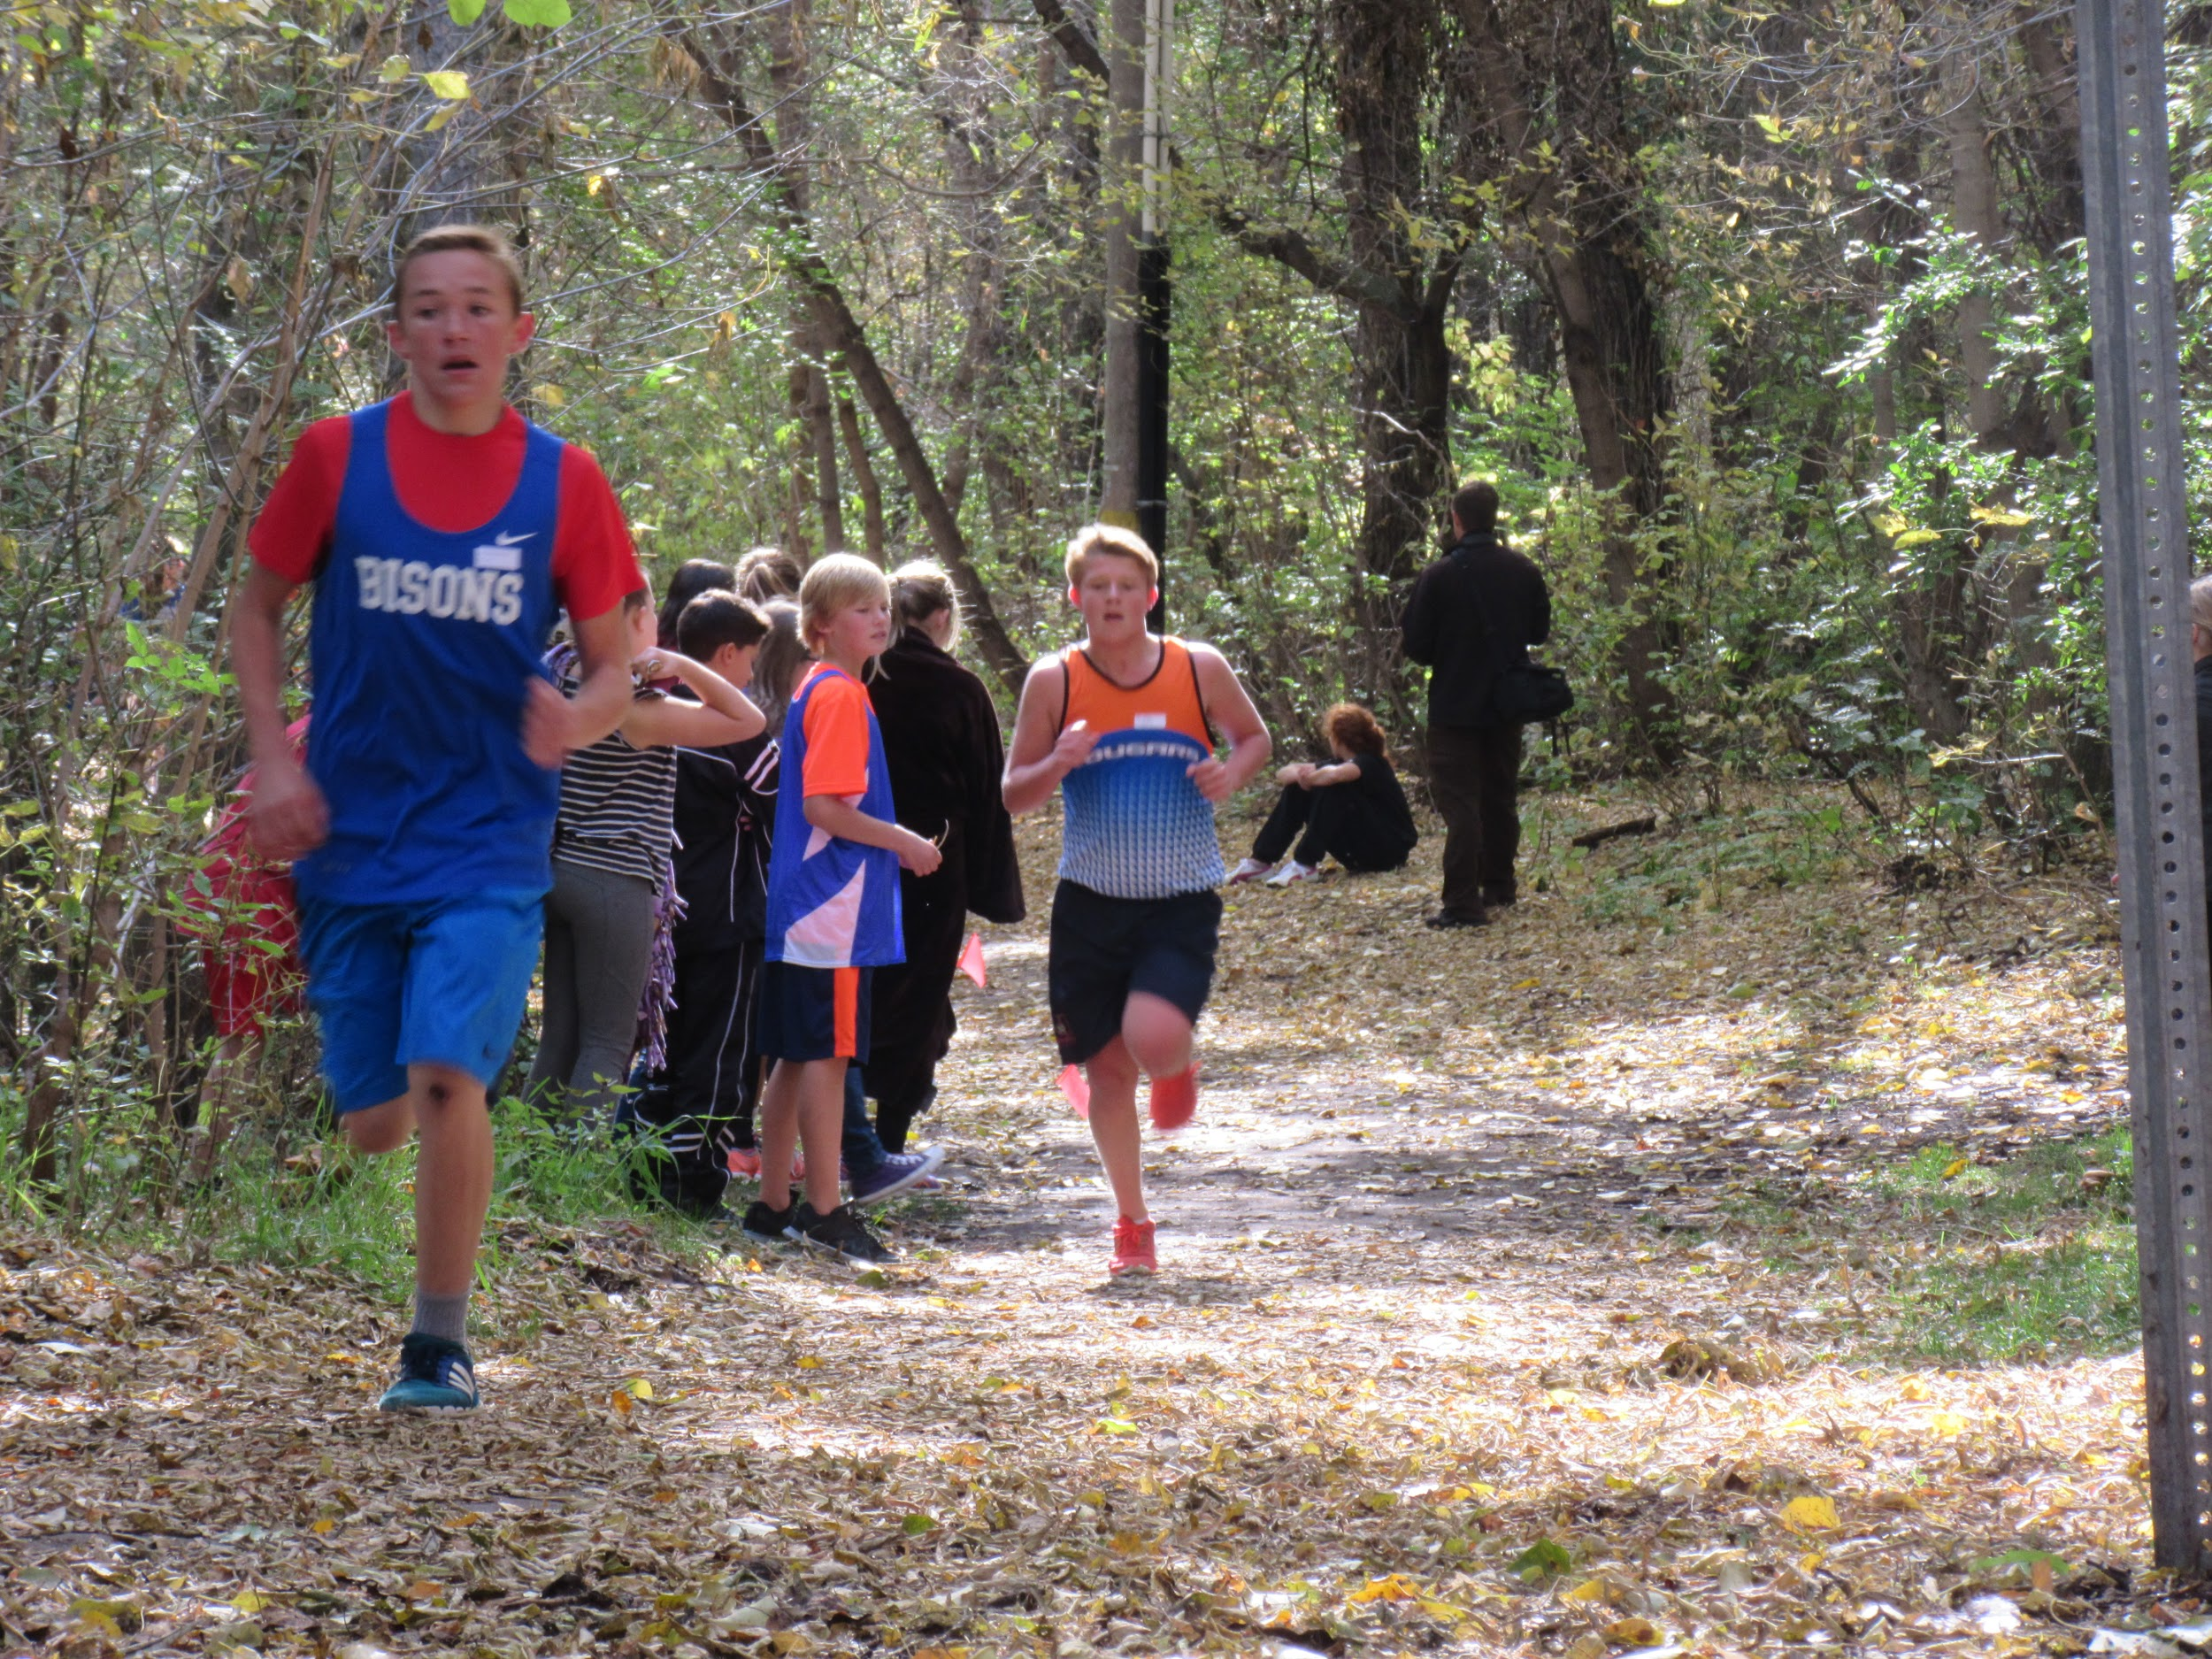
Athletics
Basketball
Volleyball
Cross Country
Handball
Track and Field
Badminton
Golf

Slide 17
At the end of grade 9, you will have completed
Etudes sociales 9;
(Social Studies 9)
Mathematiques 9;
(Mathematics 9)
Sciences 9;
(Science 9)
English Language Arts 9
(ELA 9)
French Language Arts 9
(FLA 9)
Physical Education 9 and your options

Slide 18
I completed Junior High in French, where do I go now?
Here are the courses you will need to take:

Slide 19
High School French Immersion Programming in Elk Island Public Schools
Ardrossan Jr. Sr. High School offers our French Immersion (FI) Programming for Grades 10 through 12. Along with the junior high program, we offer the high school programming needs for Elk Island Public Schools.

Slide 20
French Language Arts 10, 20, 30 Etudes Sociales (Social Studies) 10, 20, 30 Sciences – Sciences 10, Biologie 20 et 30, Chimie 20 et 30 Les Maths 10, 20, 30

Slide 21
Student 1
Good evening. I am a grade 12 student here at Ardrossan in the French immersion program. I have been in French since I was put into a francophone preschool. As I got older it became more my choice and less that of my parents. I came to the conclusion that continuing on my French education would make me much more versatile. Which it does. Being able to communicate in 2 languages opens up many doors. Whether they be having the ability to communicate with a much larger percentage of the population, opening up job opportunities or even just being able to learn new languages quicker. French has presented me with opportunities to converse in eastern Canada effortlessly and with some minor difficulty and lots of hand signals in southern America. Learning French for me has been a very good experience, and I hope you get that experience as well. I am going into university for business this upcoming fall. Having French will give me the opportunity in that world that I would not have otherwise. I hope you enjoy Ardrossan.
Notes:
Danika Oystrek

Slide 22
Find your own door and your own path
Talk to your teachers and counsellors
Look at the websites of the post-secondary institutions that interest you
Take full advantage of the tools offered to you such as the tools offered in your CALM class

Slide 23
Of course after the core subjects, students have a wide choice of options…

Slide 24
French Immersion Program
Since our program is like a small school within a bigger one, our French Immersion students can take advantage of so many opportunities, like…

Slide 25
Language-Spanish
Fine Arts- Band, Art, Drama
Wide Range of CTS courses:
Communication Technology,
Construction Technology,
Esthetician,
Fabrication Studies,
Foods and Commercial Foods
Mechanics

Slide 26
Les arts
Arts
Band
Drama
A.d.c.- Ardrossan Drama Company
Notes:
Largest band in EIPS- Festivals- Trips to Whistler, Banff and this year Toronto – Niagara Falls

Slide 27
Physical Education
Conditionnement physique (Personal Fitness)
Sports Performance
Cross Fit
COOL- Student Council
Aboriginal Studies

Slide 28
Les Sports
X-Country
Volleyball
Basketball
Badminton
Handball
Track and Field
Archery
Cheer (Jr. And Sr. High)
Soccer(High School)
Football(High School)

Slide 29
Continue in French Immersion!
Aside from enhancing his or her French, a student in French Immersion, after successfully completing grade 12, will receive a Bilingual Certificate from Elk Island Public School Board.
Here are the criteria:

Slide 30
French Immersion Certificate
Elk Island will award a French Immersion Certificate to students who:
Complete at least 2 French courses (one of which must be FLA) to the 30 level
At least 30 total credits in French Immersion (6 Courses) over the three years in high school.
- French Language Arts - Études Sociales
- Sciences - Biologie
- Mathématiques - Chimie
* Courses offered at the high school level depend on that year’s interest and student body. Over the past few years, Biologie 30 and Chimie 30 have been offered in alternating years.

Slide 31
Once in French Language Arts 30 Students will have the opportunity to write the DELF exam at the B2 level.
What is the DELF exam?
Le Diplome d’etudes de langue francaise (DELF) is an international diploma officially awarded by the French Ministry of Education to certify the French language skills of candidates from outside France.
The certification is good for life!
At this level, the student has a degree of fluency and spontaneity in interactions and is capable of correcting his/her own mistakes.

Slide 33
Students may take the DELF……….
To be assessed with the same international language standards as candidates in 173 countries
To continue studies at a French university
To complement language education with a universally recognized diploma

Slide 34
Student 2
Bonjour! Je suis une étudiante de 12me année dans le programme d’Immersion Français ici à Ardrossan. So being in a French Immersion program offers a lot of perks. I’m not here to share statistics and studies with you, I’m sure you’ve already heard those, but I am here today to share with you my experiences in French Immersion programs and how they’ve benefited me. So I started in the French Immersion program when I was in kindergarten at École Campbelltown. Learning a second language helped me grow the creative side of my brain and become interested in music. Then on to Sherwood Heights, where I continued to grow academically and creatively. At Sherwood Heights, I really started to appreciate French as a language and it is where I really started to notice the benefits of French Immersion. I came to Ardrossan for grade 10. I was pretty nervous, to be honest, I had really enjoyed my French Immersion education so far, becoming exposed to new culture, music and my personal favourite, travelling. But coming from my junior high in a class where I knew everyone and coming to a new school where I knew virtually no one besides the 15 or so kids who had also come from my junior high was really nerve-racking. In the end, though, these nerves were unfounded. What I found when I came to Ardrossan was an amazing community, especially within the French Immersion program, strong programs and amazing teachers. When you go through a French Immersion program you are with many of the same kids in lots of your classes and lots of the same teachers as well. This creates a trust and bond that is really hard to find in other programs and classes. On top of the community and teachers at Ardrossan, the academics, especially in the French Immersion program, really impressed me. I am a very academic student, I enjoy learning and coming to school, and to find teachers and classmates that helped push me to work harder and become smarter was awesome! Because of the strong academics and inspiring teachers in French Immersion, I was able to confidently apply for the WISEST summer research program. This program allowed me to work in an engineering physics lab at the UofA last summer and it was a life-changing experience. Asides from the French Immersion program and community being incredibly strong at Ardrossan, our other programs are very active. Whether music, art, drama, sports or academics are your niche you will find an amazing group of students and teachers within each one. I am highly involved in the band program here, which includes four concert bands, jazz bands and other student-run ensembles. I found a home away from home in the band room when I came to Ardrossan and our bands are very highly ranked in the province, just as our sports team and drama program are as well. Enfin, Ardrossan est une école fantastique, notamment pour l’Immersion Français. J’ai rencontré quelques un de mes meilleures amies ici à Ardrossan a cause de notre communauté fort. J'espère que vous allez choisir Ardrossan pour continuer votre éducation d’Immersion Français et je vous souhaite la bonne chance.
Notes:
Hannah Bayne

Slide 35
Do you still need another reason?

Slide 36
French Immersion, a tool to enhance your English

Slide 37
English 30-1 2017-18

Slide 38
Ardrossan Biologie 30 17/18

Slide 39
Ardrossan Social/Etudes Sociales 30 -1 17/18

Slide 40
What do we do at Elk Island Public Schools to ensure success for our French Immersion students?
We maintain contact with parents through Powerschool, email, meetings and phone calls.
Teachers discuss regularly the progress of the French Immersion students.
Excellent teachers and staff

Slide 41
Awards and beyond……
During our 2017 awards night, 40% of awards were given out to French Immersion Ardrossan students.
Graduates of Elk Island Public School`s French Immersion program have gone on to be successful in Engineering at the U of A, Sports Psychology at the U of A, Computer Sciences Degree and employed at EA Games, Medical Laboratory Sciences, Campus St. Jean and many more.

Slide 42
Campus St. Jean
Notes:
Tamia - Bursary

Slide 43
Pre-enrollment process
February 1 to 28, 2019
Online
Once registered, our counsellors will visit each school to assist with the registration process.

Slide 44
Questions…….
As a parent, how will I help my child if I do not speak French?
Sherwood Heights and Ardrossan Junior Senior High are larger schools; will my child know anyone?

Slide 45
Common questions
What will be my child’s workload should he/she remain in the program?
The overall workload in grade 7 is greater than in elementary, regardless of your child’s program.
The schedule rotates on a 6 Day cycle at Sherwood Heights and Day 1/Day 2 basis (grades 7 & 8) at Ardrossan Jr. Sr. High School and students should prepare for approximately a half-hour to an hour of homework per night.
What will happen after grade 9?
Students continue with high school courses as normal. Some FI students are intergrated into English classes depending on their new interest levels and possible scheduling conflicts.

Slide 46
I don’t speak French, so how can I help my child when he/she has questions?
With increased use of technology, new platforms (such as Google Classroom) allow for better communication between teaching staff, students, and parents.
Our staff work together to provide assistance before and after school and during lunch to aid students who struggle.
At times, additional practice material does go home in English (March Madness math packs) to allow parents or tutors to help students further develop skillsets in areas of weakness.
*Help doesn’t have to take place in the target language. Asking your child to explain what he has read, questioning fractions while doubling a recipe, and encouraging written work that has rich vocabulary and proper grammar are skills that transfer between languages and have huge impacts on student success and confidence.

Slide 47
Is it harder in French? Is the content more difficult?
The content is the same regardless of the language of instruction.
No, students grades do not change should a student transfer into an English program.
Will my child be disadvantaged or struggle in High School?
French Immersion students remain among the top students, even when in classes with their English peers. Issues pertaining to new vocabulary, for example, are resolved quickly as FI students have developed problem solving skills over the course of the first 9 years.

Slide 48
Student Council aka COOL and our Grade 12 students in French Immersion
Leadership
Volunteerism
Community

Slide 49
The Ardrossan French Immersion Program is proud of: We offer the following courses in French. French Language Arts, Biology, Chemistry, Social Studies, Math at all levels as well as Science 10. Great retention rate from Jr. High to Sr. High year after year Great rapport and relationship with each class/grade year after year Strong results and performance on provincial achievement tests (Grade 9) and diploma exams Grade 12) yearly Strong rate of participation from French Immersion students and success in sports, band, drama, exchanges, etc. Maintains a strong enrollment since beginning in 1989-90 Many graduates continue on to Campus Saint Jean University of Alberta (French University program) Strong local Canadian Parents for French chapter (Ardrossan) that supports our program Possibilities for exchange programs to Québec and France

Slide 50
Final Thought
Sherwood Heights Junior High and Ardrossan Junior Senior High are both offering you the opportunity to enhance your French skills through core subjects. Why not embrace it? You have already invested 7 to 10 years after all…
A l’an prochain!

Slide 51
Questions…..
Sherri Johnson (Assistant Principal, Sherwood Heights)
E-mail: Sherri.Johnson@eips.ca
MJ Nam (Principal, Ardrossan Junior Senior High School)
E-mail: MJ.Nam@eips.ca
Annie Garneau, EIPS French Immersion Consultant
E-mail: Annie.Garneau@eips.ca

